Slide 1
CS 476 – Programming Language Design
William Mansky

Slide 2

Notes:
Poll Title: Do not modify the notes in this section to avoid tampering with the Poll Everywhere activity.
More info at polleverywhere.com/support
Questions
https://www.polleverywhere.com/discourses/SRzwhp4zztmGWgIgz520A

Slide 3
Logic Programming
Declarative programming: say what you want, not how to do it
A logic program consists of a series of logical assertions, and a query:
man(socrates).
mortal(X) :- man(X).
?- mortal(socrates).
true.
Notes:
Now for something completely different!

Slide 4
Logic Programming
Declarative programming: say what you want, not how to do it
A logic program consists of a series of logical assertions, and a query:
man(socrates).
mortal(X) :- man(X).
?- mortal(X).
X = socrates.
Notes:
Now for something completely different!

Slide 5
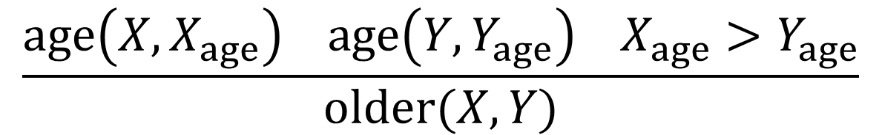
Logic Programming
age(person1, 21).
age(person2, 23).
age(person3, 25).
age(person4, 27).
older(X, Y) :- age(X, Xage), age(Y, Yage), Xage > Yage.
?- older (X, person1), older(Y, X).
Exercise: What values of X and Y make this query true?
$$\frac{age\left(X,X_{age}\right) age\left(Y,Y_{age}\right) X_{age}>Y_{age}}{older(X,Y)}$$
Notes:
Note that there are no functions, just predicates.

Slide 6
Logic Programming
age(person1, 21).
age(person2, 23).
age(person3, 25).
age(person4, 27).
older(X, Y) :- age(X, Xage), age(Y, Yage), Xage > Yage.
?- older (X, person1), older(Y, X).
X = person2, Y = person3; X = person2, Y = person4; X = person3, Y=person4.
$$\frac{age\left(X,X_{age}\right) age\left(Y,Y_{age}\right) X_{age}>Y_{age}}{older(X,Y)}$$
Notes:
Note that there are no functions, just predicates.

Slide 7
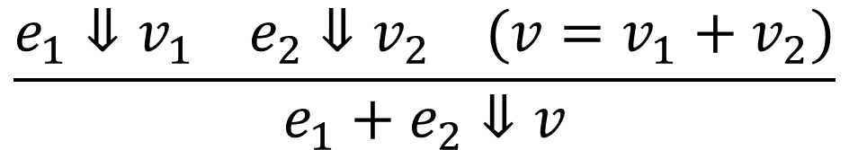
Logic Programming
eval(add(E1, E2), V) :- eval(E1, V1), eval(E2, V2), V = V1 + V2.
$$\frac{e_{1}⇓v_{1} e_{2}⇓v_{2} (v=v_{1}+v_{2})}{e_{1}+e_{2}⇓v}$$
Notes:
We could implement our language just by writing the rules in Prolog!

Slide 8
Notes:
Poll Title: Do not modify the notes in this section to avoid tampering with the Poll Everywhere activity.
More info at polleverywhere.com/support
Questions
https://www.polleverywhere.com/discourses/SRzwhp4zztmGWgIgz520A

Slide 9
Logic Programming: Syntax
T ::= true | <ident> | <#> | <Ident> | <ident>(T, …, T)
Examples: socrates, person1, pizza, …
“atom”
Notes:
I’m using the syntax of Prolog, the most popular logic programming language.

Slide 10
Logic Programming: Syntax
T ::= true | <ident> | <#> | <Ident> | <ident>(T, …, T)
Examples: X, Y, Z, …
variable
Notes:
I’m using the syntax of Prolog, the most popular logic programming language.

Slide 11
Logic Programming: Syntax
T ::= true | <ident> | <#> | <Ident> | <ident>(T, …, T)
Examples: mortal, age, has_value, …
Can take any number of arguments
predicate
Notes:
I’m using the syntax of Prolog, the most popular logic programming language.

Slide 12
Logic Programming: Syntax
T ::= true | <ident> | <#> | <Ident> | <ident>(T, …, T)
R ::= T :- T, …, T.
Q ::= ?- T, …, T.
P ::= R … R Q
Syntactic sugar: t. => t :- true.
Notes:
I’m using the syntax of Prolog, the most popular logic programming language.

Slide 13
Notes:
Poll Title: Do not modify the notes in this section to avoid tampering with the Poll Everywhere activity.
More info at polleverywhere.com/support
Questions
https://www.polleverywhere.com/discourses/SRzwhp4zztmGWgIgz520A

Slide 14
Logic Programming: Execution
Rules: age(person1, 21), …, older(X, Y) :- …
Goals: older(X, person1), older(Y, X)
older(X, Y) :- age(X, Xage), age(Y, Yage), Xage > Yage.
Notes:
How do we go about solving this? First, find a rule that matches, and apply it.

Slide 15
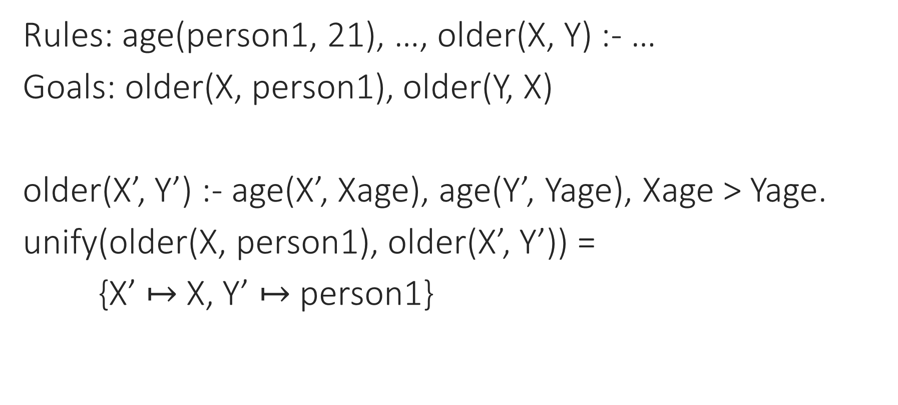
Logic Programming: Execution
Rules: age(person1, 21), …, older(X, Y) :- …
Goals: older(X, person1), older(Y, X)
older(X’, Y’) :- age(X’, Xage), age(Y’, Yage), Xage > Yage.
unify(older(X, person1), older(X’, Y’)) =
{X’ $↦$ X, Y’ $↦$ person1}
Notes:
Now, unify the conclusion with the goal.

Slide 16
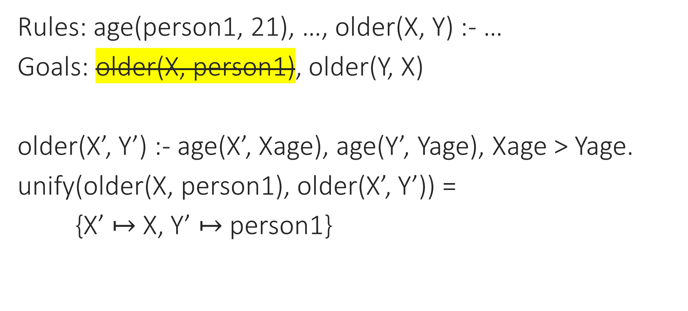
Logic Programming: Execution
Rules: age(person1, 21), …, older(X, Y) :- …
Goals: older(X, person1), older(Y, X)
older(X’, Y’) :- age(X’, Xage), age(Y’, Yage), Xage > Yage.
unify(older(X, person1), older(X’, Y’)) =
{X’ $↦$ X, Y’ $↦$ person1}
Notes:
Now, unify the conclusion with the goal.

Slide 17
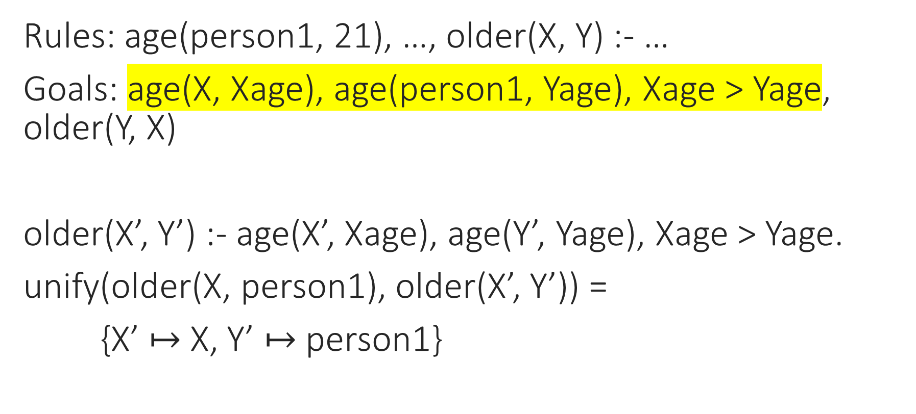
Logic Programming: Execution
Rules: age(person1, 21), …, older(X, Y) :- …
Goals: age(X, Xage), age(person1, Yage), Xage > Yage, older(Y, X)
older(X’, Y’) :- age(X’, Xage), age(Y’, Yage), Xage > Yage.
unify(older(X, person1), older(X’, Y’)) =
{X’ $↦$ X, Y’ $↦$ person1}
Notes:
Now, unify the conclusion with the goal.

Slide 18
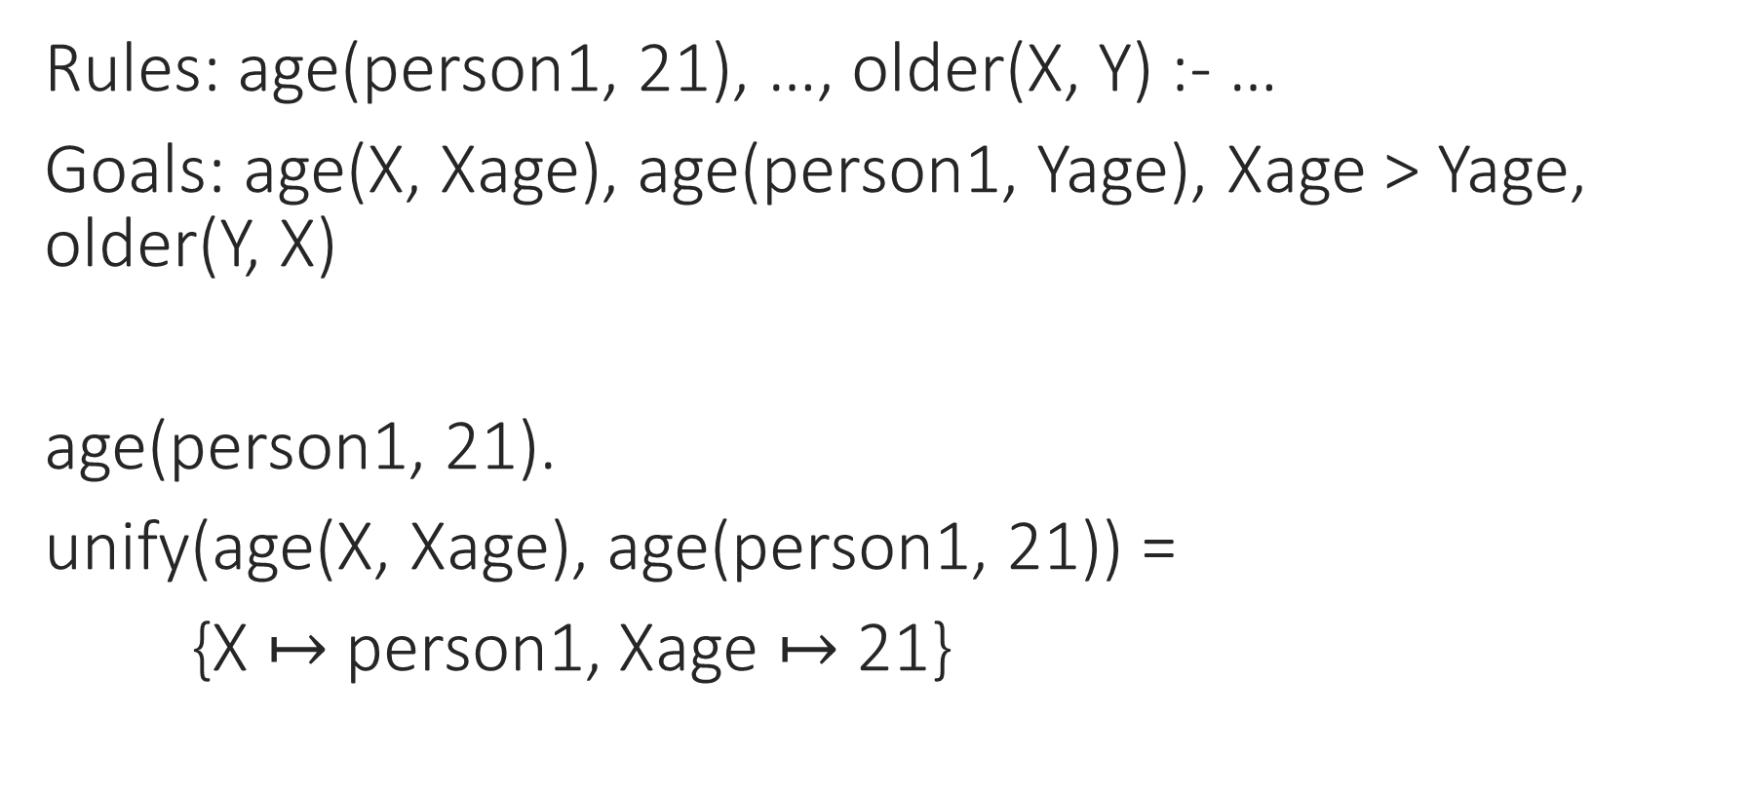
Logic Programming: Execution
Rules: age(person1, 21), …, older(X, Y) :- …
Goals: age(X, Xage), age(person1, Yage), Xage > Yage, older(Y, X)
age(person1, 21).
unify(age(X, Xage), age(person1, 21)) =
{X $↦$ person1, Xage $↦$ 21}
Notes:
Pick a rule…

Slide 19
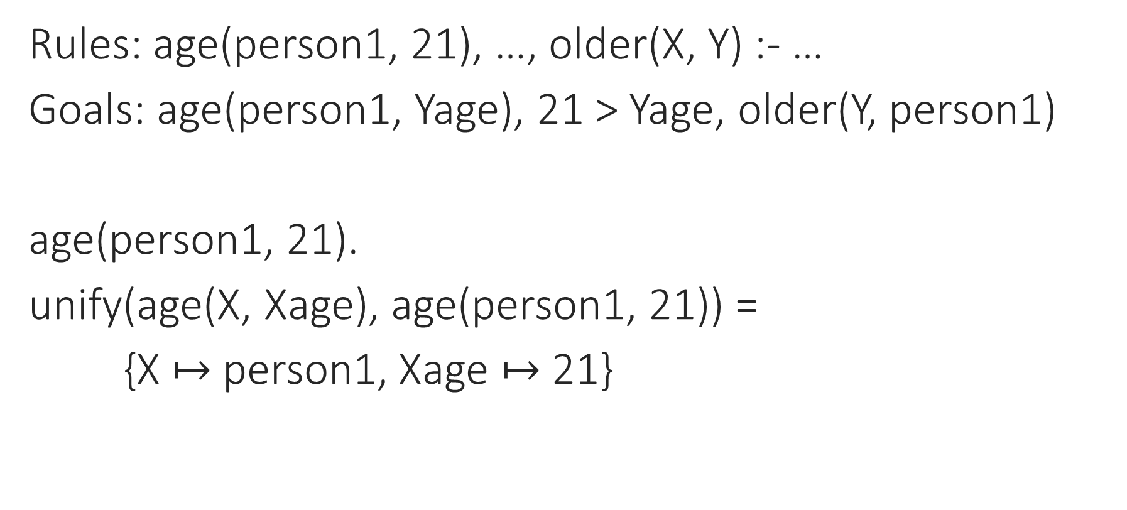
Logic Programming: Execution
Rules: age(person1, 21), …, older(X, Y) :- …
Goals: age(person1, Yage), 21 > Yage, older(Y, person1)
age(person1, 21).
unify(age(X, Xage), age(person1, 21)) =
{X $↦$ person1, Xage $↦$ 21}
Notes:
Substitute back in.

Slide 20
Logic Programming: Execution
Rules: age(person1, 21), …, older(X, Y) :- …
Goals: 21 > 21, older(Y, person1)
Unprovable!
Notes:
Should we just give up and return false? No!

Slide 21
Logic Programming: Execution
Rules: age(person1, 21), …, older(X, Y) :- …
Goals: age(X, Xage), age(person1, Yage), Xage > Yage, older(Y, X)
age(person1, 21).
unify(age(X, Xage), age(person1, 21)) =
{X $↦$ person1, Xage $↦$ 21}
Notes:
Pick a rule…

Slide 22
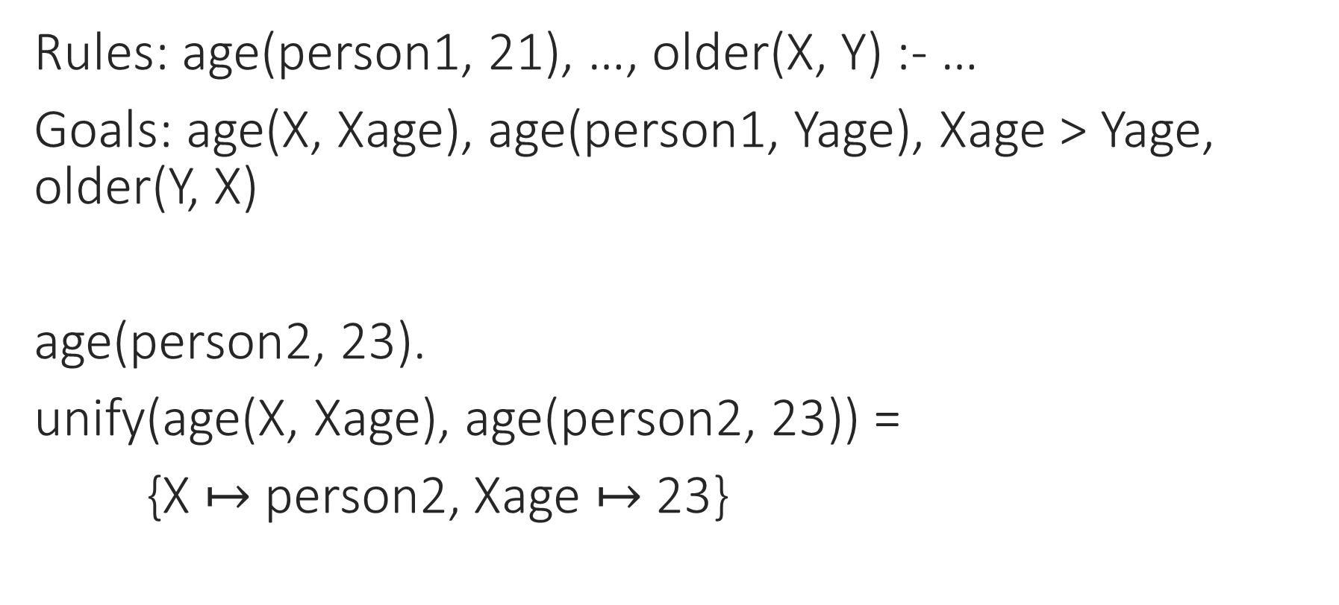
Logic Programming: Execution
Rules: age(person1, 21), …, older(X, Y) :- …
Goals: age(X, Xage), age(person1, Yage), Xage > Yage, older(Y, X)
age(person2, 23).
unify(age(X, Xage), age(person2, 23)) =
{X $↦$ person2, Xage $↦$ 23}
Notes:
We need to backtrack, choose a different rule, and go forward from there.

Slide 23

Logic Programming: Execution
Rules: age(person1, 21), …, older(X, Y) :- …
Goals:
{X $↦$ person2, Y $↦$ person3}
Notes:
What happens when we run out of goals? We output the solution (substitution), and optionally go back and try again.

Slide 24
Notes:
Poll Title: Do not modify the notes in this section to avoid tampering with the Poll Everywhere activity.
More info at polleverywhere.com/support
Questions
https://www.polleverywhere.com/discourses/SRzwhp4zztmGWgIgz520A

Slide 25
Logic Programming: Execution
Maintain a list of goals that still need to be proved
Pick a goal to prove next
Find a rule whose conclusion matches the goal, and apply it:
  Instantiate it to match the goal, by unification
  Replace the goal with the instantiated premises of the rule
If no rules apply, backtrack to the last decision point and make a different choice
If all goals are solved, output the solution

Slide 26
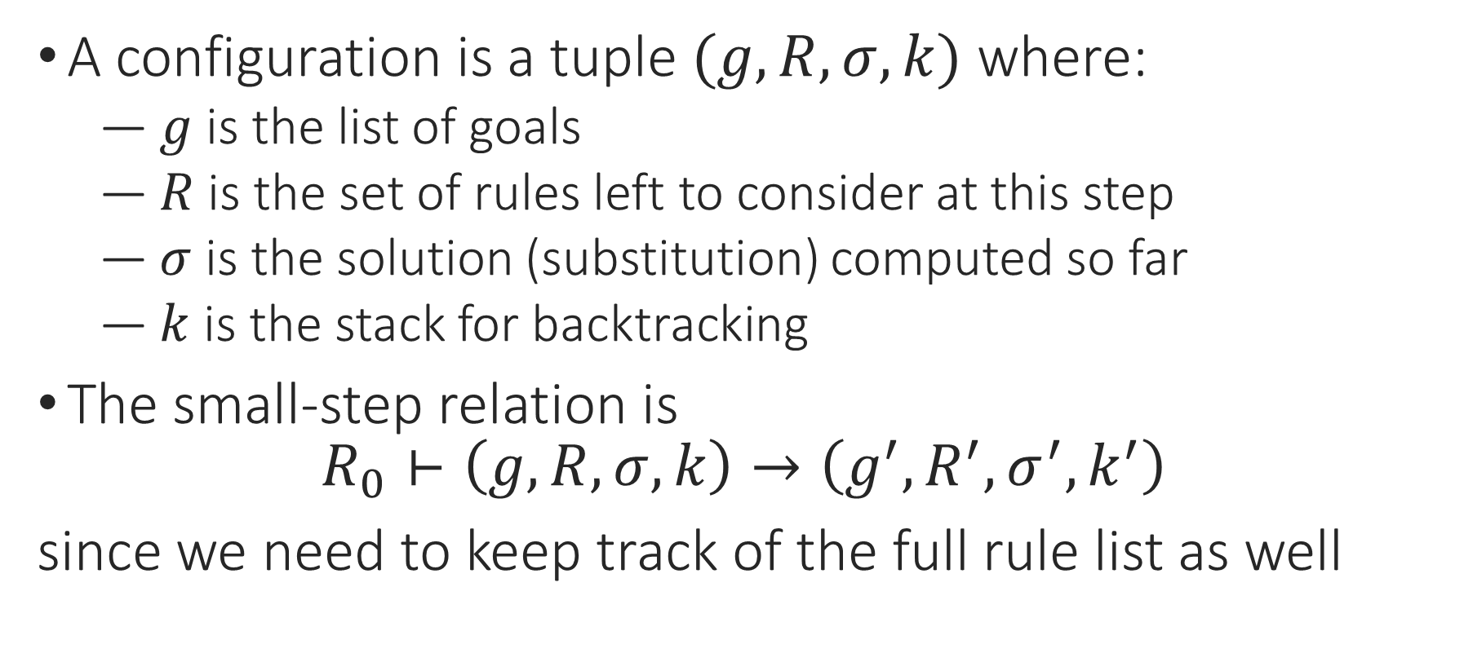
Logic Programming: Semantics
A configuration is a tuple $(g,R,σ,k)$ where:
  $g$ is the list of goals
  $R$ is the set of rules left to consider at this step
  $σ$ is the solution (substitution) computed so far
  $k$ is the stack for backtracking
The small-step relation is
$$R_{0}⊢\left(g,R,σ,k\right)→\left(g^{′},R^{′},σ^{′},k^{′}\right)$$
since we need to keep track of the full rule list as well
Notes:
Comma is and. :- is reverse implies.

Slide 27
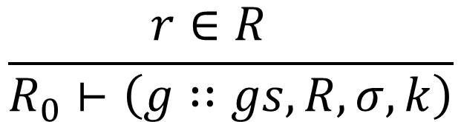
Logic Programming: Semantics
Maintain a list of goals that still need to be proved
Pick a goal to prove next
Find a rule whose conclusion matches the goal
$$\frac{r∈R }{R_{0}⊢\left(g∷gs,R,σ,k\right)}$$
Notes:
This is exactly the process we were going through whenever we built a proof tree.

Slide 28
Logic Programming: Semantics
Pick a goal to prove next
Find a rule whose conclusion matches the goal
  Choose a rule
$$\frac{r∈R }{R_{0}⊢\left(g∷gs,R,σ,k\right)}$$
Notes:
This is exactly the process we were going through whenever we built a proof tree.

Slide 29
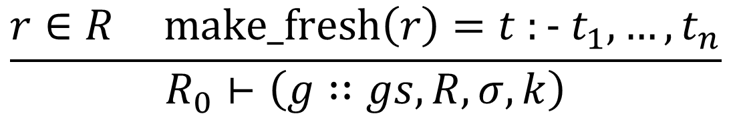
Logic Programming: Semantics
Pick a goal to prove next
Find a rule whose conclusion matches the goal
  Choose a rule
  Make a fresh copy of the rule, so variables don’t overlap
$$\frac{r∈R make_fresh\left(r\right)=t :− t_{1},…,t_{n}}{R_{0}⊢\left(g∷gs,R,σ,k\right)}$$
Notes:
This is exactly the process we were going through whenever we built a proof tree.

Slide 30
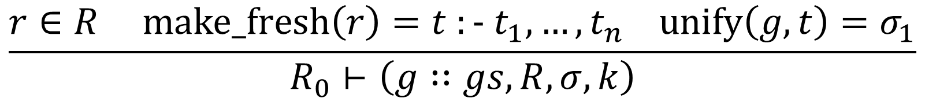
Logic Programming: Semantics
Pick a goal to prove next
Find a rule whose conclusion matches the goal
  Choose a rule
  Make a fresh copy of the rule, so variables don’t overlap
  Check whether the rule’s conclusion matches the goal
$$\frac{r∈R make_fresh\left(r\right)=t :− t_{1},…,t_{n} unify\left(g,t\right)=σ_{1}}{R_{0}⊢\left(g∷gs,R,σ,k\right)}$$
Notes:
This is exactly the process we were going through whenever we built a proof tree.

Slide 31
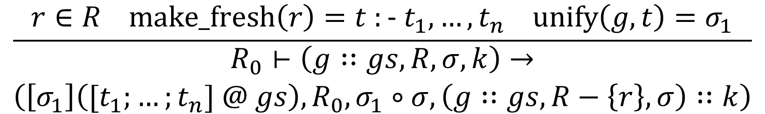
Logic Programming: Semantics
Find a rule whose conclusion matches the goal
  Choose a rule
  Make a fresh copy of the rule, so variables don’t overlap
  Check whether the rule’s conclusion matches the goal
Replace the goal with instantiated premises of the rule
$$\frac{r∈R make_fresh\left(r\right)=t :− t_{1},…,t_{n} unify\left(g,t\right)=σ_{1}}{\begin{aligned}R_{0}⊢\left(g∷gs,R,σ,k\right)→ \\ \left(\left[σ_{1}\right]\left({[t}_{1};…;t_{n}] @ gs\right), R_{0},σ_{1}∘σ,\left(g∷gs,R−\left\{r\right\},σ\right)∷k\right)\end{aligned}}$$
Notes:
This is exactly the process we were going through whenever we built a proof tree.

Slide 32
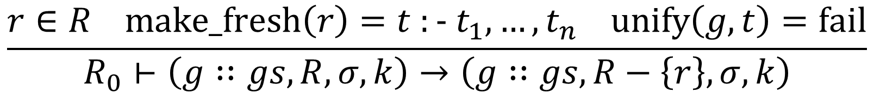
Logic Programming: Semantics
If the rule doesn’t match, try another rule
$$\frac{r∈R make_fresh\left(r\right)=t :− t_{1},…,t_{n} unify\left(g,t\right)=σ_{1}}{\begin{aligned}R_{0}⊢\left(g∷gs,R,σ,k\right)→ \\ \left(\left[σ_{1}\right]\left({[t}_{1};…;t_{n}] @ gs\right), R_{0},σ_{1}∘σ,\left(g∷gs,R−\left\{r\right\},σ\right)∷k\right)\end{aligned}}$$
$$\frac{r∈R make_fresh\left(r\right)=t :− t_{1},…,t_{n} unify\left(g,t\right)=fail}{R_{0}⊢\left(g∷gs,R,σ,k\right)→\left(g∷gs,R−\left\{r\right\},σ,k\right)}$$
Notes:
This is exactly the process we were going through whenever we built a proof tree.

Slide 33

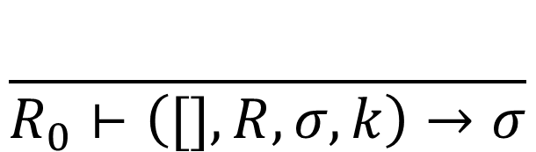
Logic Programming: Semantics
$$\frac{}{R_{0}⊢\left([],R,σ,k\right)→σ}$$
If we solve all the goals, return the current substitution $σ$
Notes:
What else can happen? We can run out of goals, we can run out of rules, we can run out of stack.

Slide 34
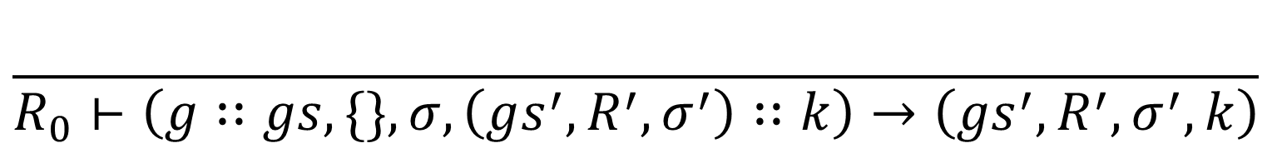
Logic Programming: Semantics
$$\frac{}{R_{0}⊢\left([],R,σ,k\right)→σ}$$
If no rules apply (i.e., we run out of rules to try), backtrack to the last decision point in the stack and make a different choice
$$\frac{}{R_{0}⊢\left(g∷gs,\{\},σ,\left(gs^{′},R^{′},σ^{′}\right)∷k\right)→\left(gs^{′},R^{′},σ^{′},k\right)}$$
Notes:
What else can happen? We can run out of goals, we can run out of rules, we can run out of stack.

Slide 35
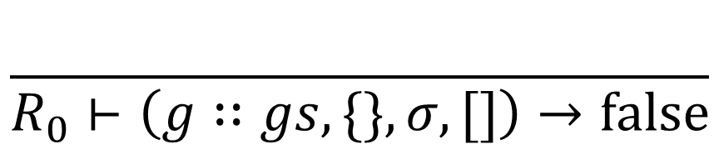
Logic Programming: Semantics
$$\frac{}{R_{0}⊢\left([],R,σ,k\right)→σ}$$
If there’s nowhere to backtrack to, the goal is unprovable
$$\frac{}{R_{0}⊢\left(g∷gs,\{\},σ,\left(gs^{′},R^{′},σ^{′}\right)∷k\right)→\left(gs^{′},R^{′},σ^{′},k\right)}$$
$$\frac{}{R_{0}⊢\left(g∷gs,\{\},σ,[]\right)→false}$$
Notes:
What else can happen? We can run out of goals, we can run out of rules, we can run out of stack.

Slide 36

Logic Programming: Execution
Note: this language is Turing-complete!
So there are non-terminating logic programs
$$\frac{circular(X)}{circular(X)}$$

Slide 37
Notes:
Poll Title: Do not modify the notes in this section to avoid tampering with the Poll Everywhere activity.
More info at polleverywhere.com/support
Questions
https://www.polleverywhere.com/discourses/SRzwhp4zztmGWgIgz520A

Slide 38



Logic Programming: Negation
We can define other connectives in Prolog:
and(P, Q) :- P, Q.
or(P, Q) :- P.
or(P, Q) :- Q.
What about “not”?
$$\frac{ P Q }{P∧Q}$$
$$\frac{ P }{ P∨Q }$$
$$\frac{ Q }{ P∨Q }$$
Notes:
“Not” is kind of weird from a proof-tree perspective: we don’t usually have premises that say “this thing can’t be proven.”

Slide 39
Logic Programming: Negation
We can define other connectives in Prolog:
not(P) :- P, fail.
not(P).
(assuming that rules are tried from top to bottom)
Problem: not(P) can always be proved true!
Notes:
This is a break from the way we’ve thought about rules before, where we could apply them in any order.

Slide 40
Logic Programming: Negation by Cut
We can define other connectives in Prolog:
not(P) :- P, !, fail.
not(P).
No backtracking past ! (“cut”)

Slide 41
Logic Programming: Negation by Cut
We can define other connectives in Prolog:
not(P) :- P, !, fail.
not(P).
?- not(older(person2, person1)).

Slide 42
Logic Programming: Negation by Cut
We can define other connectives in Prolog:
not(P) :- P, !, fail.
not(P).
older(person2, person1), !, fail.
Backtracking stack: not(older(person2, person1))

Slide 43
Logic Programming: Negation by Cut
We can define other connectives in Prolog:
not(P) :- P, !, fail.
not(P).
!, fail.
Backtracking stack: older(person2, person1), not(older(person2, person1))

Slide 44
Logic Programming: Negation by Cut
We can define other connectives in Prolog:
not(P) :- P, !, fail.
not(P).
fail.
Backtracking stack:
Result: false

Slide 45
Logic Programming: Negation by Cut
We can define other connectives in Prolog:
not(P) :- P, !, fail.
not(P).
?- not(older(person1, person2)).

Slide 46
Logic Programming: Negation by Cut
We can define other connectives in Prolog:
not(P) :- P, !, fail.
not(P).
older(person1, person2), !, fail.
Backtracking stack: not(older(person2, person1))
Unproveable!

Slide 47
Logic Programming: Negation by Cut
We can define other connectives in Prolog:
not(P) :- P, !, fail.
not(P).
not(older(person2, person1))
Backtracking stack:
Result: true

Slide 48
Logic Programming: Syntax
T ::= … | fail | !
R ::= T :- T, …, T.
Q ::= ?- T, …, T.
P ::= R … R Q
Notes:
I’m using the syntax of Prolog, the most popular logic programming language.

Slide 49
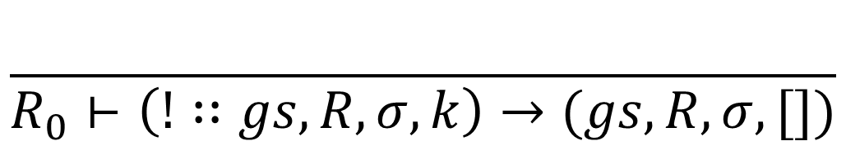
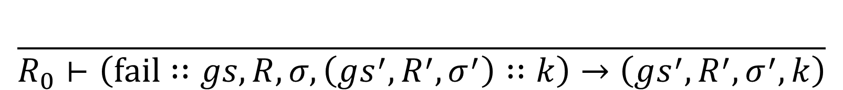
Logic Programming: Semantics
$$\frac{}{R_{0}⊢\left(fail∷gs,R,σ,\left(gs^{′},R^{′},σ^{′}\right)∷k\right)→\left(gs^{′},R^{′},σ^{′},k\right)}$$
$$\frac{}{R_{0}⊢\left(!∷gs,R,σ,k\right)→(gs,R,σ,[])}$$

Slide 50
Notes:
Poll Title: Do not modify the notes in this section to avoid tampering with the Poll Everywhere activity.
More info at polleverywhere.com/support
Questions
https://www.polleverywhere.com/discourses/SRzwhp4zztmGWgIgz520A

Slide 51
Logic Programming
Give a set of rules, ask questions about what can be proved
Searches for a proof tree for the query, filling in variables as it goes, and backtracking when it hits a dead end
Uses unification to figure out how to apply a rule to a goal
Useful for databases and knowledge retrieval systems
Can be used for PL too, but not as efficient as syntax-directed algorithms
See also λProlog: Prolog + lambda calculus!

