Slide 1
CS 476 – Programming Language Design
William Mansky

Slide 2

Notes:
Poll Title: Do not modify the notes in this section to avoid tampering with the Poll Everywhere activity.
More info at polleverywhere.com/support
Questions
https://www.polleverywhere.com/discourses/SRzwhp4zztmGWgIgz520A

Slide 3
From Typed Lambda Calculus to OCaml
User-friendly syntax
Basic types, tuples, records
Inductive datatypes and pattern-matching
Local declarations
References
Type inference
Generics/polymorphism
Notes:
Polymorphism is when a function can be used at multiple different types. We’ve already seen one form in OO.

Slide 4
Constraint-Based Type Inference
Step 1: gather constraints, outputs pair $(τ,C)$ such that if $C$ can be solved, $τ$ is the type of the expression
Step 2: unify constraints $C$, obtain solving substitution $σ$
Step 3: apply $σ$ to $τ$ to get the type of the expression
let type_of (gamma : context) (e : exp) =
let (t, c) = get_constraints gamma e in
let s = unify c in apply_subst s t

Slide 5
Constraint-Based Type Inference: Example
$$\{\}⊢\left(\text{fun} \text{f}\text{ −> }\text{fun} \text{x}\text{ −> }\text{f} \text{x} \text{+} \text{f}\text{ 3}\right) :τ_{1}→τ_{2}→int | C$$
$$C=\{τ_{3}=int,τ_{4}=int,τ_{1}=τ_{2}→τ_{3},τ_{1}=int→τ_{4}\}$$
$$σ=\{τ_{3}↦int,τ_{4}↦int,τ_{1}↦int→int,τ_{2}↦int\}$$
$$\left[σ\right]\left(τ_{1}→τ_{2}→int\right)=\left(int→int\right)→int→int$$
$$\{\}⊢\left(\text{fun} \text{f}\text{ −> }\text{fun} \text{x}\text{ −> }\text{f} \text{x}\text{ + }\text{f}\text{ 3}\right) :\left(int→int\right)→int→int$$
Notes:
Next: unify C!

Slide 6
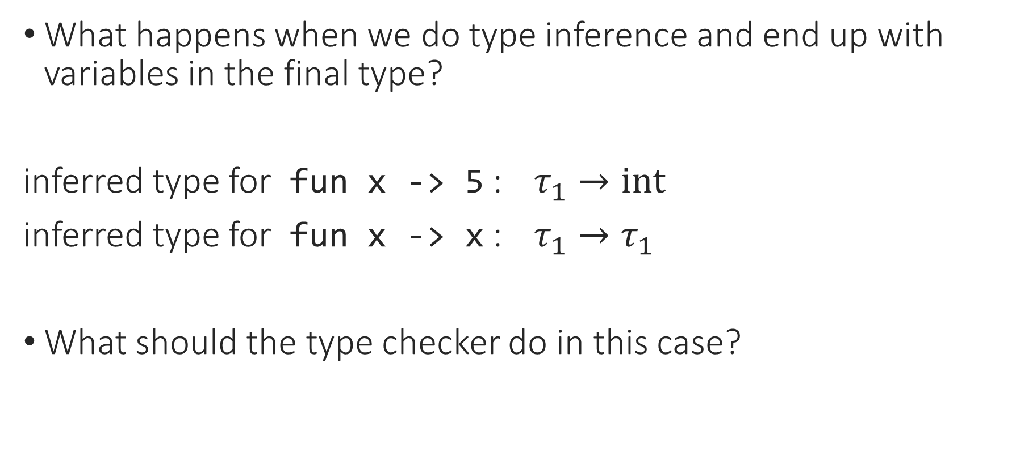
Universal Polymorphism
What happens when we do type inference and end up with variables in the final type?
inferred type for fun x -> 5 : $τ_{1}→int$
inferred type for fun x -> x : $τ_{1}→τ_{1}$
What should the type checker do in this case?
Notes:
But this isn’t really a problem. It’s not that there’s no solution to the unification problem – in fact, there are infinitely many solutions!

Slide 7
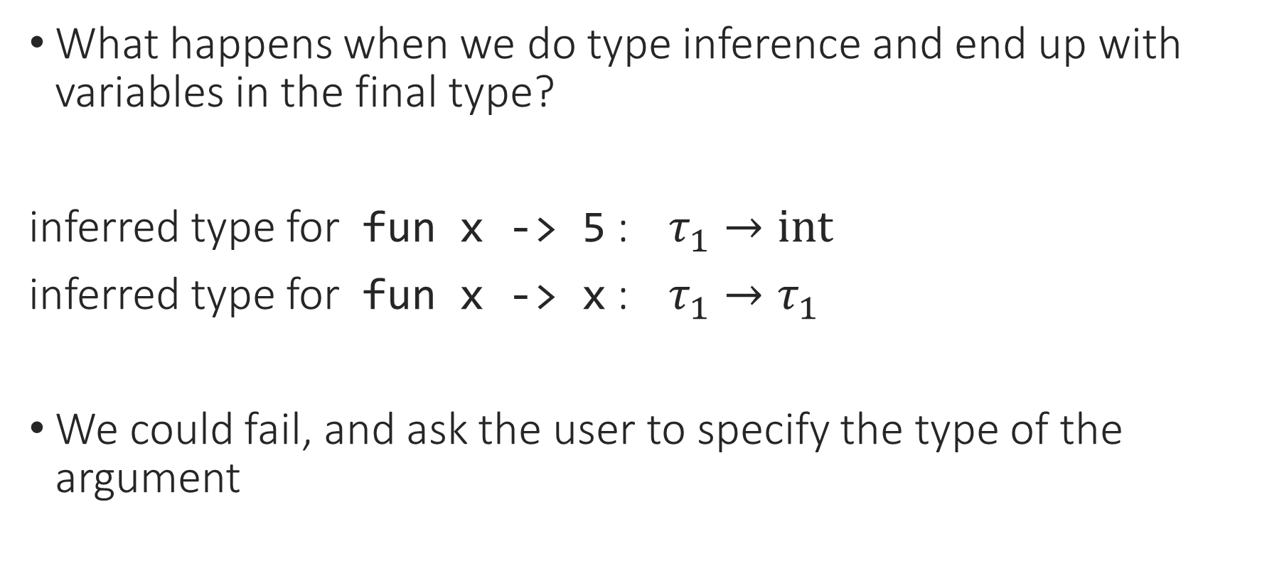
Universal Polymorphism
What happens when we do type inference and end up with variables in the final type?
inferred type for fun x -> 5 : $τ_{1}→int$
inferred type for fun x -> x : $τ_{1}→τ_{1}$
We could fail, and ask the user to specify the type of the argument
Notes:
But this isn’t really a problem. It’s not that there’s no solution to the unification problem – in fact, there are infinitely many solutions!

Slide 8
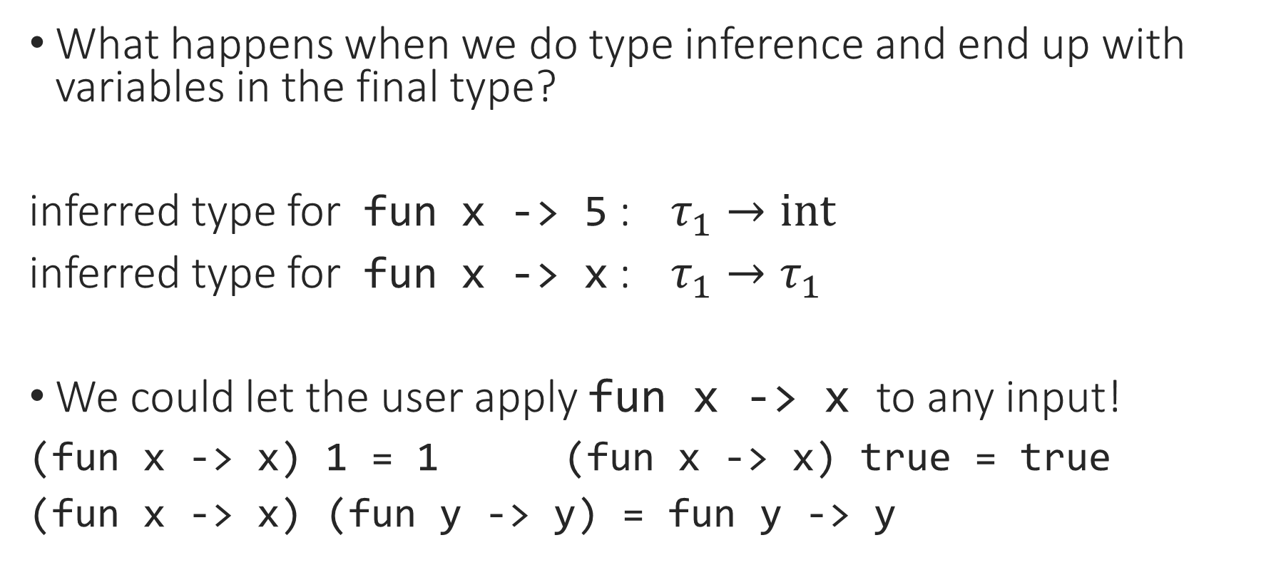
Universal Polymorphism
What happens when we do type inference and end up with variables in the final type?
inferred type for fun x -> 5 : $τ_{1}→int$
inferred type for fun x -> x : $τ_{1}→τ_{1}$
We could let the user apply fun x -> x to any input!
(fun x -> x) 1 = 1 (fun x -> x) true = true
(fun x -> x) (fun y -> y) = fun y -> y
Notes:
What happens if we write this in OCaml?
We’re defining a “generic” function.

Slide 9
Universal Polymorphism
What happens when we do type inference and end up with variables in the final type?
let id = fun x -> x;;
val id : ‘a -> ‘a = <fun>
‘a is OCaml’s way of writing a type variable
Read as “type inference has inferred that this function can be generic”
Notes:
Type inference notices when our code is more general than we intended.

Slide 10
Universal Polymorphism: Examples
let id x = x;;
val id : ‘a -> ‘a = <fun>
let f x y = y;;
val f : ‘a -> ‘b -> ‘b = <fun>
let g f x = f x;;
val g : (‘a -> ‘b) -> ‘a -> ‘b = <fun>

Slide 11

Universal Polymorphism: Examples
let id = fun x -> x;;
id : $∀$a. a -> a
let f x y = y;;
f : $∀$a, b. a -> b -> b
let g f x = f x;;
g : $∀$a, b. (a -> b) -> a -> b
Notes:
In other words, id is generic in the type of its argument.

Slide 12
Universal Polymorphism: Examples
let update f x v = fun y ->
if y = x then Some v else f y;;
(* update : ('a -> 'b option) -> 'a -> 'b -> ('a -> 'b option) *)
type context = ident -> typ option
type env = ident -> value option
update (gamma : context) x t
update (r : env) x v
Notes:
This gives us a generic update function.
And we see the same thing with, e.g., list operations that don’t care about the data in the list.

Slide 13
Notes:
Poll Title: Do not modify the notes in this section to avoid tampering with the Poll Everywhere activity.
More info at polleverywhere.com/support
Questions
https://www.polleverywhere.com/discourses/SRzwhp4zztmGWgIgz520A

Slide 14

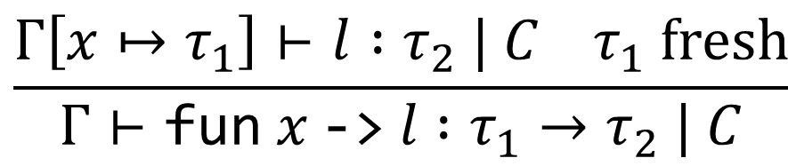
Universal Polymorphism
Universal polymorphism (also generic, or parametric): a type can have any number of universally quantified variables
A function can be applied at any instantiation of its type
Happens when a function doesn’t care about the type of an argument
  So the function will do the same thing with an input of any type
  Compare to generics in C/Java, contrast with OO polymorphism
$$\frac{Γ\left[x↦τ_{1}\right]⊢l :τ_{2} | C τ_{1} fresh}{Γ⊢\text{fun} x \text{−>} l :τ_{1}→τ_{2} | C}$$
and we end up with no constraints on $τ_{1}$ in $C$

Slide 15

Universal Polymorphism
$$\frac{?}{Γ⊢\text{let} \text{id}\text{ = }\text{fun} \text{x}\text{ −> }\text{x} \text{in}\text{ (}\text{id}\text{ 1} \text{=} \text{1) \&\& }\left(\text{id} \text{true}\right) : ?}$$
Notes:
Unfortunately, even though this follows from our type inference, it doesn’t quite work automatically.

Slide 16

Universal Polymorphism
$$\frac{… Γ\left[\text{id}↦a→a\right]⊢\text{(}\text{id}\text{ 1 = 1) \&\& }\left(\text{id} \text{true}\right) : ?}{Γ⊢\text{let} \text{id}\text{ = }\text{fun} \text{x}\text{ −> }\text{x} \text{in}\text{ (}\text{id}\text{ 1 = 1) \&\& }\left(\text{id} \text{true}\right) : ?}$$
Notes:
Unfortunately, even though this follows from our type inference, it doesn’t quite work automatically.

Slide 17
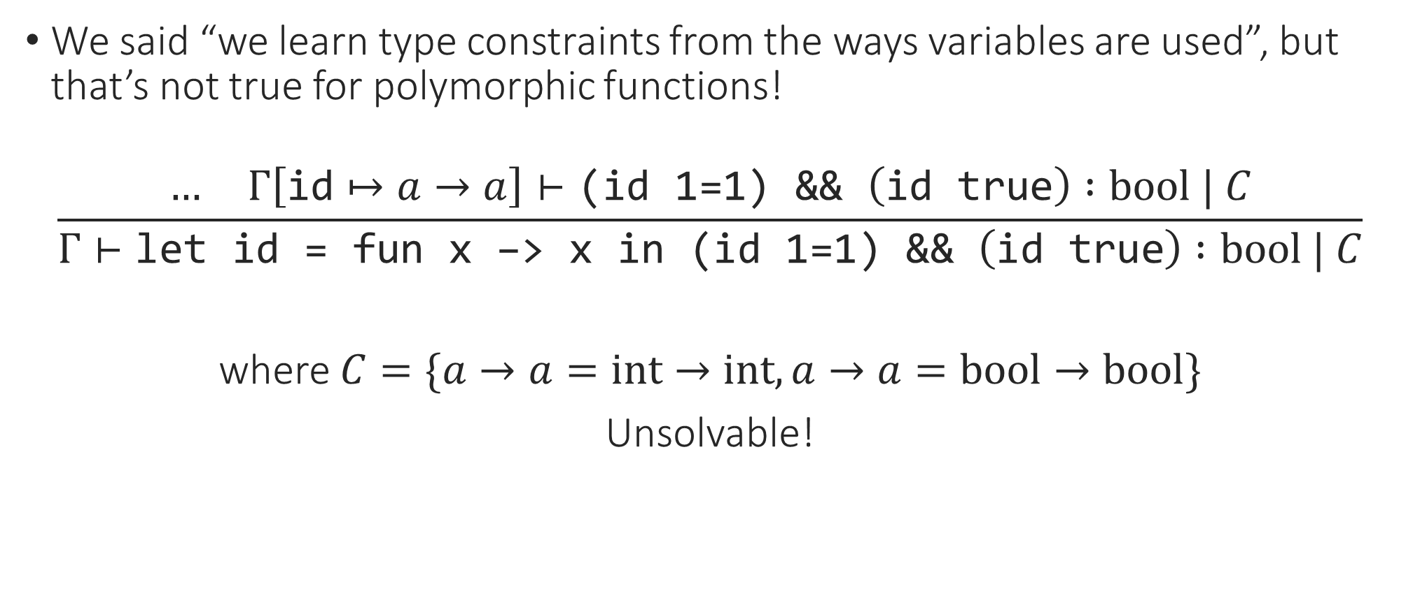
Universal Polymorphism
We said “we learn type constraints from the ways variables are used”, but that’s not true for polymorphic functions!
$$\frac{… Γ\left[\text{id}↦a→a\right]⊢\text{(}\text{id}\text{ 1=1) \&\& }\left(\text{id} \text{true}\right) :bool | C}{Γ⊢\text{let} \text{id}\text{ = }\text{fun} \text{x}\text{ −> }\text{x} \text{in}\text{ (}\text{id}\text{ 1=1) \&\& }\left(\text{id} \text{true}\right) :bool | C}$$
where $C=\{a→a=int→int, a→a=bool→bool\}$
Unsolvable!
Notes:
We want to know that a can be *any* type, not one specific type.

Slide 18
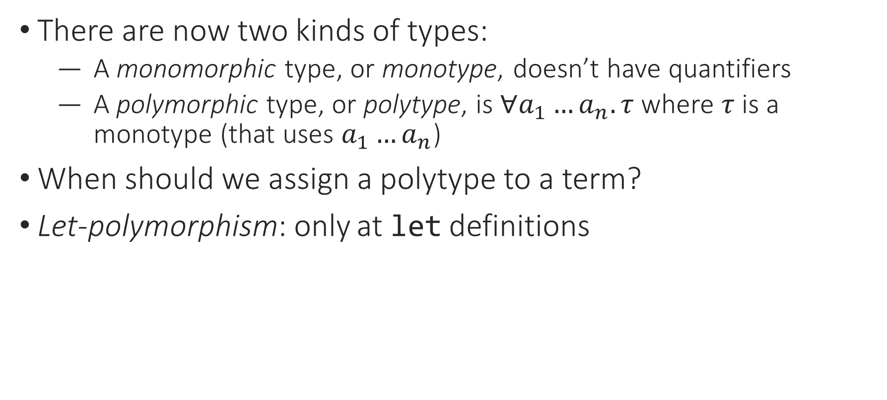
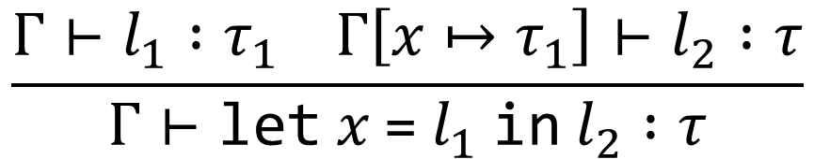
Universal Polymorphism: Typing
There are now two kinds of types:
  A monomorphic type, or monotype, doesn’t have quantifiers
  A polymorphic type, or polytype, is $∀a_{1}…a_{n}.τ$ where $τ$ is a monotype (that uses $a_{1}…a_{n}$)
When should we assign a polytype to a term?
Let-polymorphism: only at let definitions
$$\frac{Γ⊢l_{1} :τ_{1} Γ\left[x↦τ_{1}\right]⊢l_{2} :τ}{Γ⊢\text{let} x \text{=} l_{1} \text{in} l_{2} :τ}$$
Notes:
This makes sense, since we’re mostly concerned with being able to use a polymorphic function multiple times at different types, and we can’t use something multiple times unless we name it.

Slide 19
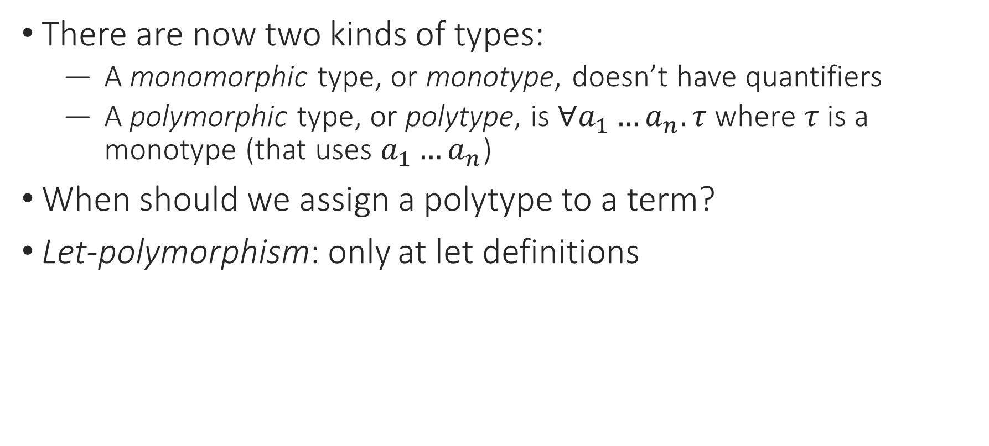
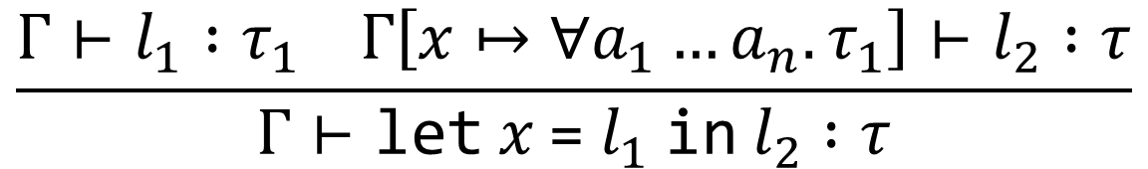
Universal Polymorphism: Typing
There are now two kinds of types:
  A monomorphic type, or monotype, doesn’t have quantifiers
  A polymorphic type, or polytype, is $∀a_{1}…a_{n}.τ$ where $τ$ is a monotype (that uses $a_{1}…a_{n}$)
When should we assign a polytype to a term?
Let-polymorphism: only at let definitions
$$\frac{Γ⊢l_{1} :τ_{1} Γ\left[x↦∀a_{1}…a_{n}.τ_{1}\right]⊢l_{2} :τ}{Γ⊢\text{let} x \text{=} l_{1} \text{in} l_{2} :τ}$$
Notes:
This makes sense, since we’re mostly concerned with being able to use a polymorphic function multiple times at different types, and we can’t use something multiple times unless we name it.

Slide 20
Notes:
Poll Title: Do not modify the notes in this section to avoid tampering with the Poll Everywhere activity.
More info at polleverywhere.com/support
Questions
https://www.polleverywhere.com/discourses/SRzwhp4zztmGWgIgz520A

Slide 21
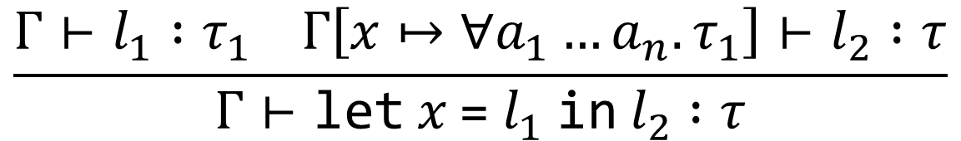


Let-Polymorphism: Typing
What variables should we quantify?
$$\frac{Γ⊢l_{1} :τ_{1} Γ\left[x↦∀a_{1}…a_{n}.τ_{1}\right]⊢l_{2} :τ}{Γ⊢\text{let} x \text{=} l_{1} \text{in} l_{2} :τ}$$
$$a→a$$
$$id :∀a. a→a$$
let id = fun x -> x in (id 1 = 1) && (id bool)
Notes:
That’s the idea: let’s see how this works.

Slide 22

Let-Polymorphism: Typing
where $vars\left(τ_{1}\right)=a_{1},…,a_{n}$
$$\frac{Γ⊢l_{1} :τ_{1} Γ\left[x↦∀a_{1}…a_{n}.τ_{1}\right]⊢l_{2} :τ}{Γ⊢\text{let} x \text{=} l_{1} \text{in} l_{2} :τ}$$
$$a→a$$
$$id :∀a. a→a$$
let id = fun x -> x in (id 1 = 1) && (id bool)
Notes:
That’s the idea: let’s see how this works.

Slide 23




Let-Polymorphism: Typing
where $vars\left(τ_{1}\right)=a_{1},…,a_{n}$
The type of y has to be int, not generic
$$\frac{Γ⊢l_{1} :τ_{1} Γ\left[x↦∀a_{1}…a_{n}.τ_{1}\right]⊢l_{2} :τ}{Γ⊢\text{let} x \text{=} l_{1} \text{in} l_{2} :τ}$$
$$Γ\left(y\right)=a$$
$$b→a$$
$$f :∀a b. b→a$$
fun y -> (let f = fun x -> y in y + f 3)
Notes:
But this is wrong: the type of y isn’t *any* a, it’s the specific a we’re still working with. We could still get more constraints on a.

Slide 24
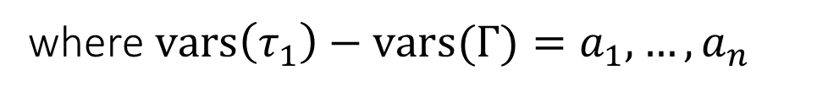



Let-Polymorphism: Typing
where $vars\left(τ_{1}\right)−vars(Γ)=a_{1},…,a_{n}$
The type of y has to be int, not generic
$$\frac{Γ⊢l_{1} :τ_{1} Γ\left[x↦∀a_{1}…a_{n}.τ_{1}\right]⊢l_{2} :τ}{Γ⊢\text{let} x \text{=} l_{1} \text{in} l_{2} :τ}$$
$$Γ\left(y\right)=a$$
$$b→a$$
$$f :∀b. b→a$$
fun y -> (let f = fun x -> y in y + f 3)
Notes:
But this is wrong: the type of y isn’t *any* a, it’s the specific a we’re still working with. We could still get more constraints on a.

Slide 25
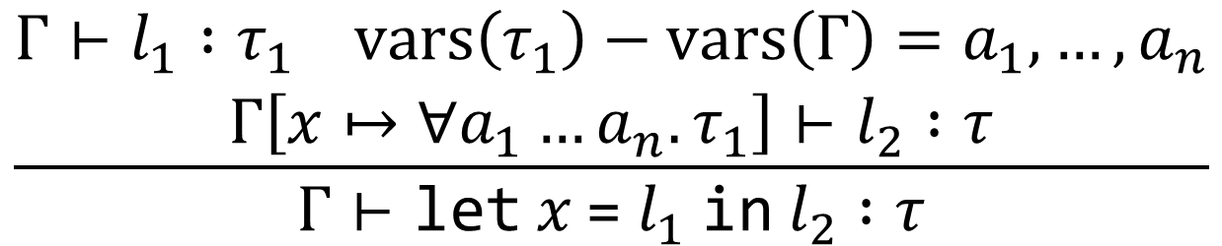
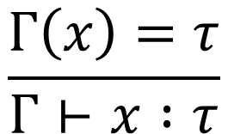
Let-Polymorphism: Typing
$$\frac{\begin{aligned}Γ⊢l_{1} :τ_{1} vars\left(τ_{1}\right)−vars\left(Γ\right)=a_{1},…,a_{n} \\ Γ\left[x↦∀a_{1}…a_{n}.τ_{1}\right]⊢l_{2} :τ\end{aligned}}{Γ⊢\text{let} x \text{=} l_{1} \text{in} l_{2} :τ}$$
$$\frac{Γ\left(x\right)=τ}{Γ⊢x :τ}$$
Notes:
When do we actually use these polymorphic types? When we use the declared variable. So this is the natural place to choose an instantiation.

Slide 26

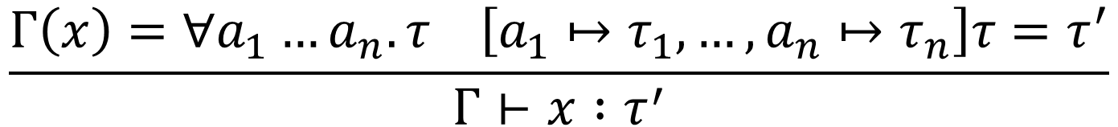
Let-Polymorphism: Typing
We can have polytypes in $Γ$, but in $Γ⊢e :τ$, $τ$ is a monotype
$$\frac{\begin{aligned}Γ⊢l_{1} :τ_{1} vars\left(τ_{1}\right)−vars\left(Γ\right)=a_{1},…,a_{n} \\ Γ\left[x↦∀a_{1}…a_{n}.τ_{1}\right]⊢l_{2} :τ\end{aligned}}{Γ⊢\text{let} x \text{=} l_{1} \text{in} l_{2} :τ}$$
$$\frac{Γ\left(x\right)=∀a_{1}…a_{n}.τ \left[a_{1}↦τ_{1},…,a_{n}↦τ_{n}\right]τ=τ^{′}}{Γ⊢x :τ^{′}}$$
Notes:
This lets us use all the other typing rules as-is, and we scarcely have to change type inference.

Slide 27
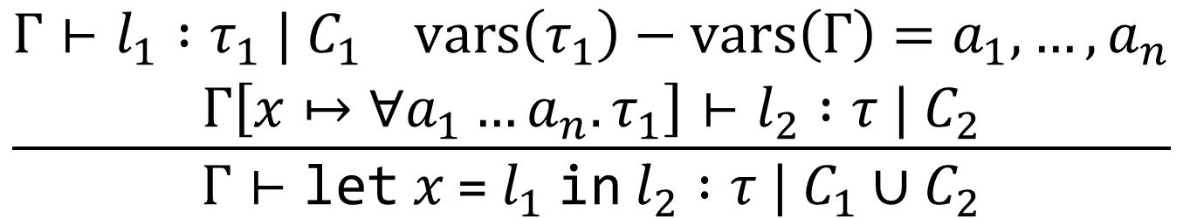
Let-Polymorphism: Type Inference
We can have polytypes in $Γ$, but in $Γ⊢e :τ$, $τ$ is a monotype
$$\frac{\begin{aligned}Γ⊢l_{1} :τ_{1} | C_{1} vars\left(τ_{1}\right)−vars\left(Γ\right)=a_{1},…,a_{n} \\ Γ\left[x↦∀a_{1}…a_{n}.τ_{1}\right]⊢l_{2} :τ | C_{2}\end{aligned}}{Γ⊢\text{let} x \text{=} l_{1} \text{in} l_{2} :τ | C_{1}∪C_{2}}$$
$$\frac{Γ\left(x\right)=∀a_{1}…a_{n}.τ \left[a_{1}↦τ_{1},…,a_{n}↦τ_{n}\right]τ=τ^{′}}{Γ⊢x :τ^{′}}$$
Notes:
This lets us use all the other typing rules as-is, and we scarcely have to change type inference.

Slide 28
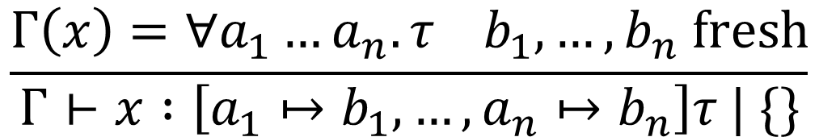
Let-Polymorphism: Type Inference
We can have polytypes in $Γ$, but in $Γ⊢e :τ$, $τ$ is a monotype
$$\frac{\begin{aligned}Γ⊢l_{1} :τ_{1} | C_{1} vars\left(τ_{1}\right)−vars\left(Γ\right)=a_{1},…,a_{n} \\ Γ\left[x↦∀a_{1}…a_{n}.τ_{1}\right]⊢l_{2} :τ | C_{2}\end{aligned}}{Γ⊢\text{let} x \text{=} l_{1} \text{in} l_{2} :τ | C_{1}∪C_{2}}$$
$$\frac{Γ\left(x\right)=∀a_{1}…a_{n}.τ b_{1},…,b_{n} fresh}{Γ⊢x :\left[a_{1}↦b_{1},…,{a_{n}↦b}_{n}\right]τ | \{\}}$$
Notes:
We instantiate the polytype of x with fresh type variables, so each use of x has a type that’s some instance of the polytype, and the constraints we gather will tell us which instance.

Slide 29
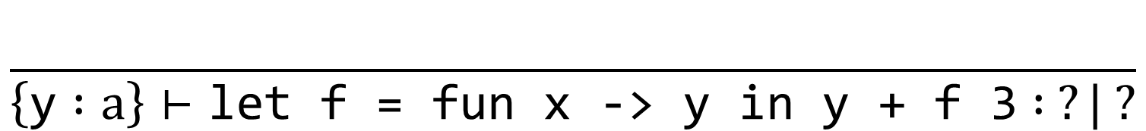
Let-Polymorphism: Type Inference
$$\frac{\begin{aligned}Γ⊢l_{1} :τ_{1} | C_{1} vars\left(τ_{1}\right)−vars\left(Γ\right)=a_{1},…,a_{n} \\ Γ\left[x↦∀a_{1}…a_{n}.τ_{1}\right]⊢l_{2} :τ | C_{2}\end{aligned}}{Γ⊢\text{let} x \text{=} l_{1} \text{in} l_{2} :τ | C_{1}∪C_{2}}$$
$$\frac{}{\left\{\text{y} :a\right\}⊢\text{let} \text{f}\text{ = }\text{fun} \text{x}\text{ −> }\text{y} \text{in} \text{y}\text{ + }\text{f}\text{ 3} : ?| ?}$$
Notes:
We instantiate the polytype of x with fresh type variables, so each use of x has a type that’s some instance of the polytype, and the constraints we gather will tell us which instance.

Slide 30
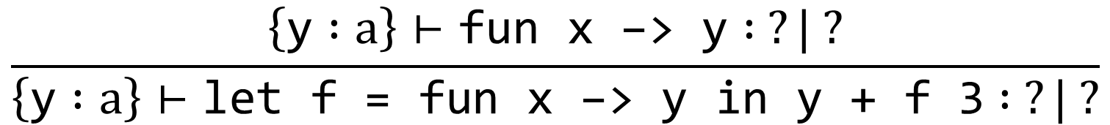
Let-Polymorphism: Type Inference
$$\frac{\begin{aligned}Γ⊢l_{1} :τ_{1} | C_{1} vars\left(τ_{1}\right)−vars\left(Γ\right)=a_{1},…,a_{n} \\ Γ\left[x↦∀a_{1}…a_{n}.τ_{1}\right]⊢l_{2} :τ | C_{2}\end{aligned}}{Γ⊢\text{let} x \text{=} l_{1} \text{in} l_{2} :τ | C_{1}∪C_{2}}$$
$$\frac{\left\{\text{y} :a\right\}⊢\text{fun} \text{x}\text{ −> }\text{y} : ?| ?}{\left\{\text{y} :a\right\}⊢\text{let} \text{f}\text{ = }\text{fun} \text{x}\text{ −> }\text{y} \text{in} \text{y}\text{ + }\text{f}\text{ 3} : ?| ?}$$
Notes:
We instantiate the polytype of x with fresh type variables, so each use of x has a type that’s some instance of the polytype, and the constraints we gather will tell us which instance.

Slide 31
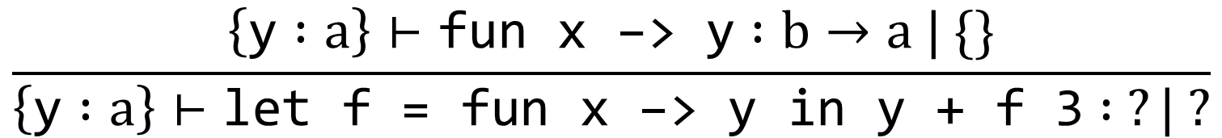
Let-Polymorphism: Type Inference
$$\frac{\begin{aligned}Γ⊢l_{1} :τ_{1} | C_{1} vars\left(τ_{1}\right)−vars\left(Γ\right)=a_{1},…,a_{n} \\ Γ\left[x↦∀a_{1}…a_{n}.τ_{1}\right]⊢l_{2} :τ | C_{2}\end{aligned}}{Γ⊢\text{let} x \text{=} l_{1} \text{in} l_{2} :τ | C_{1}∪C_{2}}$$
$$\frac{\left\{\text{y} :a\right\}⊢\text{fun} \text{x}\text{ −> }\text{y} :b→a | \{\}}{\left\{\text{y} :a\right\}⊢\text{let} \text{f}\text{ = }\text{fun} \text{x}\text{ −> }\text{y} \text{in} \text{y}\text{ + }\text{f}\text{ 3} : ?| ?}$$
Notes:
We instantiate the polytype of x with fresh type variables, so each use of x has a type that’s some instance of the polytype, and the constraints we gather will tell us which instance.

Slide 32
Let-Polymorphism: Type Inference
$$\frac{\begin{aligned}Γ⊢l_{1} :τ_{1} | C_{1} vars\left(τ_{1}\right)−vars\left(Γ\right)=a_{1},…,a_{n} \\ Γ\left[x↦∀a_{1}…a_{n}.τ_{1}\right]⊢l_{2} :τ | C_{2}\end{aligned}}{Γ⊢\text{let} x \text{=} l_{1} \text{in} l_{2} :τ | C_{1}∪C_{2}}$$
$$\frac{\left\{\text{y} :a\right\}⊢\text{fun} \text{x}\text{ −> }\text{y} :b→a \left| \{\} \left\{\text{y} :a,\text{f} : ?\right\}⊢\text{y} \text{+} \text{f}\text{ 3} : ?\right| ?}{\left\{\text{y} :a\right\}⊢\text{let} \text{f}\text{ = }\text{fun} \text{x}\text{ −> }\text{y} \text{in} \text{y}\text{ + }\text{f}\text{ 3} : ?| ?}$$
Notes:
We instantiate the polytype of x with fresh type variables, so each use of x has a type that’s some instance of the polytype, and the constraints we gather will tell us which instance.

Slide 33
Let-Polymorphism: Type Inference
$$\frac{\begin{aligned}Γ⊢l_{1} :τ_{1} | C_{1} vars\left(τ_{1}\right)−vars\left(Γ\right)=a_{1},…,a_{n} \\ Γ\left[x↦∀a_{1}…a_{n}.τ_{1}\right]⊢l_{2} :τ | C_{2}\end{aligned}}{Γ⊢\text{let} x \text{=} l_{1} \text{in} l_{2} :τ | C_{1}∪C_{2}}$$
$$\frac{\left\{\text{y} :a\right\}⊢\text{fun} \text{x} \text{−>} \text{y} :b→a \left| \{\} \left\{\text{y} :a,\text{f} :∀b. b→a\right\}⊢\text{y} \text{+} \text{f}\text{ 3} : ?\right| ?}{\left\{\text{y} :a\right\}⊢\text{let} \text{f}\text{ = }\text{fun} \text{x}\text{ −> }\text{y} \text{in} \text{y}\text{ + }\text{f}\text{ 3} : ?| ?}$$
Notes:
We instantiate the polytype of x with fresh type variables, so each use of x has a type that’s some instance of the polytype, and the constraints we gather will tell us which instance.

Slide 34
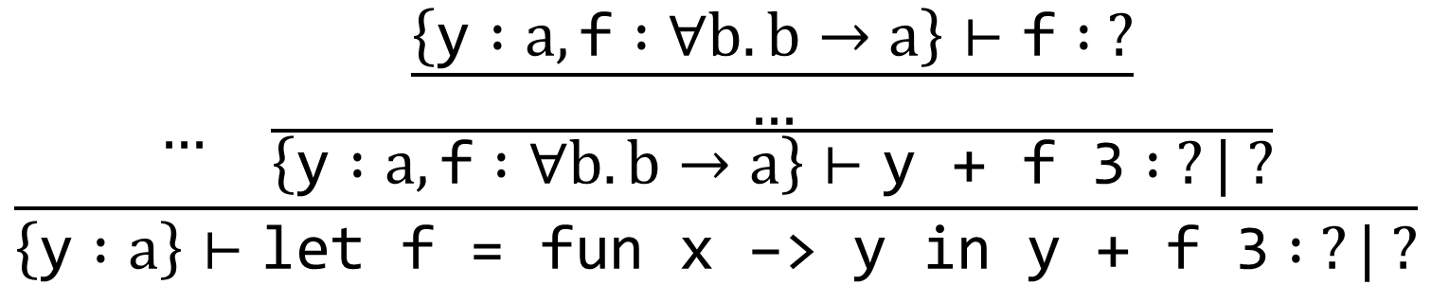
Let-Polymorphism: Type Inference
$$\frac{\begin{aligned}Γ⊢l_{1} :τ_{1} | C_{1} vars\left(τ_{1}\right)−vars\left(Γ\right)=a_{1},…,a_{n} \\ Γ\left[x↦∀a_{1}…a_{n}.τ_{1}\right]⊢l_{2} :τ | C_{2}\end{aligned}}{Γ⊢\text{let} x \text{=} l_{1} \text{in} l_{2} :τ | C_{1}∪C_{2}}$$
$$\frac{… \frac{\frac{\left\{\text{y} :a,\text{f} :∀b. b→a\right\}⊢\text{f} : ?}{…}}{\left\{\text{y} :a,\text{f} :∀b. b→a\right\}⊢\text{y} \text{+} \text{f}\text{ 3} : ?| ?}}{\left\{\text{y} :a\right\}⊢\text{let} \text{f}\text{ = }\text{fun} \text{x}\text{ −> }\text{y} \text{in} \text{y}\text{ + }\text{f}\text{ 3} : ?| ?}$$
Notes:
We instantiate the polytype of x with fresh type variables, so each use of x has a type that’s some instance of the polytype, and the constraints we gather will tell us which instance.

Slide 35
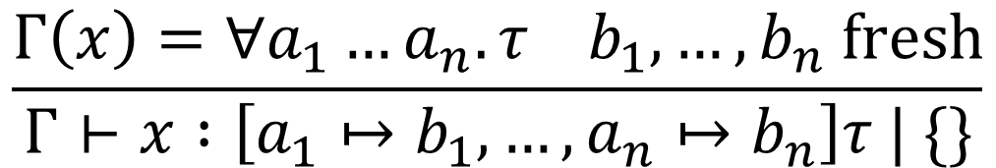
Let-Polymorphism: Type Inference
$$\frac{Γ\left(x\right)=∀a_{1}…a_{n}.τ b_{1},…,b_{n} fresh}{Γ⊢x :\left[a_{1}↦b_{1},…,{a_{n}↦b}_{n}\right]τ | \{\}}$$
$$\frac{… \frac{\frac{\left\{\text{y} :a,\text{f} :∀b. b→a\right\}⊢\text{f} : ?}{…}}{\left\{\text{y} :a,\text{f} :∀b. b→a\right\}⊢\text{y} \text{+} \text{f}\text{ 3} : ?| ?}}{\left\{\text{y} :a\right\}⊢\text{let} \text{f}\text{ = }\text{fun} \text{x}\text{ −> }\text{y} \text{in} \text{y}\text{ + }\text{f}\text{ 3} : ?| ?}$$
Notes:
We instantiate the polytype of x with fresh type variables, so each use of x has a type that’s some instance of the polytype, and the constraints we gather will tell us which instance.

Slide 36
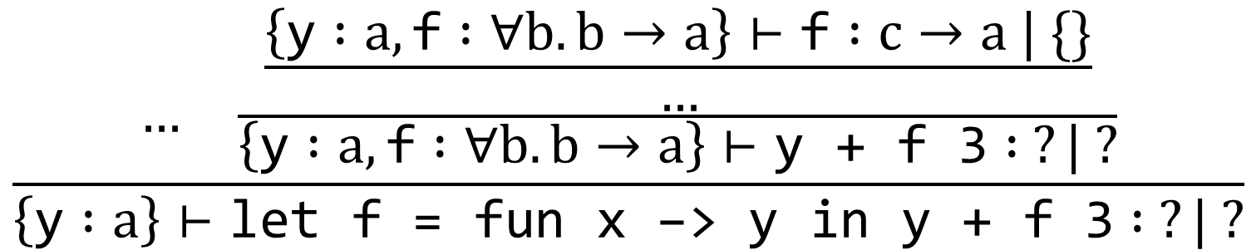
Let-Polymorphism: Type Inference
$$\frac{Γ\left(x\right)=∀a_{1}…a_{n}.τ b_{1},…,b_{n} fresh}{Γ⊢x :\left[a_{1}↦b_{1},…,{a_{n}↦b}_{n}\right]τ | \{\}}$$
a and c will be int, but b stays quantified
$$\frac{… \frac{\frac{\left\{\text{y} :a,\text{f} :∀b. b→a\right\}⊢\text{f} :c→a | \{\}}{…}}{\left\{\text{y} :a,\text{f} :∀b. b→a\right\}⊢\text{y} \text{+} \text{f}\text{ 3} : ?| ?}}{\left\{\text{y} :a\right\}⊢\text{let} \text{f}\text{ = }\text{fun} \text{x}\text{ −> }\text{y} \text{in} \text{y}\text{ + }\text{f}\text{ 3} : ?| ?}$$
Notes:
We instantiate the polytype of x with fresh type variables, so each use of x has a type that’s some instance of the polytype, and the constraints we gather will tell us which instance.

Slide 37
Notes:
Poll Title: Do not modify the notes in this section to avoid tampering with the Poll Everywhere activity.
More info at polleverywhere.com/support
Questions
https://www.polleverywhere.com/discourses/SRzwhp4zztmGWgIgz520A

Slide 38
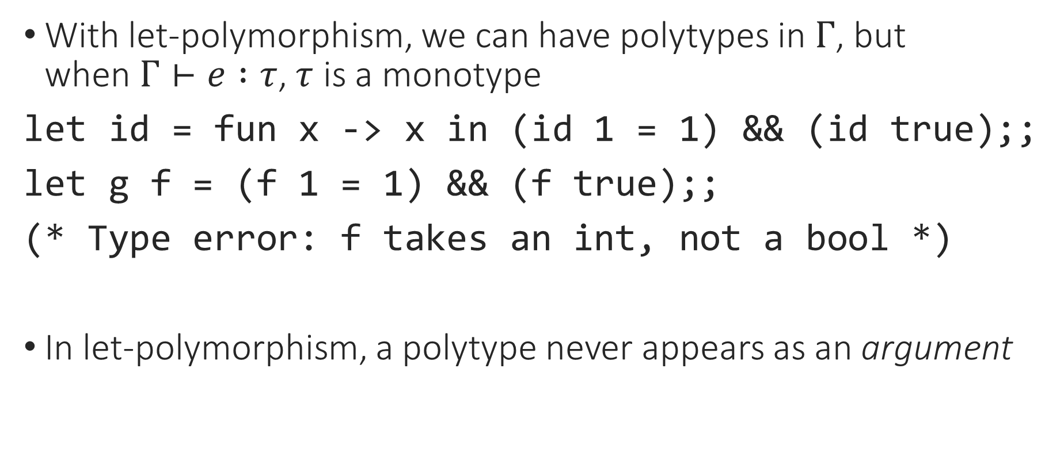
More Universal Polymorphism
With let-polymorphism, we can have polytypes in $Γ$, but when$Γ⊢e :τ$, $τ$ is a monotype
let id = fun x -> x in (id 1 = 1) && (id true);;
let g f = (f 1 = 1) && (f true);;
(* Type error: f takes an int, not a bool *)
In let-polymorphism, a polytype never appears as an argument

Slide 39
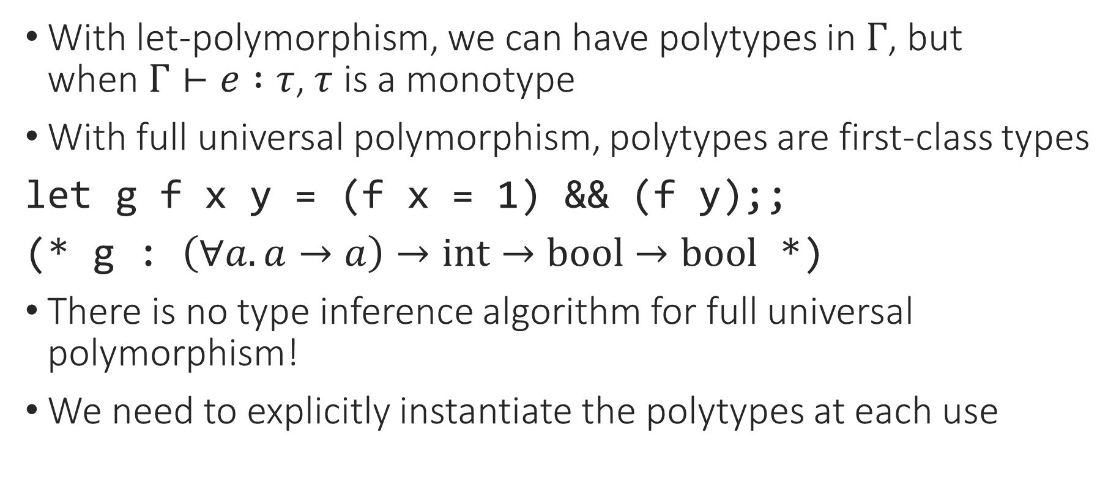
More Universal Polymorphism
With let-polymorphism, we can have polytypes in $Γ$, but when$Γ⊢e :τ$, $τ$ is a monotype
With full universal polymorphism, polytypes are first-class types
let g f x y = (f x = 1) && (f y);;
(* g : $\left(∀a. a→a\right)→int→bool→bool$ *)
There is no type inference algorithm for full universal polymorphism!
We need to explicitly instantiate the polytypes at each use

Slide 40
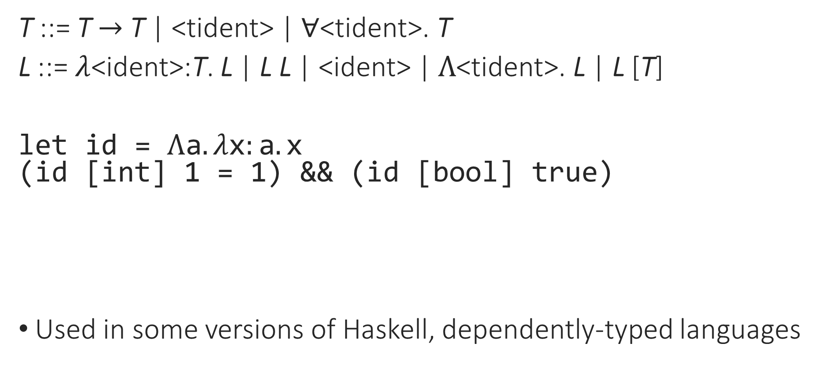
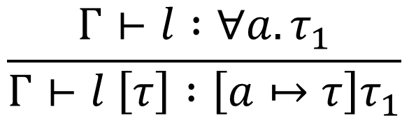

System F
T ::= T $→$ T | <tident> | $∀$<tident>. T
L ::= $λ$<ident>:T. L | L L | <ident> | $Λ$<tident>. L | L [T]
let id = $Λ\text{a}. λ\text{x}:\text{a}. \text{x}$
(id [int] 1 = 1) && (id [bool] true)
Used in some versions of Haskell, dependently-typed languages
$$\frac{Γ⊢l :τ}{Γ⊢Λa. l :∀a. τ}$$
$$\frac{Γ⊢l :∀a.τ_{1}}{Γ⊢l \left[τ\right] :\left[a↦τ\right]τ_{1}}$$

Slide 41
Notes:
Poll Title: Do not modify the notes in this section to avoid tampering with the Poll Everywhere activity.
More info at polleverywhere.com/support
Questions
https://www.polleverywhere.com/discourses/SRzwhp4zztmGWgIgz520A

Slide 42
Universal Polymorphism
In OCaml, a function with free type variables gets a universal type, and can be used at any instantiation of its type
Happens when a function doesn’t care about the type of an argument, and will do the same thing with an input of any type
Requires only a small change to type checking/inference to automatically infer when a function can be generic
More general universal polymorphism is possible, but if we go too general, we lose automatic type inference!

Slide 43
From Typed Lambda Calculus to OCaml
User-friendly syntax
Basic types, tuples, records
Inductive datatypes and pattern-matching
Local declarations
References
Type inference
Generics/polymorphism
Notes:
And that’s it! This isn’t every feature of OCaml, but it is most of them, focusing on the parts that are found in most (strongly typed) functional languages.

