Slide 1
CS 476 – Programming Language Design
William Mansky

Slide 2
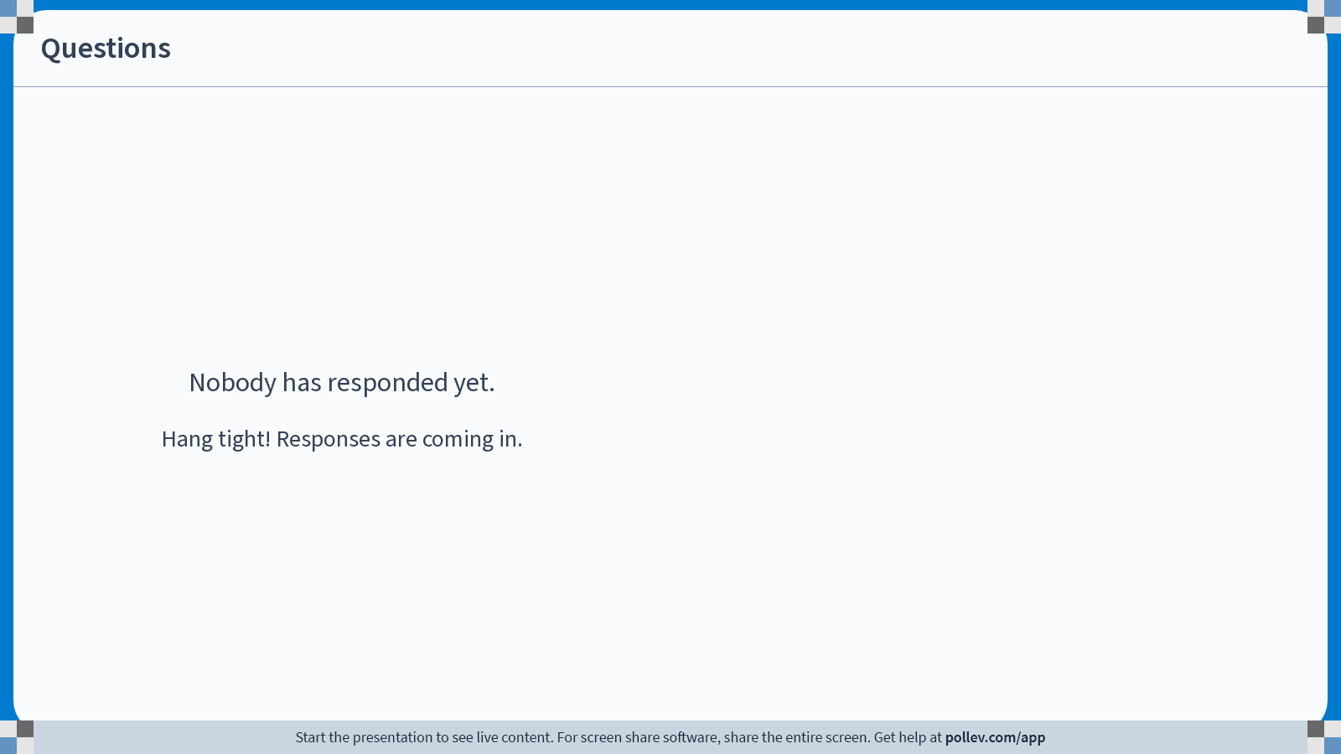
Notes:
Poll Title: Do not modify the notes in this section to avoid tampering with the Poll Everywhere activity.
More info at polleverywhere.com/support
Questions
https://www.polleverywhere.com/discourses/SRzwhp4zztmGWgIgz520A

Slide 3
Project Workshop
Exercise: Tell me something you’ve done for your project! Added cases to syntax, written semantic rules, read about related work, or anything else like that.
  If you haven’t started yet, this is the time to start!

Slide 4
Project Workshop
switch(some expression){
case 0: <code for case 0>
case 1: <code for case 1>
…
default: <code for default case>
}
If the expression’s value is 0, run case 0
…
If the expression doesn’t match any of the cases, run the default case

Slide 5
Project Workshop
switch(some expression){
case 0: <code for case 0>
case 1: <code for case 1>
…
default: <code for default case>
}
E ::= …
C ::= … | switch(E){ case <#>: C … case <#>: C default: C }

Slide 6
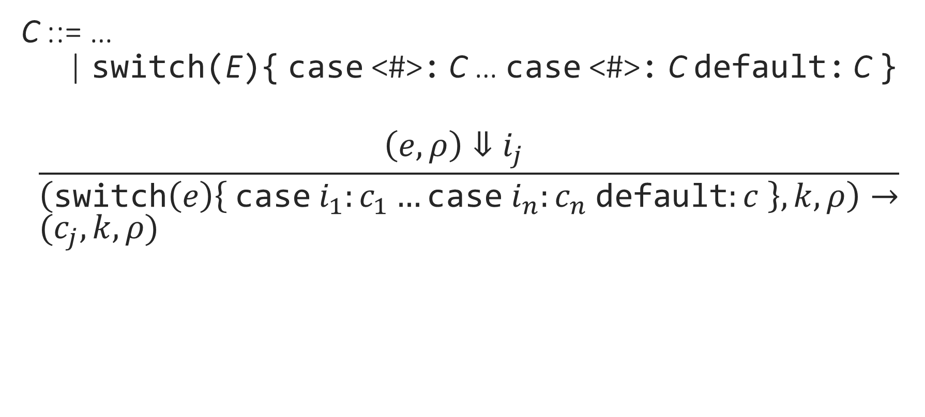
Project Workshop
C ::= …
| switch(E){ case <#>: C … case <#>: C default: C }
$$\frac{\left(e,ρ\right)⇓i_{j} }{\left(\text{switch}\left(e\right)\left\{ \text{case} i_{1}:c_{1}…\text{case} i_{n}:c_{n} \text{default}:c \right\},k,ρ\right)→} \\ (c_{j},k,ρ)$$
Notes:
Explore some variations, run some tests
Now implement it!

