Slide 1
CS 476 – Programming Language Design
William Mansky

Slide 2
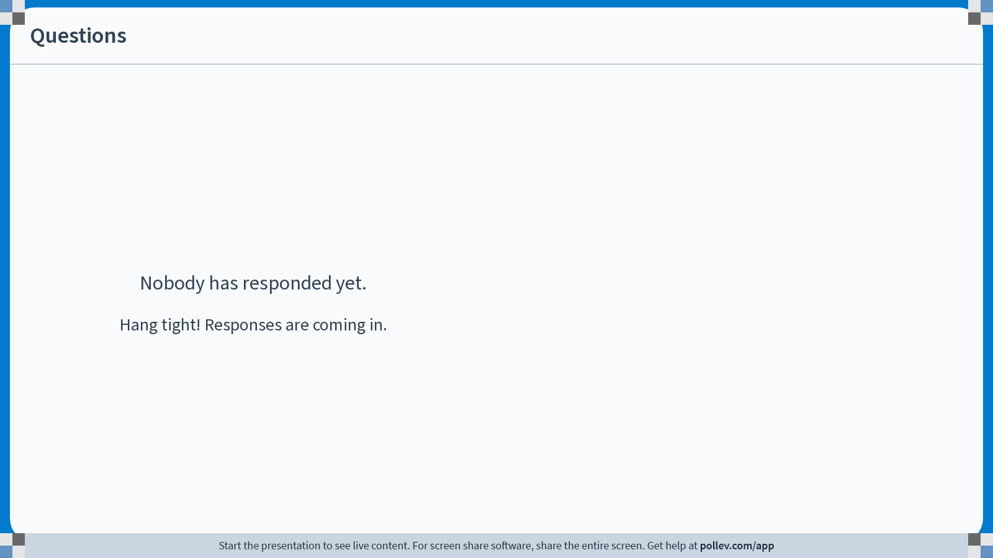
Notes:
Poll Title: Do not modify the notes in this section to avoid tampering with the Poll Everywhere activity.
More info at polleverywhere.com/support
Questions
https://www.polleverywhere.com/discourses/SRzwhp4zztmGWgIgz520A

Slide 3
Project Workshop
Exercise: Give me a quick update on your project status (before or after today’s workshop). Is there anything you’re stuck on? Is there anything you wanted to do but couldn’t figure out?

