Slide 1
CS 476 – Programming Language Design
William Mansky

Slide 2

Notes:
Poll Title: Do not modify the notes in this section to avoid tampering with the Poll Everywhere activity.
More info at polleverywhere.com/support
Questions
https://www.polleverywhere.com/discourses/SRzwhp4zztmGWgIgz520A

Slide 3
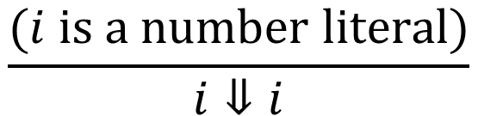
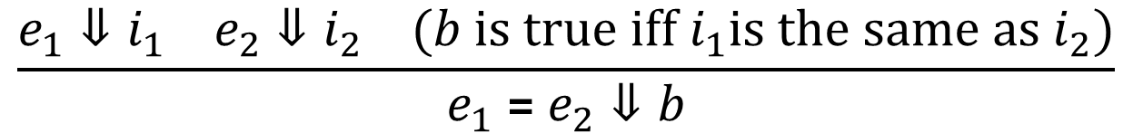
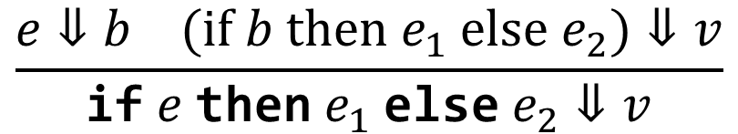
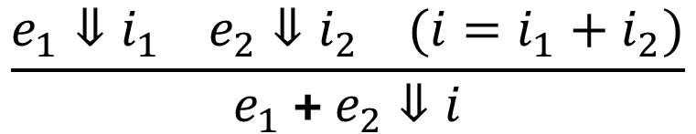
Expressions: Big-Step Semantics
$$\frac{(i is a number literal)}{i⇓i}$$
$$\frac{e_{1}⇓i_{1} e_{2}⇓i_{2} (i=i_{1}+i_{2})}{e_{1} \text{+} e_{2}⇓i}$$
$$\frac{e_{1}⇓i_{1} e_{2}⇓i_{2} (b is true iff i_{1}is the same as i_{2})}{e_{1} \text{=}{ e}_{2}⇓b}$$
$$\frac{e⇓b (if b then e_{1} else e_{2})⇓v}{\text{if} e \text{then} e_{1} \text{else} e_{2}⇓v}$$

Slide 4
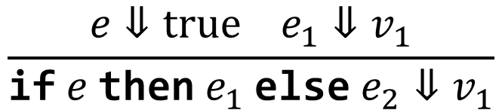
A More Direct Semantic Rule
$$\frac{e⇓true e_{1}⇓v_{1}}{\text{if} e \text{then} e_{1} \text{else} e_{2}⇓v_{1}}$$
$$\text{if} \text{true} \text{then} e_{1} \text{else} e_{2} ⇓ e_{1}$$
Notes:
There are a couple of reasons this doesn’t work in our rule format: the right-hand side is supposed to be a value, not a term that still needs to be evaluated, and the condition might not just be the literal true or false.
But we can do this in another style!

Slide 5
A More Direct Semantic Rule
$$\frac{e⇓true e_{1}⇓v_{1}}{\text{if} e \text{then} e_{1} \text{else} e_{2}⇓v_{1}}$$
$$\text{if} \text{true} \text{then} e_{1} \text{else} e_{2}→ e_{1}$$
Notes:
There are a couple of reasons this doesn’t work in our rule format: the right-hand side is supposed to be a value, not a term that still needs to be evaluated, and the condition might not just be the literal true or false.
But we can do this in another style!

Slide 6
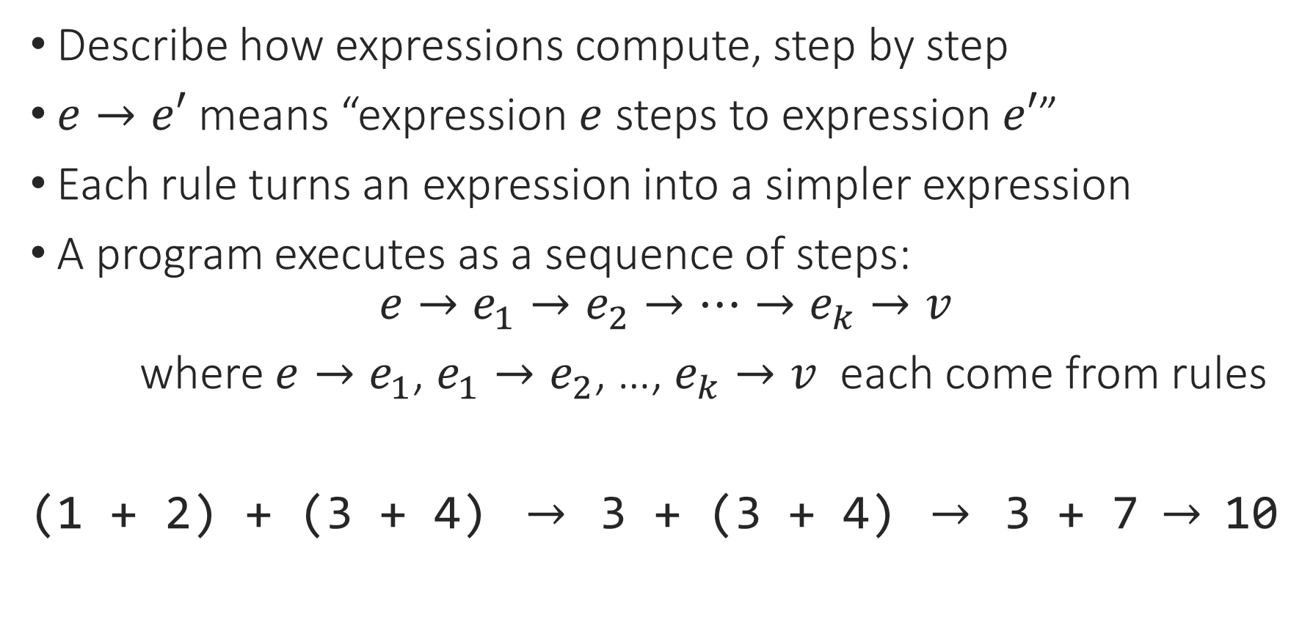
Small-Step Operational Semantics
Describe how expressions compute, step by step
$e→e′$ means “expression $e$ steps to expression $e′$”
Each rule turns an expression into a simpler expression
A program executes as a sequence of steps:
$$e→e_{1}→e_{2}→…→e_{k}→v$$
where $e→e_{1}$, $e_{1}→e_{2}$, …, $e_{k}→v$ each come from rules
(1 + 2) + (3 + 4) $→$ 3 + (3 + 4) $→$ 3 + 7 $→$ 10
Notes:
Also SOS, transition semantics

Slide 7
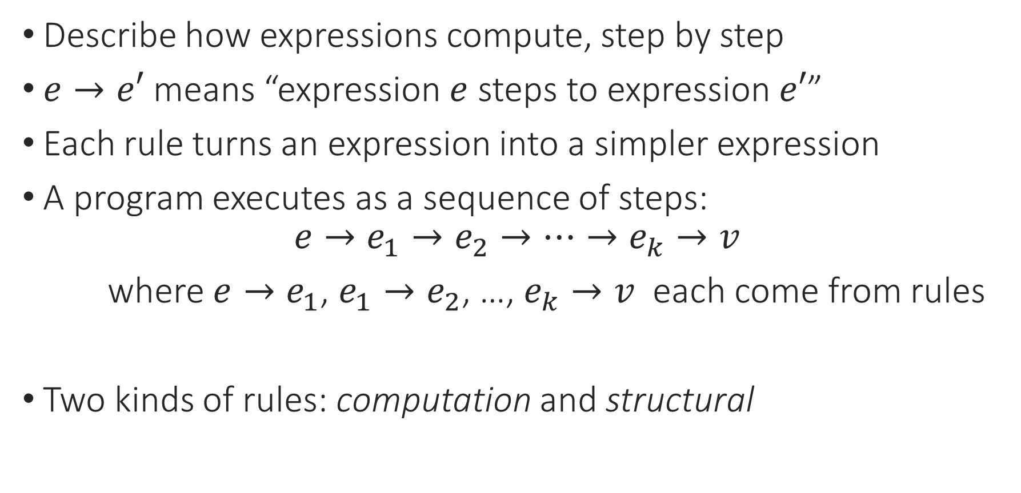
Small-Step Operational Semantics
Describe how expressions compute, step by step
$e→e′$ means “expression $e$ steps to expression $e′$”
Each rule turns an expression into a simpler expression
A program executes as a sequence of steps:
$$e→e_{1}→e_{2}→…→e_{k}→v$$
where $e→e_{1}$, $e_{1}→e_{2}$, …, $e_{k}→v$ each come from rules
Two kinds of rules: computation and structural
Notes:
Note that a program steps to *another program*, not just a value as in big-step semantics.

Slide 8

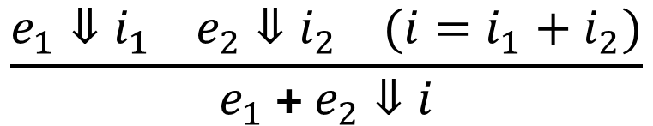


Expressions: Small-Step Semantics
Values: int, bool
Rule 0: Values are done executing!
Structural rules:
Computation rule:
$$\frac{e_{1}⇓i_{1} e_{2}⇓i_{2} (i=i_{1}+i_{2})}{e_{1} \text{+} e_{2}⇓i}$$
$$\frac{e_{1}→e_{1}^{′}}{e_{1} \text{+}{ e}_{2}→e_{1}^{′} \text{+}{ e}_{2}}$$
$$\frac{e_{2}→e_{2}^{′}}{e_{1} \text{+}{ e}_{2}→e_{1} \text{+}{ e}_{2}^{′}}$$
$$\frac{{(v}_{1} + v_{2}=v)}{v_{1} \text{+}{ v}_{2}→v}$$
Notes:
What if we wanted to fix the evaluation order?

Slide 9



Expressions: Small-Step Semantics
Rule 0: Values are done executing!
Structural rules:
Computation rule:
(3 + 4) + (5 + 6)
$$\frac{e_{1}→e_{1}^{′}}{e_{1} \text{+} e_{2}→e_{1}^{′} \text{+} e_{2}}$$
$$\frac{e_{2}→e_{2}^{′}}{e_{1} \text{+}{ e}_{2}→e_{1} \text{+} e_{2}^{′}}$$
$$\frac{{(v}_{1} + v_{2}=v)}{v_{1} \text{+} v_{2}→v}$$
Notes:
We have to choose one of the structural rules to apply.

Slide 10
Expressions: Small-Step Semantics
Rule 0: Values are done executing!
Structural rules:
Computation rule:
(3 + 4) + (5 + 6)
$$\frac{e_{1}→e_{1}^{′}}{e_{1} \text{+} e_{2}→e_{1}^{′} \text{+} e_{2}}$$
$$\frac{e_{2}→e_{2}^{′}}{e_{1} \text{+}{ e}_{2}→e_{1} \text{+} e_{2}^{′}}$$
$$\frac{{(v}_{1} + v_{2}=v)}{v_{1} \text{+} v_{2}→v}$$
Notes:
We have to choose one of the structural rules to apply.

Slide 11
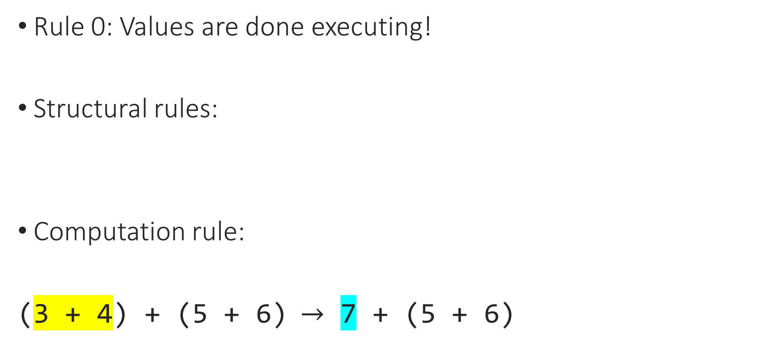
Expressions: Small-Step Semantics
Rule 0: Values are done executing!
Structural rules:
Computation rule:
(3 + 4) + (5 + 6) $→$ 7 + (5 + 6)
$$\frac{e_{1}→e_{1}^{′}}{e_{1} \text{+} e_{2}→e_{1}^{′} \text{+} e_{2}}$$
$$\frac{e_{2}→e_{2}^{′}}{e_{1} \text{+}{ e}_{2}→e_{1} \text{+} e_{2}^{′}}$$
$$\frac{{(v}_{1} + v_{2}=v)}{v_{1} \text{+} v_{2}→v}$$
Notes:
We have to choose one of the structural rules to apply.

Slide 12

Expressions: Small-Step Semantics
Rule 0: Values are done executing!
Structural rules:
Computation rule:
(3 + 4) + (5 + 6) $→$ 7 + (5 + 6) $→$ 7 + 11
$$\frac{e_{1}→e_{1}^{′}}{e_{1} \text{+} e_{2}→e_{1}^{′} \text{+} e_{2}}$$
$$\frac{e_{2}→e_{2}^{′}}{e_{1} \text{+}{ e}_{2}→e_{1} \text{+} e_{2}^{′}}$$
$$\frac{{(v}_{1} + v_{2}=v)}{v_{1} \text{+} v_{2}→v}$$
Notes:
We have to choose one of the structural rules to apply.

Slide 13

Expressions: Small-Step Semantics
Rule 0: Values are done executing!
Structural rules:
Computation rule:
(3 + 4) + (5 + 6) $→$ 7 + (5 + 6) $→$ 7 + 11 $→$ 18
$$\frac{e_{1}→e_{1}^{′}}{e_{1} \text{+} e_{2}→e_{1}^{′} \text{+} e_{2}}$$
$$\frac{e_{2}→e_{2}^{′}}{e_{1} \text{+}{ e}_{2}→e_{1} \text{+} e_{2}^{′}}$$
$$\frac{{(v}_{1} + v_{2}=v)}{v_{1} \text{+} v_{2}→v}$$
Notes:
We have to choose one of the structural rules to apply.

Slide 14
Notes:
Poll Title: Do not modify the notes in this section to avoid tampering with the Poll Everywhere activity.
More info at polleverywhere.com/support
Questions
https://www.polleverywhere.com/discourses/SRzwhp4zztmGWgIgz520A

Slide 15
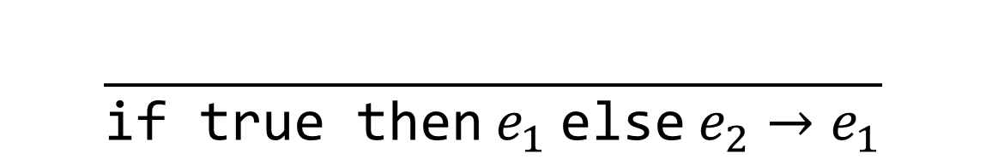


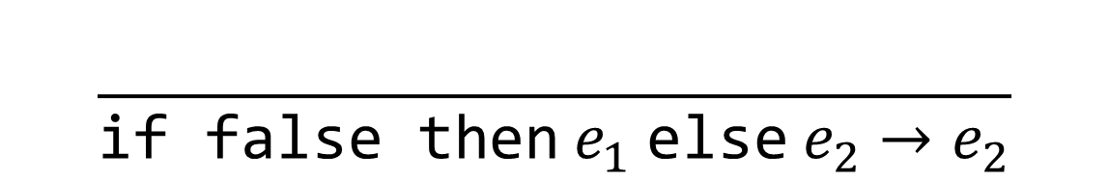
Expressions: Small-Step Semantics
Exercise: Write a structural rule for if-then-else.
Structural rule(s):
Computation rules:
$$\frac{e_{1}→e_{1}^{′}}{e_{1} \text{+} e_{2}→e_{1}^{′} \text{+} e_{2}}$$
$$\frac{e_{2}→e_{2}^{′}}{e_{1} \text{+}{ e}_{2}→e_{1} \text{+} e_{2}^{′}}$$
$$\frac{}{\text{if} \text{true} \text{then} e_{1} \text{else} e_{2}→e_{1}}$$
$$\frac{}{\text{if} \text{false} \text{then} e_{1} \text{else} e_{2}→e_{2}}$$
Notes:
strictness

Slide 16
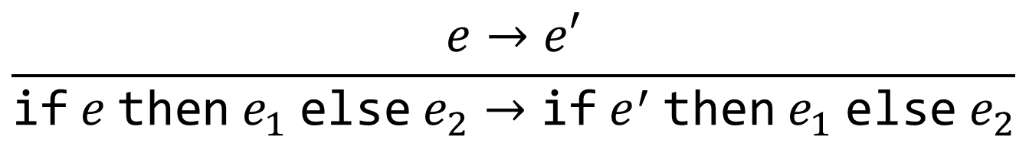
Expressions: Small-Step Semantics
Structural rule(s):
Computation rules:
$$\frac{e→e′}{\text{if} e \text{then} e_{1} \text{else} e_{2}→\text{if} e^{′} \text{then} e_{1} \text{else} e_{2}}$$
$$\frac{}{\text{if} \text{true} \text{then} e_{1} \text{else} e_{2}→e_{1}}$$
$$\frac{}{\text{if} \text{false} \text{then} e_{1} \text{else} e_{2}→e_{2}}$$
Notes:
Structure of a structural rule: expression on the bottom-left, same expression on the bottom-right, step above the line
The structural rule is what we do when we *don’t know* yet whether the condition is true or false.

Slide 17
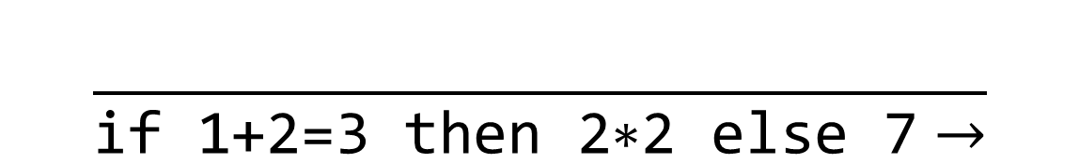
Using the Small-Step Semantics
$$\frac{}{\text{if}\text{ 1+2=3 }\text{then}\text{ 2∗2 }\text{else}\text{ 7}→}$$

Slide 18
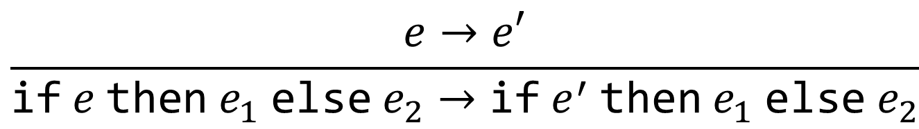
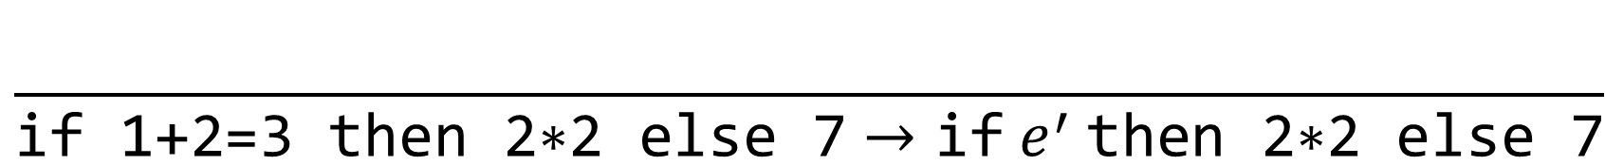
Using the Small-Step Semantics
$$\frac{e→e′}{\text{if} e \text{then} e_{1} \text{else} e_{2}→\text{if} e^{′} \text{then} e_{1} \text{else} e_{2}}$$
$$\frac{}{\text{if}\text{ 1+2=3 }\text{then}\text{ 2∗2 }\text{else}\text{ 7}→\text{if} e^{′} \text{then}\text{ 2∗2 }\text{else}\text{ 7}}$$

Slide 19
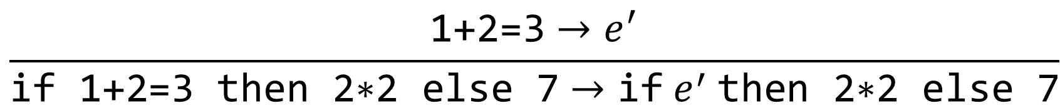
Using the Small-Step Semantics
$$\frac{e→e′}{\text{if} e \text{then} e_{1} \text{else} e_{2}→\text{if} e^{′} \text{then} e_{1} \text{else} e_{2}}$$
$$\frac{\text{1+2=3}→e^{′}}{\text{if}\text{ 1+2=3 }\text{then}\text{ 2∗2 }\text{else}\text{ 7}→\text{if} e^{′} \text{then}\text{ 2∗2 }\text{else}\text{ 7}}$$

Slide 20

Using the Small-Step Semantics
$$\frac{e_{1}→e_{1}^{′}}{e_{1} \text{=} e_{2}→e_{1}^{′} \text{=} e_{2}}$$
$$\frac{\text{1+2=3}→e^{′}}{\text{if}\text{ 1+2=3 }\text{then}\text{ 2∗2 }\text{else}\text{ 7}→\text{if} e^{′} \text{then}\text{ 2∗2 }\text{else}\text{ 7}}$$

Slide 21
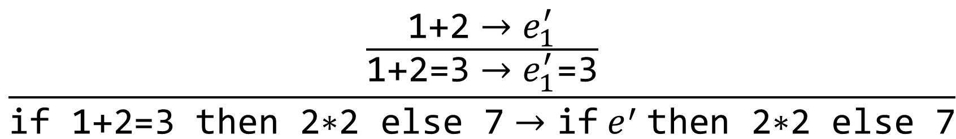
Using the Small-Step Semantics
$$\frac{e_{1}→e_{1}^{′}}{e_{1} \text{=} e_{2}→e_{1}^{′} \text{=} e_{2}}$$
$$\frac{\frac{\text{1+2}→e_{1}^{′}}{\text{1+2=3}→e_{1}^{′}\text{=3}}}{\text{if}\text{ 1+2=3 }\text{then}\text{ 2∗2 }\text{else}\text{ 7}→\text{if} e^{′} \text{then}\text{ 2∗2 }\text{else}\text{ 7}}$$

Slide 22
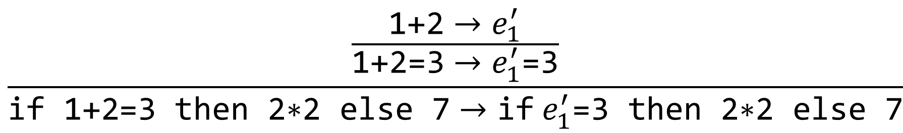
Using the Small-Step Semantics
$$\frac{e_{1}→e_{1}^{′}}{e_{1} \text{=} e_{2}→e_{1}^{′} \text{=} e_{2}}$$
$$\frac{\frac{\text{1+2}→e_{1}^{′}}{\text{1+2=3}→e_{1}^{′}\text{=3}}}{\text{if}\text{ 1+2=3 }\text{then}\text{ 2∗2 }\text{else}\text{ 7}→\text{if}{ e}_{1}^{′}\text{=3} \text{then}\text{ 2∗2 }\text{else}\text{ 7}}$$

Slide 23

Using the Small-Step Semantics
$$\frac{{(v}_{1} + v_{2}=v)}{v_{1} \text{+}{ v}_{2}→v}$$
$$\frac{\frac{\text{1+2}→e_{1}^{′}}{\text{1+2=3}→e_{1}^{′}\text{=3}}}{\text{if}\text{ 1+2=3 }\text{then}\text{ 2∗2 }\text{else}\text{ 7}→\text{if}{ e}_{1}^{′}\text{=3} \text{then}\text{ 2∗2 }\text{else}\text{ 7}}$$

Slide 24
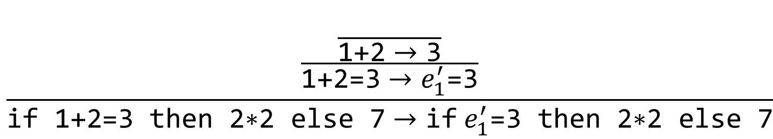
Using the Small-Step Semantics
$$\frac{{(v}_{1} + v_{2}=v)}{v_{1} \text{+}{ v}_{2}→v}$$
$$\frac{\frac{\frac{}{\text{1+2}→\text{3}}}{\text{1+2=3}→e_{1}^{′}\text{=3}}}{\text{if}\text{ 1+2=3 }\text{then}\text{ 2∗2 }\text{else}\text{ 7}→\text{if}{ e}_{1}^{′}\text{=3} \text{then}\text{ 2∗2 }\text{else}\text{ 7}}$$

Slide 25
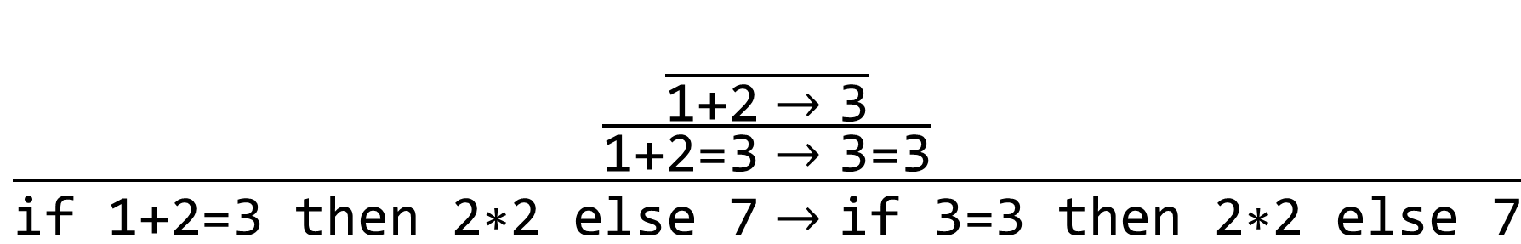
Using the Small-Step Semantics
$$\frac{{(v}_{1} + v_{2}=v)}{v_{1} \text{+}{ v}_{2}→v}$$
$$\frac{\frac{\frac{}{\text{1+2}→\text{3}}}{\text{1+2=3}→\text{3}\text{=3}}}{\text{if}\text{ 1+2=3 }\text{then}\text{ 2∗2 }\text{else}\text{ 7}→\text{if} \text{3}\text{=3} \text{then}\text{ 2∗2 }\text{else}\text{ 7}}$$
Notes:
Each step will use exactly one computation rule, but any number of structural rules.

Slide 26
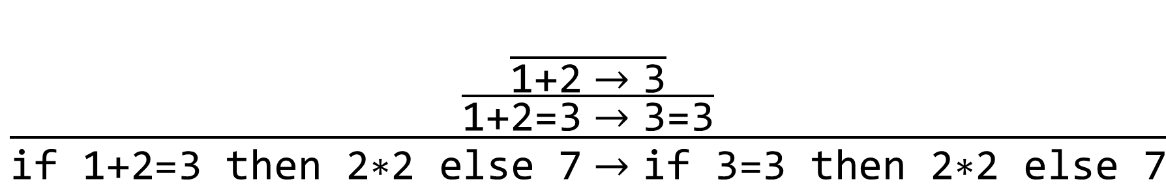
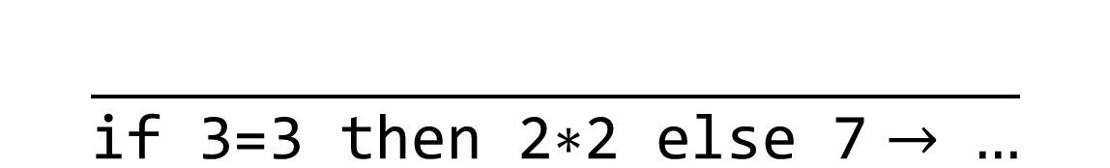
Using the Small-Step Semantics
Exercise: What is the next step for the expression?
$$\frac{\frac{\frac{}{\text{1+2}→\text{3}}}{\text{1+2=3}→\text{3}\text{=3}}}{\text{if}\text{ 1+2=3 }\text{then}\text{ 2∗2 }\text{else}\text{ 7}→\text{if} \text{3}\text{=3} \text{then}\text{ 2∗2 }\text{else}\text{ 7}}$$
$$\frac{}{\text{if} \text{3}\text{=3} \text{then}\text{ 2∗2 }\text{else}\text{ 7}→ …}$$
Notes:
If we want to keep running the program…

Slide 27
Using the Small-Step Semantics
Exercise: What is the next step for the expression?
$$\frac{\frac{\frac{}{\text{1+2}→\text{3}}}{\text{1+2=3}→\text{3}\text{=3}}}{\text{if}\text{ 1+2=3 }\text{then}\text{ 2∗2 }\text{else}\text{ 7}→\text{if} \text{3}\text{=3} \text{then}\text{ 2∗2 }\text{else}\text{ 7}}$$
$$\frac{}{\text{if} \text{3}\text{=3} \text{then}\text{ 2∗2 }\text{else}\text{ 7}→\text{if} \text{true} \text{then}\text{ 2∗2 }\text{else}\text{ 7}}$$
Notes:
If we want to keep running the program…

Slide 28
Notes:
Poll Title: Do not modify the notes in this section to avoid tampering with the Poll Everywhere activity.
More info at polleverywhere.com/support
Questions
https://www.polleverywhere.com/discourses/SRzwhp4zztmGWgIgz520A

Slide 29
Small-Step vs. Big-Step
Small-Step
Shows intermediate states
Allows control of evaluation order
Closer to underlying implementation
Can count the number of steps
Translates directly to debugger
Big-Step
Doesn’t need structural rules
Clearer statement of the right results
Sometimes internal steps don’t matter
Translates directly to interpreter

Slide 30
Small-Step vs. Big-Step
Small-Step
Shows intermediate states
Allows control of evaluation order
Closer to underlying implementation
Can count the number of steps
Translates directly to debugger
Big-Step
Doesn’t need structural rules
Clearer statement of the right results
Sometimes internal steps don’t matter
Translates directly to interpreter

Slide 31
Small-Step Interpreter/Debugger
let rec step (e : exp) =

Slide 32

Small-Step Interpreter/Debugger
let rec step (e : exp) : exp option = (* e $→$ e’ *)

Slide 33

Small-Step Interpreter/Debugger
let rec step (e : exp) : exp option = (* e $→$ e’ *)
match e with
| Num i ->
| Add (e1, e2) ->
| …
Rule 0: Values are done executing!

Slide 34




Small-Step Interpreter/Debugger
$$\frac{e_{1}→e_{1}^{′}}{e_{1} \text{+} e_{2}→e_{1}^{′} \text{+} e_{2}}$$
let rec step (e : exp) : exp option = (* e $→$ e’ *)
match e with
| Num i -> None
| Add (e1, e2) ->
| …
Rule 0: Values are done executing!
$$\frac{e_{2}→e_{2}^{′}}{e_{1} \text{+}{ e}_{2}→e_{1} \text{+} e_{2}^{′}}$$
$$\frac{{(v}_{1} + v_{2}=v)}{v_{1} \text{+} v_{2}→v}$$

Slide 35

Small-Step Interpreter/Debugger
$$\frac{e_{1}→e_{1}^{′}}{e_{1} \text{+} e_{2}→e_{1}^{′} \text{+} e_{2}}$$
let rec step (e : exp) : exp option = (* e $→$ e’ *)
match e with
| Add (e1, e2) -> (match e1, e2 with
| Num v1, Num v2 -> Some (Num (v1 + v2))
$$\frac{e_{2}→e_{2}^{′}}{e_{1} \text{+}{ e}_{2}→e_{1} \text{+} e_{2}^{′}}$$
$$\frac{{(v}_{1} + v_{2}=v)}{v_{1} \text{+} v_{2}→v}$$

Slide 36
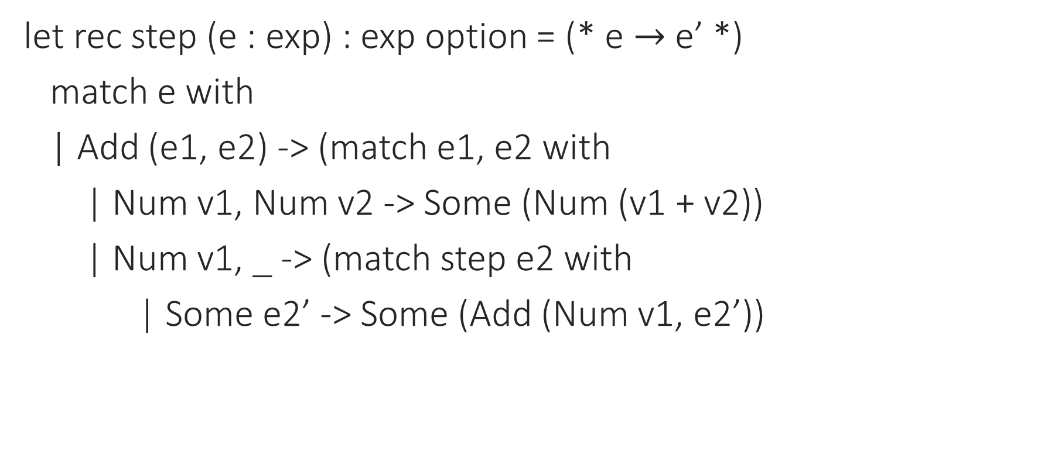
Small-Step Interpreter/Debugger
$$\frac{e_{1}→e_{1}^{′}}{e_{1} \text{+} e_{2}→e_{1}^{′} \text{+} e_{2}}$$
let rec step (e : exp) : exp option = (* e $→$ e’ *)
match e with
| Add (e1, e2) -> (match e1, e2 with
| Num v1, Num v2 -> Some (Num (v1 + v2))
| Num v1, _ -> (match step e2 with
| Some e2’ -> Some (Add (Num v1, e2’))
$$\frac{e_{2}→e_{2}^{′}}{e_{1} \text{+}{ e}_{2}→e_{1} \text{+} e_{2}^{′}}$$
$$\frac{{(v}_{1} + v_{2}=v)}{v_{1} \text{+} v_{2}→v}$$

Slide 37
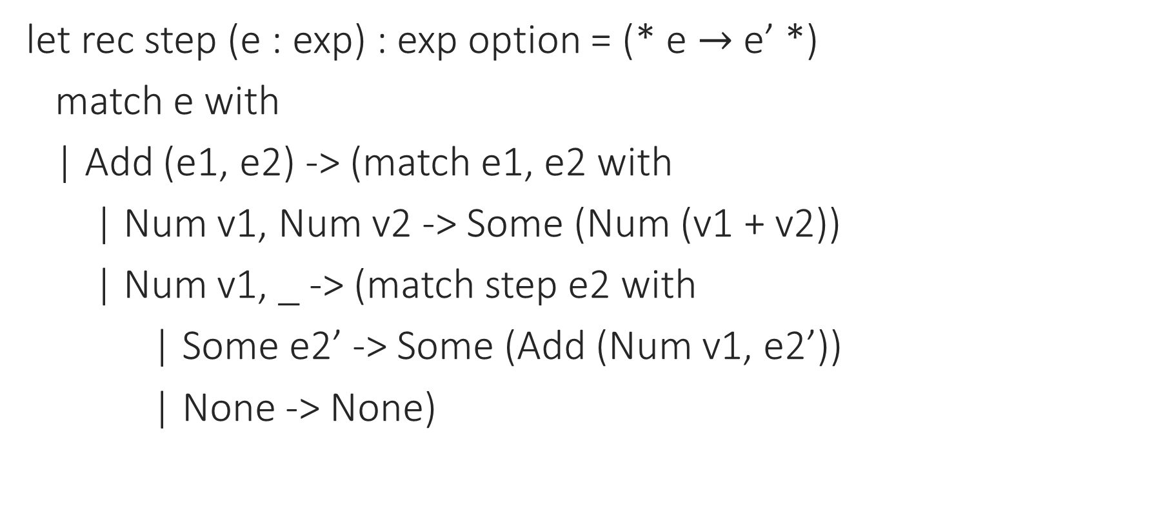
Small-Step Interpreter/Debugger
$$\frac{e_{1}→e_{1}^{′}}{e_{1} \text{+} e_{2}→e_{1}^{′} \text{+} e_{2}}$$
let rec step (e : exp) : exp option = (* e $→$ e’ *)
match e with
| Add (e1, e2) -> (match e1, e2 with
| Num v1, Num v2 -> Some (Num (v1 + v2))
| Num v1, _ -> (match step e2 with
| Some e2’ -> Some (Add (Num v1, e2’))
| None -> None)
$$\frac{e_{2}→e_{2}^{′}}{e_{1} \text{+}{ e}_{2}→e_{1} \text{+} e_{2}^{′}}$$
$$\frac{{(v}_{1} + v_{2}=v)}{v_{1} \text{+} v_{2}→v}$$

Slide 38
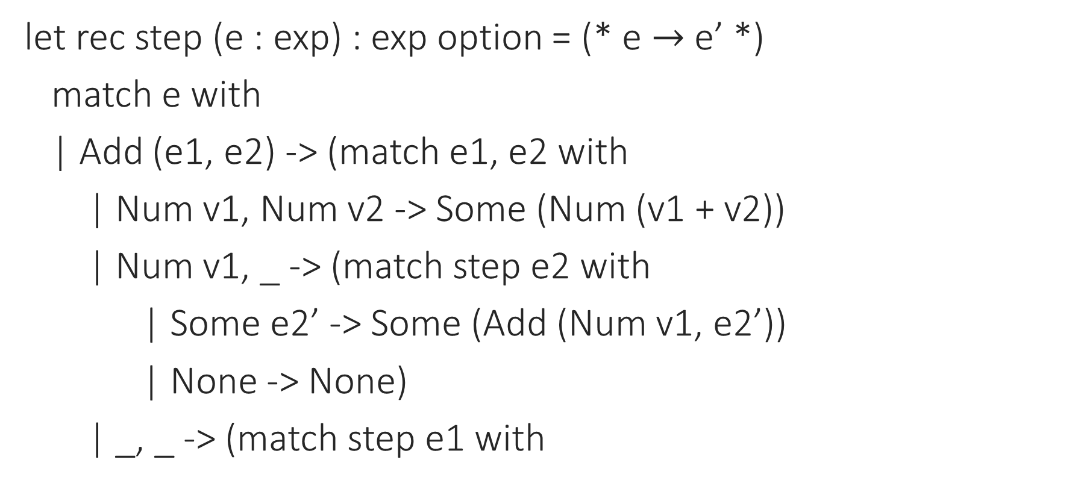
Small-Step Interpreter/Debugger
$$\frac{e_{1}→e_{1}^{′}}{e_{1} \text{+} e_{2}→e_{1}^{′} \text{+} e_{2}}$$
let rec step (e : exp) : exp option = (* e $→$ e’ *)
match e with
| Add (e1, e2) -> (match e1, e2 with
| Num v1, Num v2 -> Some (Num (v1 + v2))
| Num v1, _ -> (match step e2 with
| Some e2’ -> Some (Add (Num v1, e2’))
| None -> None)
| _, _ -> (match step e1 with
$$\frac{e_{2}→e_{2}^{′}}{e_{1} \text{+}{ e}_{2}→e_{1} \text{+} e_{2}^{′}}$$
$$\frac{{(v}_{1} + v_{2}=v)}{v_{1} \text{+} v_{2}→v}$$

Slide 39
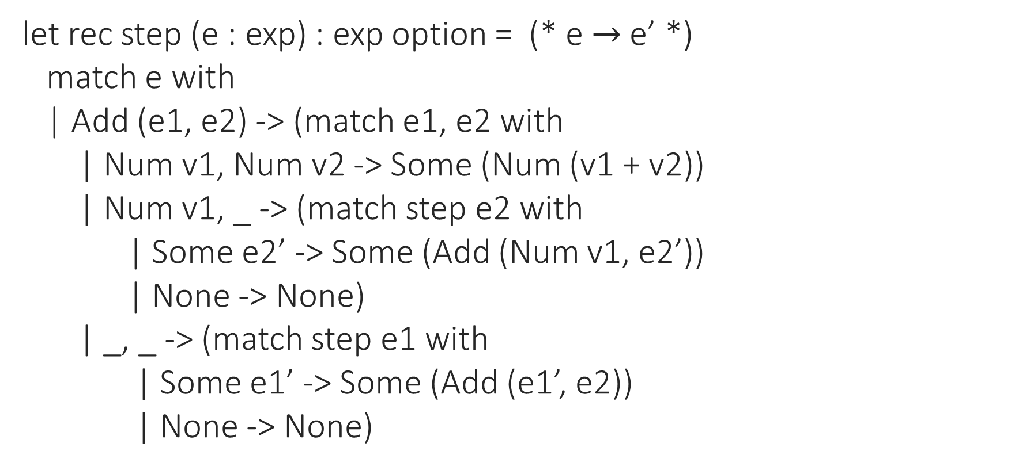
Small-Step Interpreter/Debugger
$$\frac{e_{1}→e_{1}^{′}}{e_{1} \text{+} e_{2}→e_{1}^{′} \text{+} e_{2}}$$
let rec step (e : exp) : exp option = (* e $→$ e’ *)
match e with
| Add (e1, e2) -> (match e1, e2 with
| Num v1, Num v2 -> Some (Num (v1 + v2))
| Num v1, _ -> (match step e2 with
| Some e2’ -> Some (Add (Num v1, e2’))
| None -> None)
| _, _ -> (match step e1 with
| Some e1’ -> Some (Add (e1’, e2))
| None -> None)
$$\frac{e_{2}→e_{2}^{′}}{e_{1} \text{+}{ e}_{2}→e_{1} \text{+} e_{2}^{′}}$$
$$\frac{{(v}_{1} + v_{2}=v)}{v_{1} \text{+} v_{2}→v}$$

Slide 40
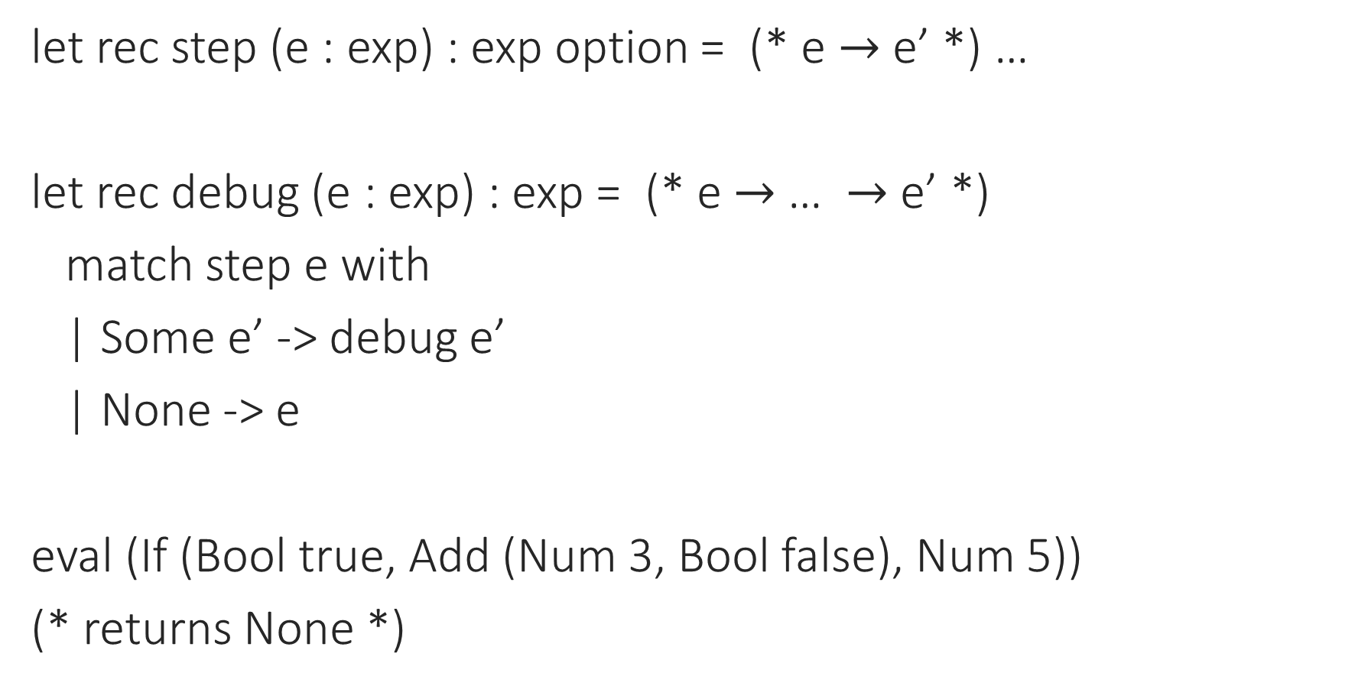
Small-Step Interpreter/Debugger
let rec step (e : exp) : exp option = (* e $→$ e’ *) …
let rec debug (e : exp) : exp = (* e $→$ … $→$ e’ *)
match step e with
| Some e’ -> debug e’
| None -> e
eval (If (Bool true, Add (Num 3, Bool false), Num 5))
(* returns None *)

Slide 41
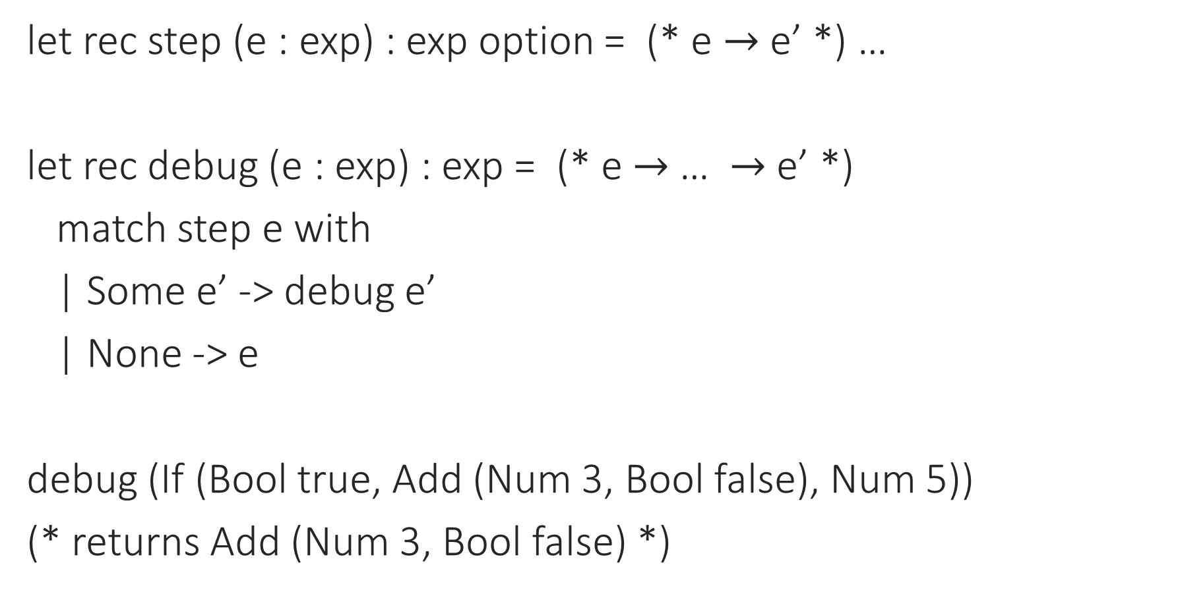
Small-Step Interpreter/Debugger
let rec step (e : exp) : exp option = (* e $→$ e’ *) …
let rec debug (e : exp) : exp = (* e $→$ … $→$ e’ *)
match step e with
| Some e’ -> debug e’
| None -> e
debug (If (Bool true, Add (Num 3, Bool false), Num 5))
(* returns Add (Num 3, Bool false) *)

Slide 42
Notes:
Poll Title: Do not modify the notes in this section to avoid tampering with the Poll Everywhere activity.
More info at polleverywhere.com/support
Questions
https://www.polleverywhere.com/discourses/SRzwhp4zztmGWgIgz520A

