Slide 1
CS 476 – Programming Language Design
William Mansky

Slide 2
Imperative Languages
Arithmetic and boolean expressions
Variables and assignment
Control flow (conditionals, loops)
Variable declarations
Function declarations and calls
There’s more, but we’ve covered the essentials!

Slide 3
An Overview of Programming Languages
What counts as a programming language?
What kinds of programming languages are there?
Where did they come from? Why are there so many?
Do the differences between them really matter?

Slide 4
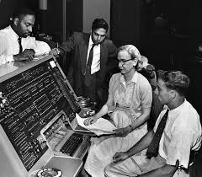
History of Programming Languages
1945: ENIAC, the first programmable computer, is built, programmed by setting switches (machine language, 1’s and 0’s)
1947: Kathleen Booth invents assembly language
1951-1952: Grace Hopper and her team invent A-0, a very low-level compiler
1955-1959: Hopper invents FLOW-MATIC, the first programming language with English-like syntax, which later becomes part of COBOL
1957: an IBM team led by John Backus
releases the FORTRAN compiler, the first
commercially available compiler
1960: FORTRAN, COBOL, ALGOL, and LISP
become the four main programming languages
1970—: They inspire an explosion of new
languages

Slide 5
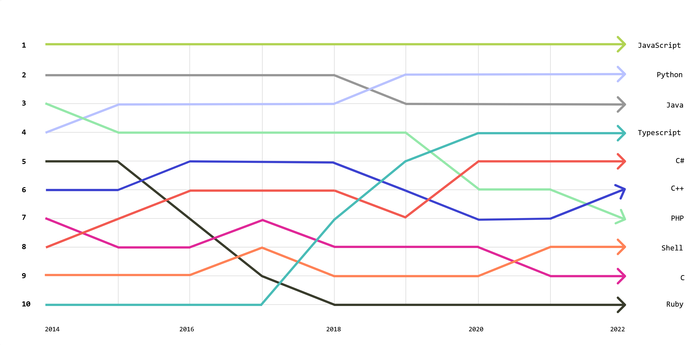
An Overview of Programming Languages
https://octoverse.github.com/2022/top-programming-languages

Slide 6
Kinds of Languages
Imperative: C, Rust, …
Object-oriented: Java, C++, C#, …
Functional: OCaml, F#, Haskell, Lisp, …
Logic: Prolog, Datalog, …
Scripting: JavaScript, Python, PHP, Ruby, shell script(?)
Systems: C, C++, Rust

Slide 7
An Overview of Programming Languages
Genealogy: https://erkin.party/blog/190208/spaghetti/
Over 900 listed on https://www.rosettacode.org/wiki/Category:Programming_Languages

Slide 8
Why are there so many languages?
Example: the ML family
1970s: Robin Milner’s group at U. Edinburgh develops Meta Language (ML) to implement a proof-checking program
1980s: the original ML team develops Standard ML (SML), while a team at INRIA builds their own version, Caml
1996: the Caml team rebuilds the compiler from scratch and adds object-oriented features, making OCaml
  Meanwhile, SML adds its own set of extensions! vectors, etc.
2005: Don Syme at Microsoft Research implements a .NET version of (part of) OCaml, which becomes F#
And it keeps going: Manticore for parallel programming, F* and Coq for theorem proving, …

Slide 9
An Overview of Programming Languages
What counts as a programming language?
What kinds of programming languages are there?
Where did they come from? Why are there so many?
Do the differences between them really matter?
Exercise: What language, or kind of language, are you most interested in learning more about?

Slide 10

Notes:
Poll Title: Do not modify the notes in this section to avoid tampering with the Poll Everywhere activity.
More info at polleverywhere.com/support
Questions
https://www.polleverywhere.com/discourses/SRzwhp4zztmGWgIgz520A

Slide 11
Making a New Language
Reasons for making a new language:
  To change the syntax
  To make a design decision in the other direction
  To make a common pattern easier to write
  To make (certain kinds of) programs run faster
  To combine features that can’t easily be added on to an existing language
  More reasons than I can think of!

Slide 12
Where languages come from
Old languages: academia, industry
New languages: industry, the open-source community
Corporate control, the rise and fall of Swift/Kotlin
Something about the Rust Foundation

Slide 13
Combining Language Features
Functional programming features in imperative/OO languages:
f = lambda x : x + 1 # evaluates to a closure
match event.get():
case Click((x, y), button=Button.LEFT):
handle_click_at(x, y)
case Click():
pass # ignore other clicks
Notes:
Some features mesh fairly neatly into existing languages.

Slide 14
Combining Language Features
Functional programming features in imperative/OO languages:
F# combines OO and universal polymorphism
There are now two “anything” types: Object and ‘a
  Generic functions are defined with universal types
  Other .NET methods (ToString, etc.) are defined on Object
  Type inference may infer Object or ‘a as the type of an argument depending on how it’s used, unpredictably
  Reflection makes this even worse: “generic” functions can case on the type of the input, turning polymorphism ad-hoc
Notes:
This happens in F#!

Slide 15
Turing-Incomplete Languages
We don’t have to choose language based on what’s possible to compute
And our languages don’t have to be able to compute everything!
There are some useful Turing-incomplete domain-specific languages (DSLs):
  Regular expressions
  HTML
  Some versions of SQL
  Interactive theorem provers
Notes:
See also https://www.gabrielpickard.com/turing-incomplete_edited.pdf

Slide 16
Notes:
Poll Title: Do not modify the notes in this section to avoid tampering with the Poll Everywhere activity.
More info at polleverywhere.com/support
Questions
https://www.polleverywhere.com/discourses/SRzwhp4zztmGWgIgz520A

Slide 17
Choosing a Language
We don’t have to choose a language based on what’s possible to compute
Reasons for choosing a language:
  Familiarity
  Existing/legacy code
  Support infrastructure (libraries, IDEs, …)
  Performance
  Paradigm/ease of expressing certain kinds of ideas
Exercise: Why might you write a new language instead of using an existing one?
Notes:
What about making a new language?

Slide 18
Representing Ideas in Code

Slide 19
Notes:
Poll Title: Do not modify the notes in this section to avoid tampering with the Poll Everywhere activity.
More info at polleverywhere.com/support
Questions
https://www.polleverywhere.com/discourses/SRzwhp4zztmGWgIgz520A

