Slide 1
CS 476 – Programming Language Design
William Mansky

Slide 2

Notes:
Poll Title: Do not modify the notes in this section to avoid tampering with the Poll Everywhere activity.
More info at polleverywhere.com/support
Questions
https://www.polleverywhere.com/discourses/p2pykZB7ifMumvCFR9ys1

Slide 3
Structure of a Language
Syntax
  Abstract – what are the pieces of a program?
  Concrete – what do programs look like?
Semantics
  Static – what are acceptable programs?
  Dynamic – what do programs do when we run them?
Pragmatics
  Implementation – how can we actually make the semantics happen?
  IDE, tool support, etc.
Notes:
We’ll focus mainly on these points: (abstract syntax, semantics, a bit of implementation)

Slide 4
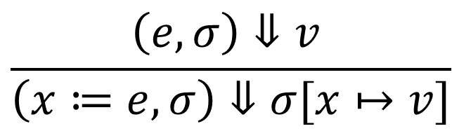
Metalanguages
We want to describe how languages should work, and write code that actually runs those languages
Natural language: “x := y + z sets x to be y plus z”
Inference rules:
OCaml: match s with
| Assign x e => update env x (eval env e)
We’ll learn to translate between these three metalanguages!
$$\frac{\left(e,σ\right)⇓v }{\left(x≔e,σ\right)⇓σ[x↦v]}$$
Notes:
Let’s see how this works for syntax, starting from a natural-language description.

Slide 5
Defining Syntax for a Language
This language has expressions and commands
Expressions are things like adding or subtracting two numbers, or calling a function
Commands include assigning values to variables, and if-then-else blocks
Notes:
Suppose we start with an English-language description of a programming language.

Slide 6
Defining Syntax for a Language
This language has expressions E and commands C
Expressions are things like adding two numbers, or calling a function
Commands include assigning values to variables, and if-then-else blocks

Slide 7
Defining Syntax for a Language
This language has expressions E and commands C
E := <num> + <num> | <name> ( E )
Commands include assigning values to variables, and if-then-else blocks

Slide 8
Defining Syntax for a Language
This language has expressions E and commands C
E := <num> + <num> | <name> ( E )
C := <name> = E ; | if ( E ) { C } else { C }

Slide 9
Context-Free Grammars
A series of rules describing a set of strings (“language”)
Each rule has a nonterminal on the left, and a sequence of nonterminals and terminals (letters, numbers, operators, etc.) on the right
E := <num> + <num> | <name> ( E )
C := <name> = E ; | if ( E ) { C } else { C }
nonterminals: E C terminals: <num> <name> + ( ) = ; if else { }

Slide 10
Context-Free Grammars
A series of rules describing a set of strings (“language”)
Any string that can be made by applying the rules belongs to the language
E := <num> + <num> | <name> ( E )
C := <name> = E ; | if ( E ) { C } else { C }
C

Slide 11
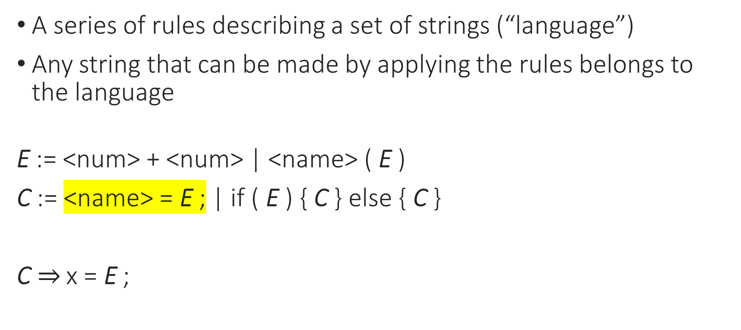
Context-Free Grammars
A series of rules describing a set of strings (“language”)
Any string that can be made by applying the rules belongs to the language
E := <num> + <num> | <name> ( E )
C := <name> = E ; | if ( E ) { C } else { C }
C$⇒$ x = E ;

Slide 12
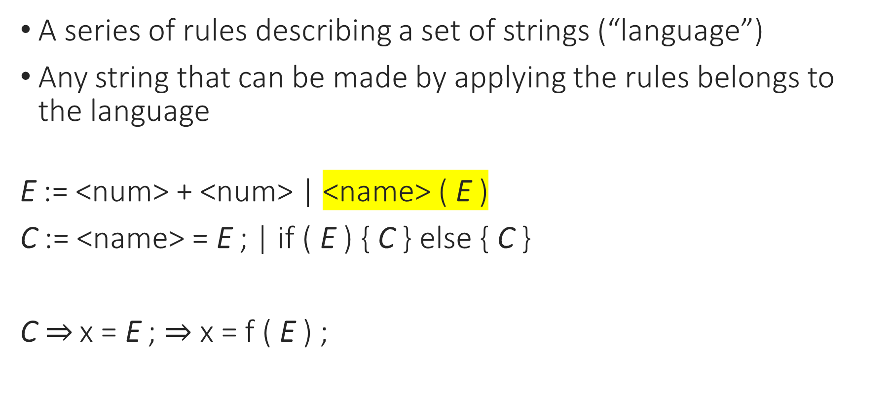
Context-Free Grammars
A series of rules describing a set of strings (“language”)
Any string that can be made by applying the rules belongs to the language
E := <num> + <num> | <name> ( E )
C := <name> = E ; | if ( E ) { C } else { C }
C$⇒$ x = E ; $⇒$ x = f ( E ) ;

Slide 13
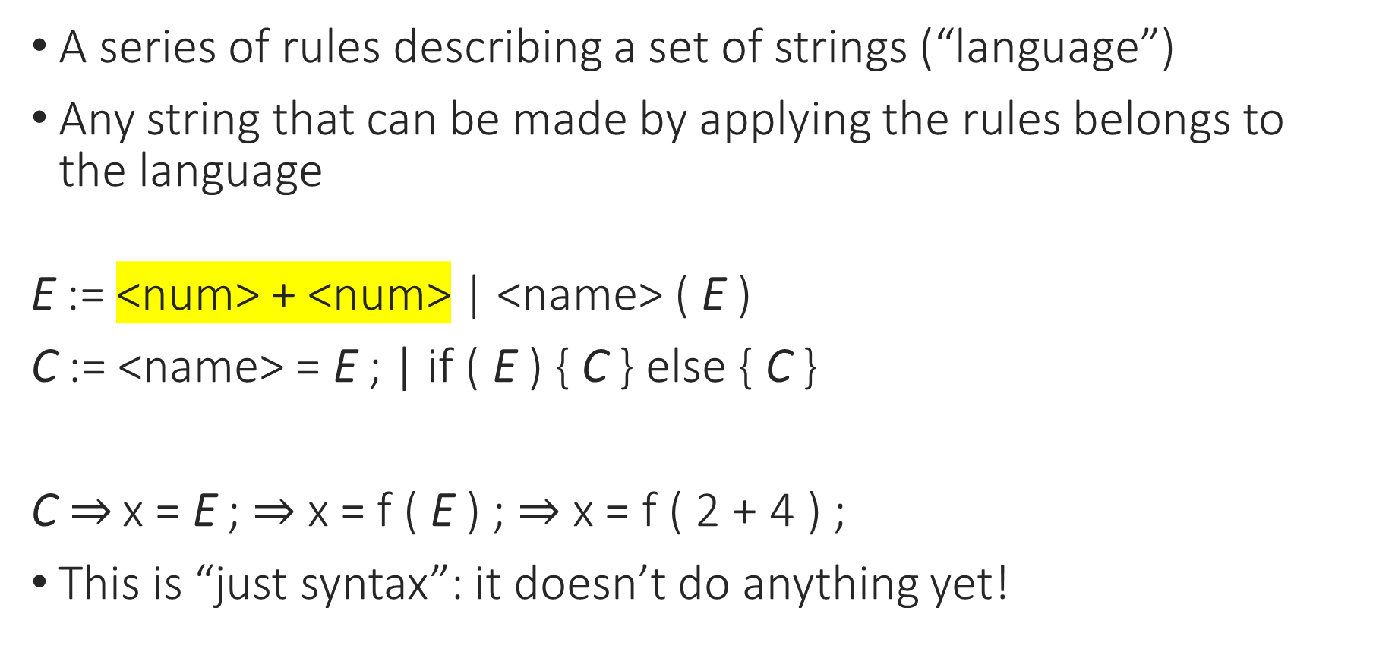
Context-Free Grammars
A series of rules describing a set of strings (“language”)
Any string that can be made by applying the rules belongs to the language
E := <num> + <num> | <name> ( E )
C := <name> = E ; | if ( E ) { C } else { C }
C$⇒$ x = E ; $⇒$ x = f ( E ) ; $⇒$ x = f ( 2 + 4 ) ;
This is “just syntax”: it doesn’t do anything yet!
A program in the language of the grammar

Slide 14
Notes:
Poll Title: Do not modify the notes in this section to avoid tampering with the Poll Everywhere activity.
More info at polleverywhere.com/support
Questions
https://www.polleverywhere.com/discourses/p2pykZB7ifMumvCFR9ys1

Slide 15
Context-Free Grammars
A series of rules describing a set of strings (“language”)
…that looks a lot like an inductive datatype!
E := <num> + <num> | <name> ( E )
C := <name> = E ; | if ( E ) { C } else { C }
type E = Add | Call
type C = Assign | If

Slide 16
Context-Free Grammars
A series of rules describing a set of strings (“language”)
…that looks a lot like an inductive datatype!
We’re interested in the abstract syntax, the parts that can vary
E := <num> + <num> | <name> ( E )
C := <name> = E ; | if ( E ) { C } else { C }
type E = Add | Call
type C = Assign | If

Slide 17
Context-Free Grammars
A series of rules describing a set of strings (“language”)
…that looks a lot like an inductive datatype!
We’re interested in the abstract syntax, the parts that can vary
E := <num> + <num> | <name> ( E )
C := <name> = E ; | if ( E ) { C } else { C }
type E = Add of int * int | Call
type C = Assign | If

Slide 18
Context-Free Grammars
A series of rules describing a set of strings (“language”)
…that looks a lot like an inductive datatype!
We’re interested in the abstract syntax, the parts that can vary
E := <num> + <num> | <name> ( E )
C := <name> = E ; | if ( E ) { C } else { C }
type E = Add of int * int | Call of name * E
type C = Assign | If

Slide 19
Context-Free Grammars
A series of rules describing a set of strings (“language”)
…that looks a lot like an inductive datatype!
We’re interested in the abstract syntax, the parts that can vary
E := <num> + <num> | <name> ( E )
C := <name> = E ; | if ( E ) { C } else { C }
type E = Add of int * int | Call of name * E
type C = Assign | If

Slide 20
Context-Free Grammars
A series of rules describing a set of strings (“language”)
…that looks a lot like an inductive datatype!
We’re interested in the abstract syntax, the parts that can vary
E := <num> + <num> | <name> ( E )
C := <name> = E ; | if ( E ) { C } else { C }
type E = Add of int * int | Call of name * E
type C = Assign of name * E | If of E * C * C

Slide 21
Notes:
Poll Title: Do not modify the notes in this section to avoid tampering with the Poll Everywhere activity.
More info at polleverywhere.com/support
Questions
https://www.polleverywhere.com/discourses/p2pykZB7ifMumvCFR9ys1

Slide 22
Grammars: Variations
E := <num> + <num> | <name> ( E )
C := <name> = E ; | if ( E ) { C } else { C }
type E = Add of int * int | Call of name * E
type C = Assign of name * E | If of E * C * C
Exercise: Change one thing about the grammar of the language. How would that change the OCaml types?

Slide 23
Grammars: Variations
E := <num> + <num> | <name> ( E )
C := <name> := E | if E then C else C
type E = Add of int * int | Call of name * E
type C = Assign of name * E | If of E * C * C
Exercise: Change one thing about the grammar of the language. How would that change the OCaml types?
Notes:
Changing the concrete syntax doesn’t change the types at all.

Slide 24
Grammars: Variations
E := <num> + <num> - <num> | <name> ( E )
C := <name> = E ; | if ( E ) { C } else { C }
type E = Add of int * int * int | Call of name * E
type C = Assign of name * E | If of E * C * C
Exercise: Change one thing about the grammar of the language. How would that change the OCaml types?
Notes:
Removing the else case’s command would remove an argument.

Slide 25
Grammars: Variations
E := <num> + <num> | <name> ( E ) | <num> * 2
C := <name> = E ; | if ( E ) { C } else { C } | C; C
type E = Add of int * int | Call of name * E | Mul2 of int
type C = Assign of name * E | If of E * C * C | Seq of C * C
Exercise: Change one thing about the grammar of the language. How would that change the OCaml types?
Notes:
Adding new cases adds new constructors. (Make sure to give them distinct names!)
How about <num> * 2?

Slide 26
Grammars: Variations
E := <num> + <num> | <name> ( E )
C := <name> = E ; | if ( E ) { C } else { C }
type E = Add of int * int | Call of name * E
type C = Assign of name * E | If of E * C * C
Exercise: Change one thing about the grammar of the language. How would that change the OCaml types?
Notes:
AddSub, and the parts that do and don’t matter

Slide 27
Notes:
Poll Title: Do not modify the notes in this section to avoid tampering with the Poll Everywhere activity.
More info at polleverywhere.com/support
Questions
https://www.polleverywhere.com/discourses/p2pykZB7ifMumvCFR9ys1

Slide 28
Defining Syntax for a Language
Step 1: write down what’s in the language in English
Step 2: write a grammar that describes all possible programs
Step 3: write a datatype that abstracts the grammar
Result: a datatype of programs in the language

Slide 29
Writing Functions on Syntax
type E = Add of int * int | Call of name * E
type C = Assign of name * E | If of E * C * C
let my_prog : C = If (Add (3, 4), Assign (“x”, Add (3, 4)), …)
let rec print_vars (prog : C) =
match prog with
| Assign (x, e) -> print_string x
| If (cond, tcase, fcase) ->
print_vars tcase; print_vars fcase

Slide 30
Writing Functions on Syntax
Step 1: write down what’s in the language in English
Step 2: write a grammar that describes all possible programs
Step 3: write a datatype that abstracts the grammar
Result: a datatype of programs in the language
Now we can write programs that operate on programs!

Slide 31
Notes:
Poll Title: Do not modify the notes in this section to avoid tampering with the Poll Everywhere activity.
More info at polleverywhere.com/support
Questions
https://www.polleverywhere.com/discourses/p2pykZB7ifMumvCFR9ys1

