Slide 1
CS 476 – Programming Language Design
William Mansky

Slide 2
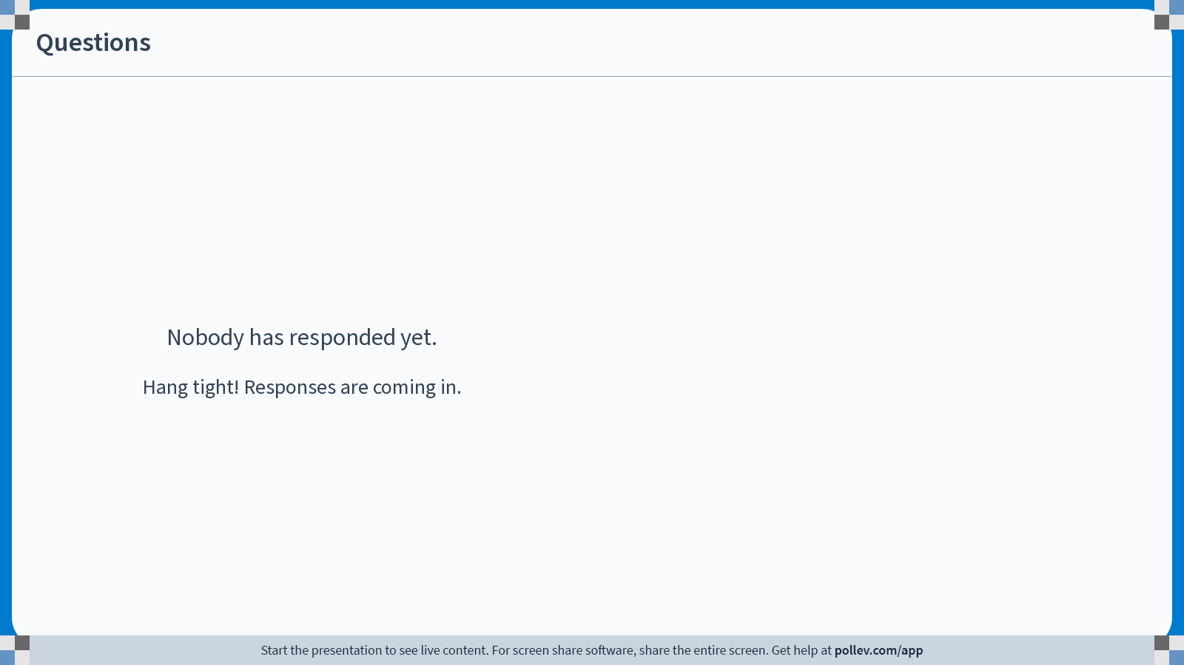
Notes:
Poll Title: Do not modify the notes in this section to avoid tampering with the Poll Everywhere activity.
More info at polleverywhere.com/support
Questions
https://www.polleverywhere.com/discourses/SRzwhp4zztmGWgIgz520A

Slide 3
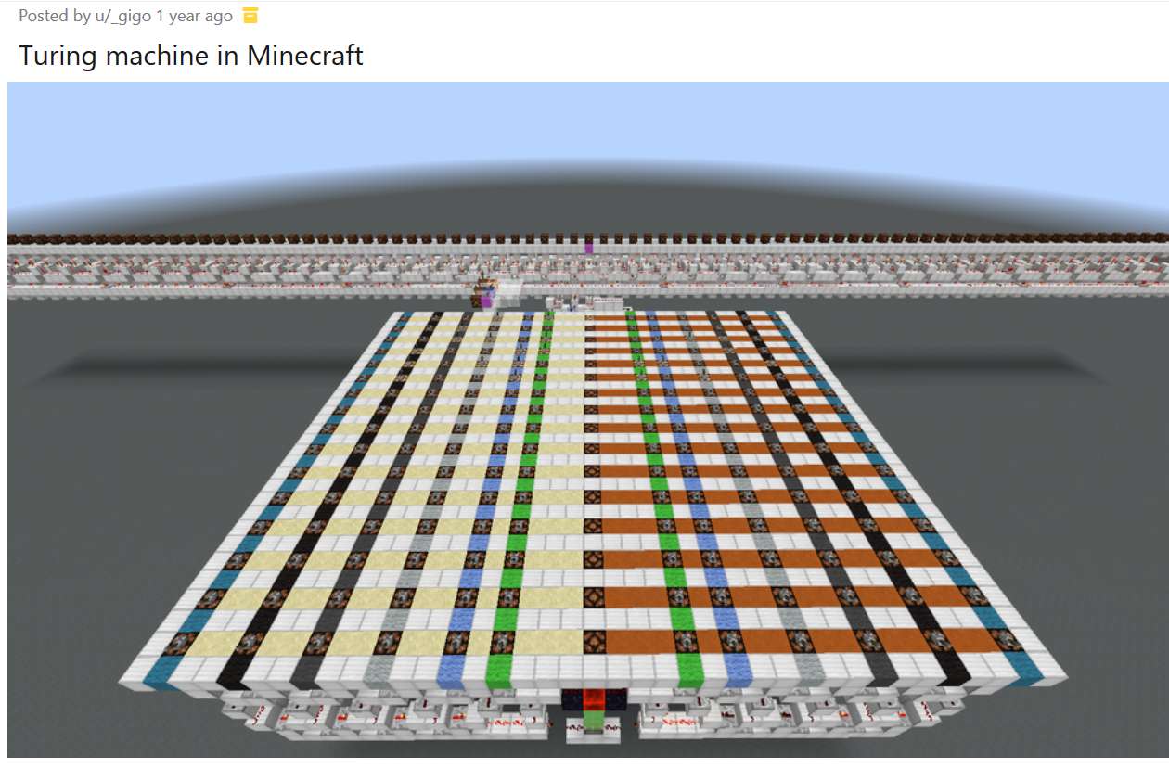
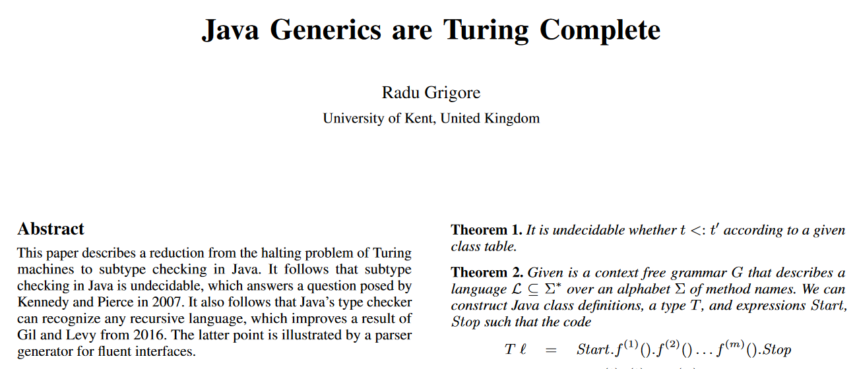
Turing-Completeness
Almost every programming language is Turing-complete: it can theoretically express any computation
And so are a lot of other things:
Notes:
Obviously you’re not going to write your next program in MtG. So what does this mean in practice?

Slide 4
Turing-Completeness: Representation
Functional, imperative, etc. languages can all simulate each other
We can define any language in OCaml (syntax, type system, semantics, interpreter)
  Or in C, or in Java, or…
We don’t have to choose language based on what’s possible to compute

Slide 5
Turing-Incomplete Languages
We don’t have to choose language based on what’s possible to compute
But also, our languages don’t have to be able to compute everything!
There are some useful Turing-incomplete domain-specific languages (DSLs):
  Regular expressions
  HTML
  Some versions of SQL
  Configuration languages
  Interactive theorem provers
Notes:
See also https://www.gabrielpickard.com/turing-incomplete_edited.pdf

Slide 6
Turing-Incomplete Languages
E ::= <#> | <ident>
| E + E | E – E | E * E
| <bool>
| E and E | E or E
| not E
| E = E
C ::= <ident> := E
| C; C
| skip
| if(E){ C } else { C }
| while(E) { C }
Notes:
If we rule out infinite loops, the language is automatically Turing-incomplete.

Slide 7
Turing-Incomplete Languages
E ::= <#> | <ident>
| E + E | E – E | E * E
| <bool>
| E and E | E or E
| not E
| E = E
C ::= <ident> := E
| C; C
| skip
| if(E){ C } else { C }
| while(E) max <#> { C }
while(x > 0) max 10 {
y := y * x; x := x – 1; }
Notes:
If we rule out infinite loops, the language is automatically Turing-incomplete.

Slide 8
Turing-Incomplete Languages
E ::= <#> | <ident>
| E + E | E – E | E * E
| <bool>
| E and E | E or E
| not E
| E = E
C ::= <ident> := E
| C; C
| skip
| if(E){ C } else { C }
| while(E) max E { C }
while(x > 0) max x {
y := y * x; x := x – 1; }
Notes:
If we rule out infinite loops, the language is automatically Turing-incomplete.

Slide 9
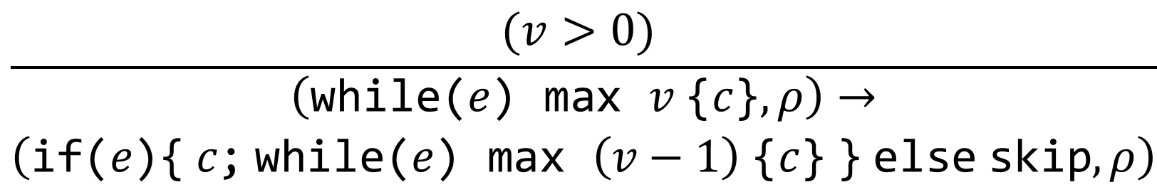
Turing-Incomplete Languages
$$\frac{(v>0) }{\begin{aligned}\left(\text{while}\text{(}e\text{)} \text{max} v \text{\{}c\text{\}},ρ\right)→ \\ \left(\text{if}\text{(}e\text{)\{} c\text{;} \text{while}\text{(}e\text{)} \text{max} \left(v−1\right) \text{\{}c\text{\}} \text{\}} \text{else} \text{skip},ρ\right)\end{aligned}}$$
C ::= … | while(E) max E { C }
while(x > 0) max x {
y := y * x; x := x – 1; }
Notes:
If we rule out infinite loops, the language is automatically Turing-incomplete.

Slide 10
Turing-Incomplete Languages
Our languages don’t have to be able to compute everything!
There are some useful Turing-incomplete domain-specific languages (DSLs):
  Regular expressions
  HTML
  Some versions of SQL
  Interactive theorem provers
And we can make a Turing-incomplete general-purpose language just by bounding loops
  But there will be some functions we can’t compute, and we won’t know which until we try!
Notes:
See also https://www.gabrielpickard.com/turing-incomplete_edited.pdf

Slide 11
Notes:
Poll Title: Do not modify the notes in this section to avoid tampering with the Poll Everywhere activity.
More info at polleverywhere.com/support
Questions
https://www.polleverywhere.com/discourses/SRzwhp4zztmGWgIgz520A

Slide 12
Course Evaluations
Exercise: Please take a few minutes to fill out the course evaluation, and then submit “finished” for Exercise 11/29.
If you’d rather not and still want to get credit for the exercise, you can submit “finished” anyway.
Thank you for your feedback!

