Slide 1
CS 476 – Programming Language Design
William Mansky

Slide 2

Notes:
Poll Title: Do not modify the notes in this section to avoid tampering with the Poll Everywhere activity.
More info at polleverywhere.com/support
Questions
https://www.polleverywhere.com/discourses/SRzwhp4zztmGWgIgz520A

Slide 3
From Typed Lambda Calculus to OCaml
User-friendly syntax
Basic types, tuples, records
Inductive datatypes and pattern-matching
Local declarations
References
Type inference
Generics/polymorphism
Notes:
In theory, this is a nice-to-have, but in practice it makes OCaml programming much smoother.

Slide 4
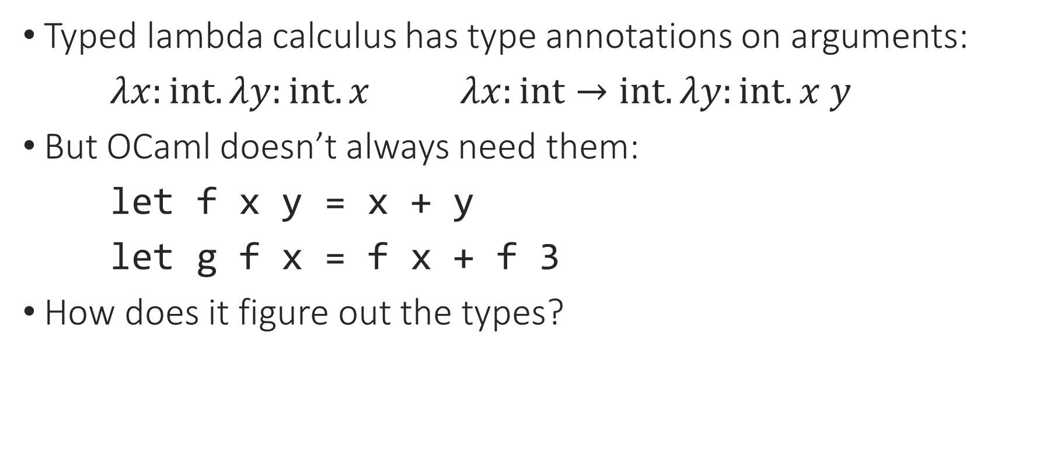
Type Inference
Typed lambda calculus has type annotations on arguments:
$λx:int. λy:int. x$ $λx:int→int. λy:int. x y$
But OCaml doesn’t always need them:
let f x y = x + y
let g f x = f x + f 3
How does it figure out the types?
Notes:
We’ve run into two inference from two angles now.

Slide 5
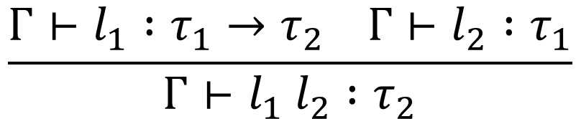
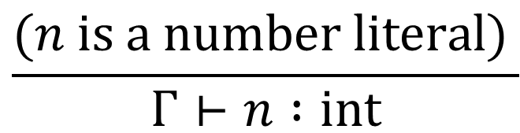
Type Inference
Our typing rules have the form:
First-pass inference algorithm: mark literals with their types, then pass types down through the proof tree
  Like the type_of function for imperative/OO expressions
$$\frac{Γ⊢l_{1} :τ_{1}→τ_{2} Γ⊢l_{2} :τ_{1}}{Γ⊢l_{1} l_{2} :τ_{2}}$$
$$\frac{(n is a number literal) }{Γ⊢n :int}$$
Notes:
We’ve run into two inference from two angles now.

Slide 6
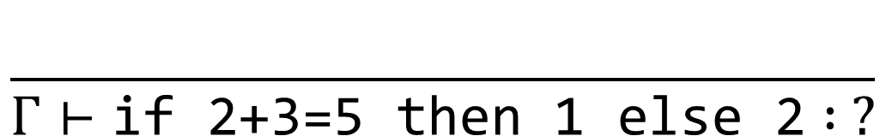
Direct Type Inference
$$\frac{}{Γ⊢\text{if}\text{ 2+3=5 }\text{then}\text{ 1 }\text{else}\text{ 2} : ?}$$

Slide 7
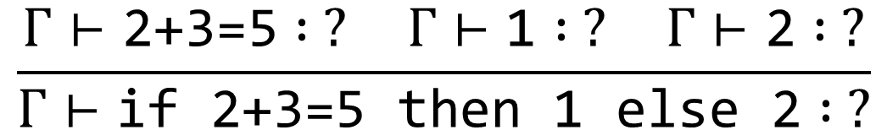
Direct Type Inference
$$\frac{Γ⊢\text{2+3=5} : ? Γ⊢\text{1} : ? Γ⊢\text{2} : ?}{Γ⊢\text{if}\text{ 2+3=5 }\text{then}\text{ 1 }\text{else}\text{ 2} : ?}$$

Slide 8
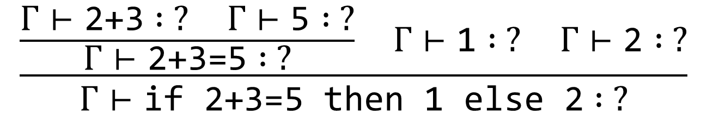
Direct Type Inference
$$\frac{\frac{Γ⊢\text{2+3} : ? Γ⊢\text{5} : ?}{Γ⊢\text{2+3=5} : ?} Γ⊢\text{1} : ? Γ⊢\text{2} : ?}{Γ⊢\text{if}\text{ 2+3=5 }\text{then}\text{ 1 }\text{else}\text{ 2} : ?}$$

Slide 9
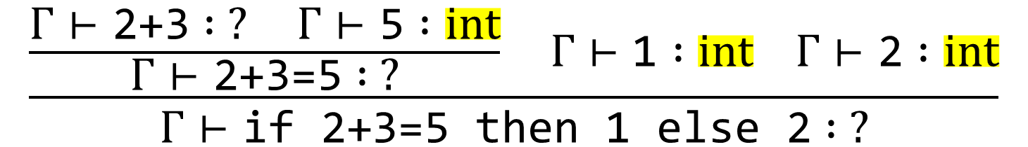
Direct Type Inference
$$\frac{\frac{Γ⊢\text{2+3} : ? Γ⊢\text{5} :int}{Γ⊢\text{2+3=5} : ?} Γ⊢\text{1} :int Γ⊢\text{2} :int}{Γ⊢\text{if}\text{ 2+3=5 }\text{then}\text{ 1 }\text{else}\text{ 2} : ?}$$

Slide 10
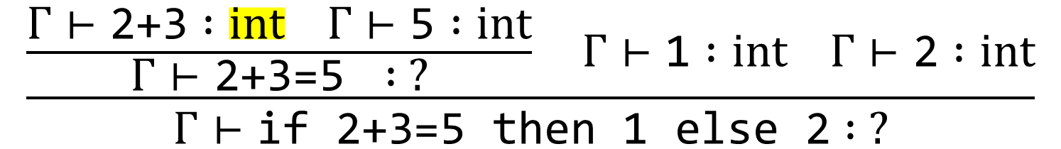
Direct Type Inference
$$\frac{\frac{Γ⊢\text{2+3} :int Γ⊢\text{5} :int}{Γ⊢\text{2+3=5 }: ?} Γ⊢\text{1} :int Γ⊢\text{2} :int}{Γ⊢\text{if}\text{ 2+3=5 }\text{then}\text{ 1 }\text{else}\text{ 2} : ?}$$

Slide 11
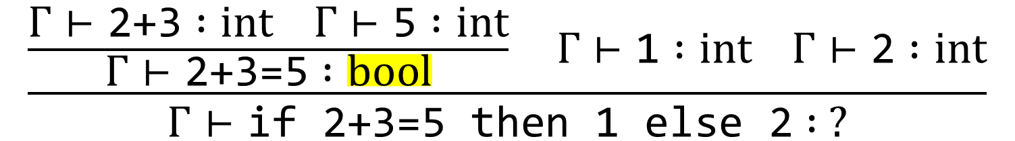
Direct Type Inference
$$\frac{\frac{Γ⊢\text{2+3} :int Γ⊢\text{5} :int}{Γ⊢\text{2+3=5} :bool} Γ⊢\text{1} :int Γ⊢\text{2} :int}{Γ⊢\text{if}\text{ 2+3=5 }\text{then}\text{ 1 }\text{else}\text{ 2} : ?}$$

Slide 12
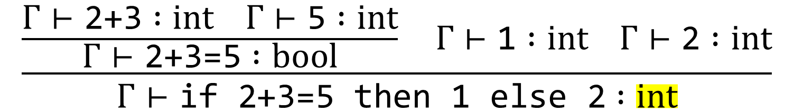
Direct Type Inference
$$\frac{\frac{Γ⊢\text{2+3} :int Γ⊢\text{5} :int}{Γ⊢\text{2+3=5} :bool} Γ⊢\text{1} :int Γ⊢\text{2} :int}{Γ⊢\text{if}\text{ 2+3=5 }\text{then}\text{ 1 }\text{else}\text{ 2} :int}$$

Slide 13
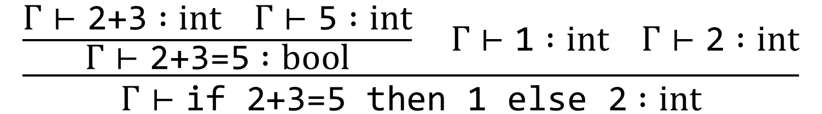
Direct Type Inference
$$\frac{\frac{Γ⊢\text{2+3} :int Γ⊢\text{5} :int}{Γ⊢\text{2+3=5} :bool} Γ⊢\text{1} :int Γ⊢\text{2} :int}{Γ⊢\text{if}\text{ 2+3=5 }\text{then}\text{ 1 }\text{else}\text{ 2} :int}$$
let type_of (e : exp) : typ option =
match e with
| Num i -> Some IntTy
| Add (e1, e2) -> (match type_of e1, type_of e2 with
| Some IntTy, Some IntTy -> Some IntTy
| _ -> None)

Slide 14
Notes:
Poll Title: Do not modify the notes in this section to avoid tampering with the Poll Everywhere activity.
More info at polleverywhere.com/support
Questions
https://www.polleverywhere.com/discourses/SRzwhp4zztmGWgIgz520A

Slide 15
Direct Type Inference
let type_of (gamma : context) (e : exp) : typ option =
match e with
| Num i -> Some IntTy
| Add (e1, e2) -> (match type_of e1, type_of e2 with
| Some IntTy, Some IntTy -> Some IntTy
| _ -> None)
| Var x -> lookup gamma x
Notes:
When we have variables, we rely on already knowing their types.

Slide 16
Type Inference
Exercise: What type does this term have? How would you figure it out?
$$Γ⊢\text{fun} \text{f}\text{ −> }\text{fun} \text{x} \text{−>} \text{f} \text{x} \text{+} \text{f}\text{ 3 :}\text{ ?}$$
Notes:
So how can we handle functions that don’t declare the types of their parameters?

Slide 17
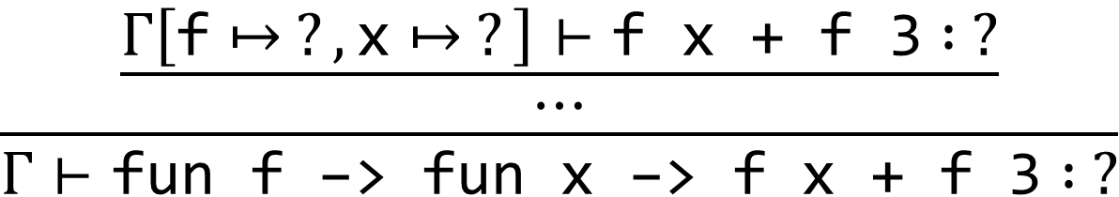
Type Inference
$$\frac{\frac{Γ\left[\text{f}↦ ?,\text{x}↦ ?\right]⊢\text{f} \text{x}\text{ + }\text{f}\text{ 3} : ?}{⋯}}{Γ⊢\text{fun} \text{f}\text{ −> }\text{fun} \text{x}\text{ −> }\text{f} \text{x}\text{ + }\text{f}\text{ 3} : ?}$$
Notes:
But what about terms with variables?

Slide 18
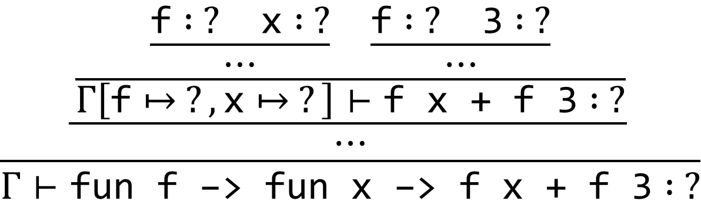
Type Inference
$$\frac{\frac{\frac{\frac{\text{f} : ? \text{x} : ?}{⋯} \frac{\text{f} : ? \text{3} : ?}{⋯}}{Γ\left[\text{f}↦ ?,\text{x}↦ ?\right]⊢\text{f} \text{x}\text{ + }\text{f}\text{ 3} : ?}}{⋯}}{Γ⊢\text{fun} \text{f}\text{ −> }\text{fun} \text{x}\text{ −> }\text{f} \text{x}\text{ + }\text{f}\text{ 3} : ?}$$
Notes:
But what about terms with variables?

Slide 19
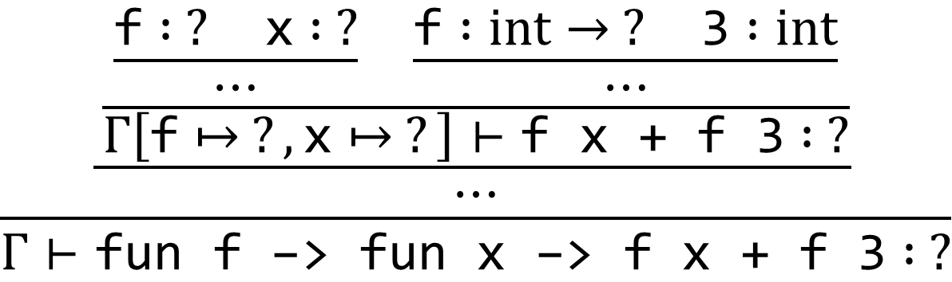
Type Inference
$$\frac{\frac{\frac{\frac{\text{f} : ? \text{x} : ?}{⋯} \frac{\text{f} :int→ ? \text{3} :int}{⋯}}{Γ\left[\text{f}↦ ?,\text{x}↦ ?\right]⊢\text{f} \text{x}\text{ + }\text{f}\text{ 3} : ?}}{⋯}}{Γ⊢\text{fun} \text{f}\text{ −> }\text{fun} \text{x}\text{ −> }\text{f} \text{x}\text{ + }\text{f}\text{ 3} : ?}$$
Notes:
But what about terms with variables?

Slide 20
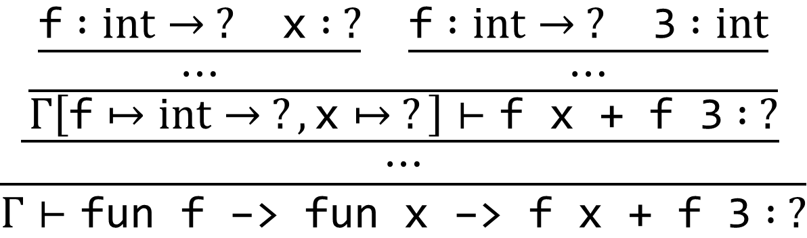
Type Inference
$$\frac{\frac{\frac{\frac{\text{f} :int→ ? \text{x} : ?}{⋯} \frac{\text{f} :int→ ? \text{3} :int}{⋯}}{Γ\left[\text{f}↦int→ ?,\text{x}↦ ?\right]⊢\text{f} \text{x}\text{ + }\text{f}\text{ 3} : ?}}{⋯}}{Γ⊢\text{fun} \text{f}\text{ −> }\text{fun} \text{x}\text{ −> }\text{f} \text{x}\text{ + }\text{f}\text{ 3} : ?}$$
Notes:
But what about terms with variables?

Slide 21
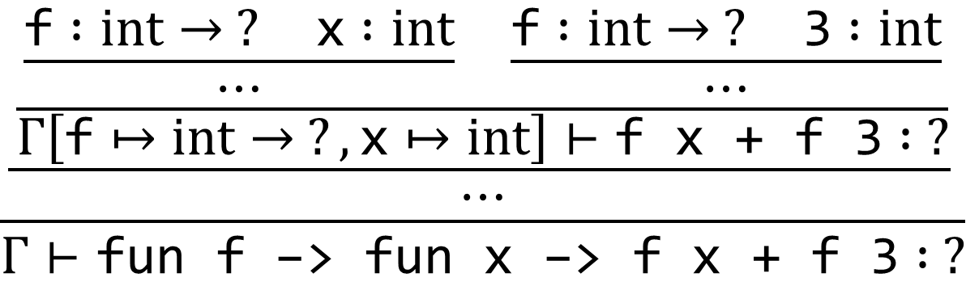
Type Inference
$$\frac{\frac{\frac{\frac{\text{f} :int→ ? \text{x} :int}{⋯} \frac{\text{f} :int→ ? \text{3} :int}{⋯}}{Γ\left[\text{f}↦int→ ?,\text{x}↦int\right]⊢\text{f} \text{x}\text{ + }\text{f}\text{ 3} : ?}}{⋯}}{Γ⊢\text{fun} \text{f}\text{ −> }\text{fun} \text{x}\text{ −> }\text{f} \text{x}\text{ + }\text{f}\text{ 3} : ?}$$
Notes:
But what about terms with variables?

Slide 22
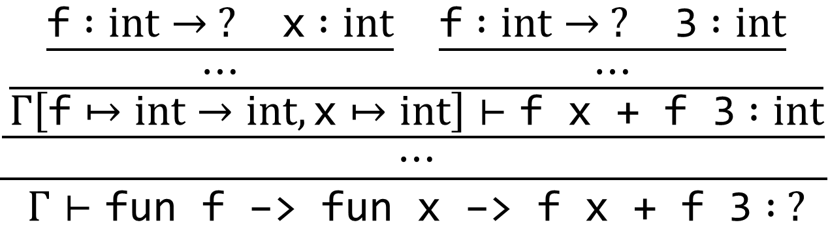
Type Inference
$$\frac{\frac{\frac{\frac{\text{f} :int→ ? \text{x} :int}{⋯} \frac{\text{f} :int→ ? \text{3} :int}{⋯}}{Γ\left[\text{f}↦int→int,\text{x}↦int\right]⊢\text{f} \text{x}\text{ + }\text{f}\text{ 3} :int}}{⋯}}{Γ⊢\text{fun} \text{f}\text{ −> }\text{fun} \text{x}\text{ −> }\text{f} \text{x}\text{ + }\text{f}\text{ 3} : ?}$$
Notes:
But what about terms with variables?

Slide 23
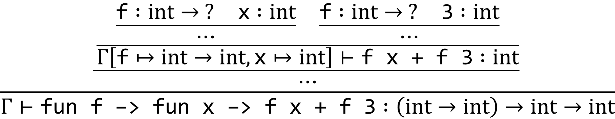
Type Inference
$$\frac{\frac{\frac{\frac{\text{f} :int→ ? \text{x} :int}{⋯} \frac{\text{f} :int→ ? \text{3} :int}{⋯}}{Γ\left[\text{f}↦int→int,\text{x}↦int\right]⊢\text{f} \text{x}\text{ + }\text{f}\text{ 3} :int}}{⋯}}{Γ⊢\text{fun} \text{f}\text{ −> }\text{fun} \text{x}\text{ −> }\text{f} \text{x}\text{ + }\text{f}\text{ 3} :\left(int→int\right)→int→int}$$
Notes:
But what about terms with variables?

Slide 24
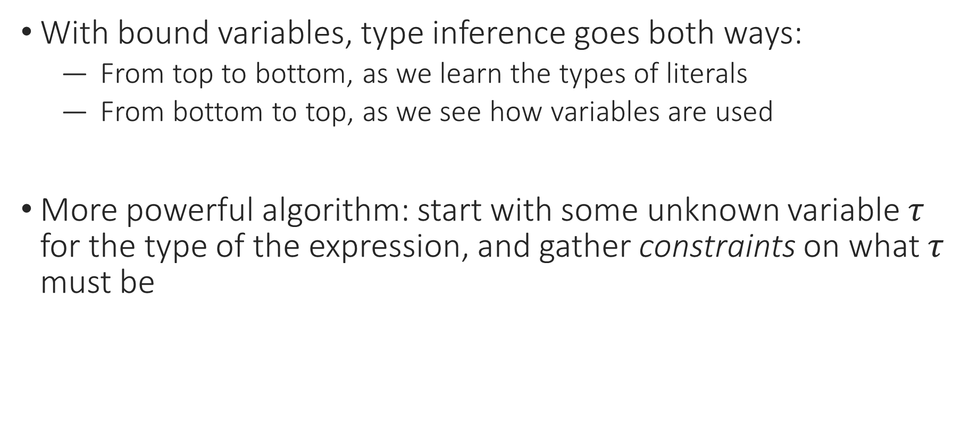
Type Inference
With bound variables, type inference goes both ways:
  From top to bottom, as we learn the types of literals
  From bottom to top, as we see how variables are used
More powerful algorithm: start with some unknown variable $τ$ for the type of the expression, and gather constraints on what $τ$ must be

Slide 25
Notes:
Poll Title: Do not modify the notes in this section to avoid tampering with the Poll Everywhere activity.
More info at polleverywhere.com/support
Questions
https://www.polleverywhere.com/discourses/SRzwhp4zztmGWgIgz520A

Slide 26
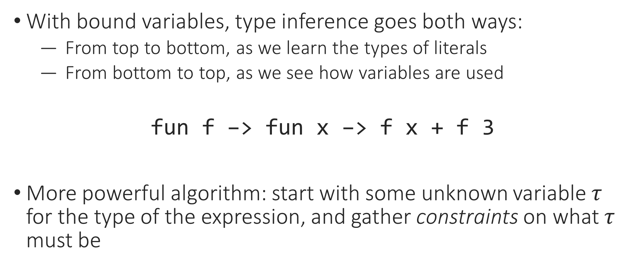
Type Inference
With bound variables, type inference goes both ways:
  From top to bottom, as we learn the types of literals
  From bottom to top, as we see how variables are used
$$\text{fun} \text{f}\text{ −> }\text{fun} \text{x} \text{−>} \text{f} \text{x} \text{+} \text{f}\text{ 3}$$
More powerful algorithm: start with some unknown variable $τ$ for the type of the expression, and gather constraints on what $τ$ must be

Slide 27
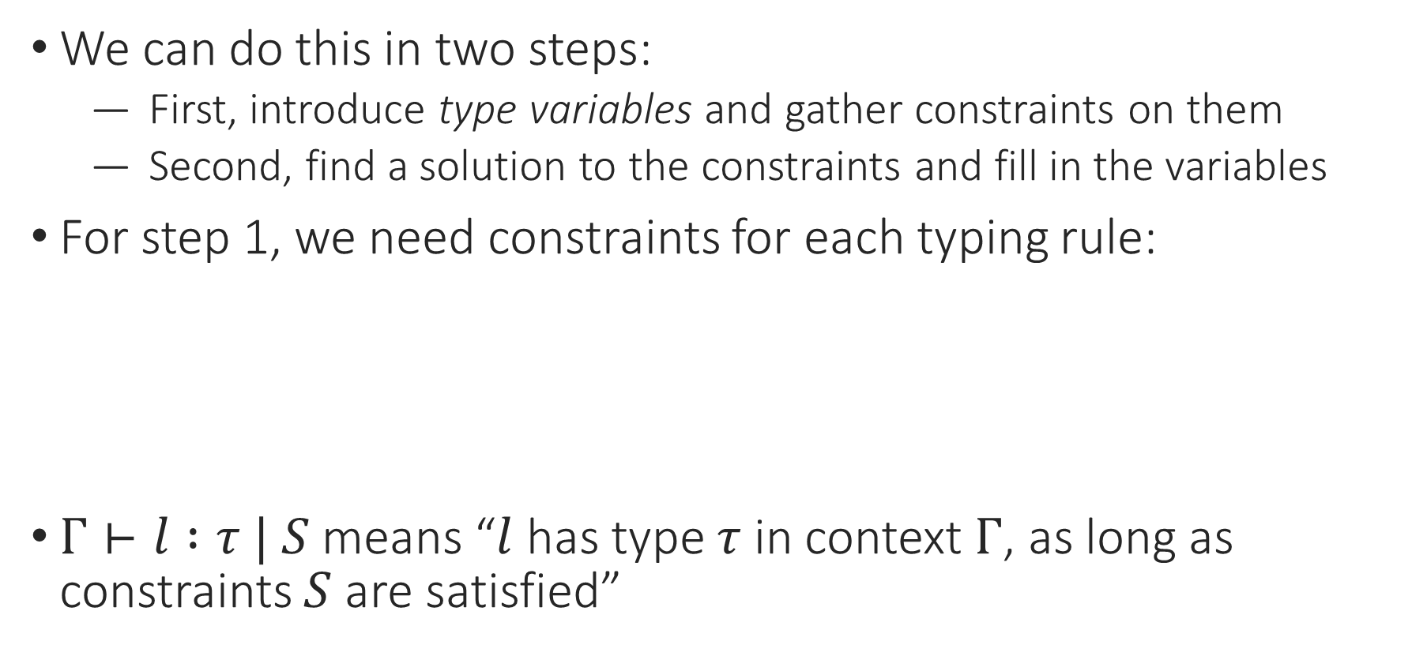
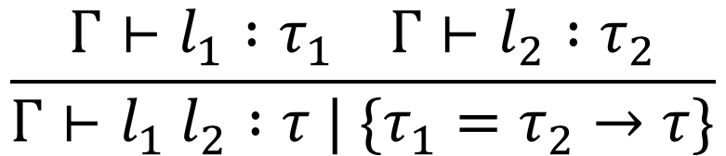
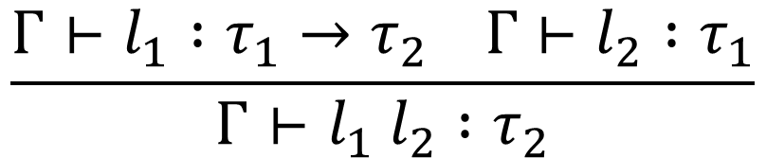
Constraint-Based Type Inference
We can do this in two steps:
  First, introduce type variables and gather constraints on them
  Second, find a solution to the constraints and fill in the variables
For step 1, we need constraints for each typing rule:
$Γ⊢l :τ | S$ means “$l$ has type $τ$ in context $Γ$, as long as constraints $S$ are satisfied”
$$\frac{Γ⊢l_{1} :τ_{1}→τ_{2} Γ⊢l_{2} :τ_{1}}{Γ⊢l_{1} l_{2} :τ_{2}}$$
$$\frac{Γ⊢l_{1} :τ_{1} Γ⊢l_{2} :τ_{2}}{Γ⊢l_{1} l_{2} :τ | \{τ_{1}=τ_{2}→τ\}}$$

Slide 28
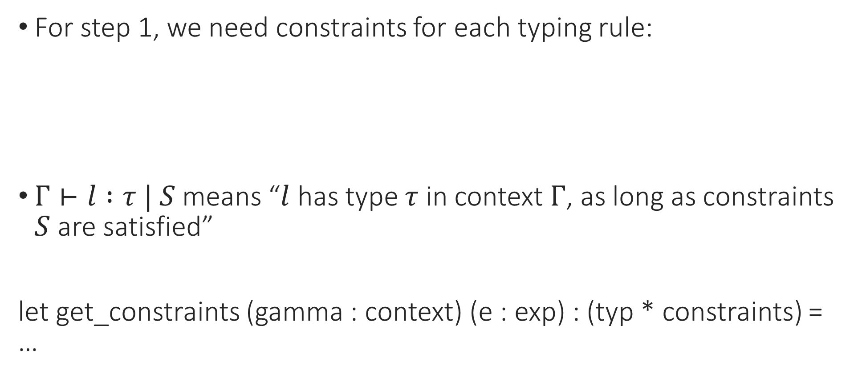
Constraint-Based Type Inference
For step 1, we need constraints for each typing rule:
$Γ⊢l :τ | S$ means “$l$ has type $τ$ in context $Γ$, as long as constraints $S$ are satisfied”
let get_constraints (gamma : context) (e : exp) : (typ * constraints) = …
$$\frac{Γ⊢l_{1} :τ_{1}→τ_{2} Γ⊢l_{2} :τ_{1}}{Γ⊢l_{1} l_{2} :τ_{2}}$$
$$\frac{Γ⊢l_{1} :τ_{1} Γ⊢l_{2} :τ_{2}}{Γ⊢l_{1} l_{2} :τ | \{τ_{1}=τ_{2}→τ\}}$$
Notes:
Where typ now can include these type variables, these “unknown types”.

Slide 29
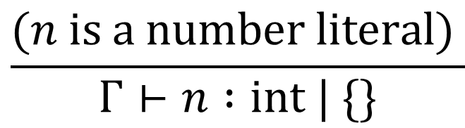
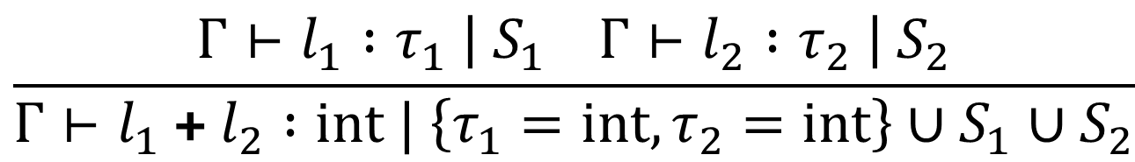
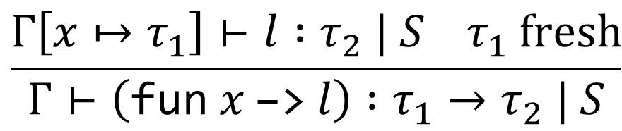
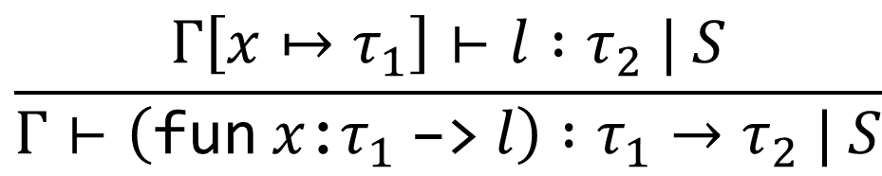
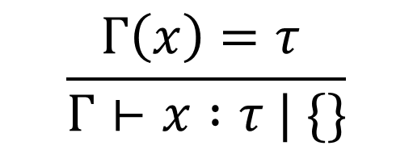
Constraint-Based Type Inference: Rules
$$\frac{(n is a number literal) }{Γ⊢n :int | \{\}}$$
$$\frac{Γ\left(x\right)=τ }{Γ⊢x :τ | \{\}}$$
$$\frac{Γ⊢l_{1} :τ_{1} \left| S_{1} Γ⊢l_{2} :τ_{2} \right| S_{2}}{Γ⊢l_{1} \text{+} l_{2} :int | \left\{τ_{1}=int,τ_{2}=int\right\}∪S_{1}∪S_{2}}$$
$$\frac{Γ\left[x↦τ_{1}\right]⊢l :τ_{2} | S}{Γ⊢\left(\text{fun} x \text{:}τ_{1} \text{−>} l\right) :τ_{1}→τ_{2} | S}$$
$$\frac{Γ\left[x↦τ_{1}\right]⊢l :τ_{2} | S τ_{1} fresh}{Γ⊢\left(\text{fun} x \text{−>} l\right) :τ_{1}→τ_{2} | S}$$
Notes:
Why don’t we force l1 and l2 to typecheck as int? Because they might be “unknowns” that only get filled in when we see the plus. In other words, we’re not pattern-matching on them because they might be variables; instead, we’re adding constraints that will eventually fill the variables in.

Slide 30
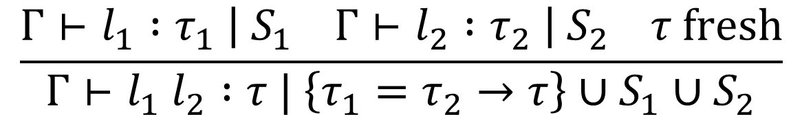
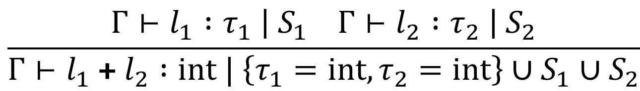
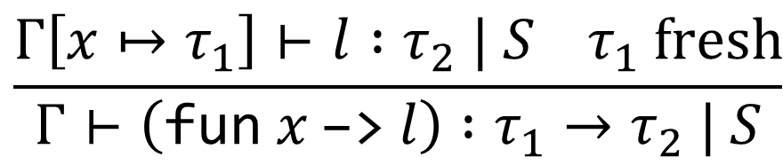
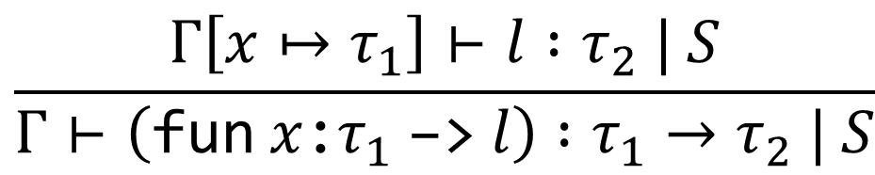
Constraint-Based Type Inference: Rules
$$\frac{Γ⊢l_{1} :τ_{1} \left| S_{1} Γ⊢l_{2} :τ_{2} \right| S_{2}}{Γ⊢l_{1} \text{+} l_{2} :int | \left\{τ_{1}=int,τ_{2}=int\right\}∪S_{1}∪S_{2}}$$
$$\frac{Γ\left[x↦τ_{1}\right]⊢l :τ_{2} | S}{Γ⊢\left(\text{fun} x \text{:}τ_{1} \text{−>} l\right) :τ_{1}→τ_{2} | S}$$
$$\frac{Γ\left[x↦τ_{1}\right]⊢l :τ_{2} | S τ_{1} fresh}{Γ⊢\left(\text{fun} x \text{−>} l\right) :τ_{1}→τ_{2} | S}$$
$$\frac{Γ⊢l_{1} :τ_{1} \left| S_{1} Γ⊢l_{2} :τ_{2} \right| S_{2} τ fresh}{Γ⊢l_{1} l_{2} :τ | \left\{τ_{1}=τ_{2}→τ\right\}∪S_{1}∪S_{2}}$$
Notes:
Do a demo!

Slide 31
Notes:
Poll Title: Do not modify the notes in this section to avoid tampering with the Poll Everywhere activity.
More info at polleverywhere.com/support
Questions
https://www.polleverywhere.com/discourses/SRzwhp4zztmGWgIgz520A

Slide 32
Constraint-Based Type Inference: Example
$$\text{fun} \text{f}\text{ −> }\text{fun} \text{x}\text{ −> }\text{f} \text{x} \text{+} \text{f}\text{ 3}$$

Slide 33
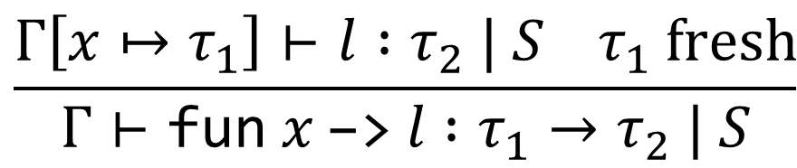
Constraint-Based Type Inference: Example
$$\frac{Γ\left[x↦τ_{1}\right]⊢l :τ_{2} | S τ_{1} fresh}{Γ⊢\text{fun} x \text{−>} l :τ_{1}→τ_{2} | S}$$
$$\{\}⊢\text{fun} \text{f}\text{ −> }\text{fun} \text{x}\text{ −> }\text{f} \text{x}\text{ + }\text{f}\text{ 3} : ?| ?$$

Slide 34
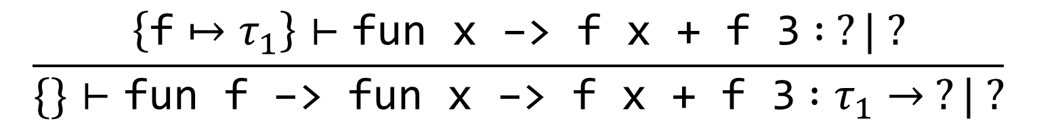
Constraint-Based Type Inference: Example
$$\frac{Γ\left[x↦τ_{1}\right]⊢l :τ_{2} | S τ_{1} fresh}{Γ⊢\text{fun} x \text{−>} l :τ_{1}→τ_{2} | S}$$
$$\frac{\left\{\text{f}↦τ_{1}\right\}⊢\text{fun} \text{x}\text{ −> }\text{f} \text{x}\text{ + }\text{f}\text{ 3} : ?| ?}{\{\}⊢\text{fun} \text{f}\text{ −> }\text{fun} \text{x}\text{ −> }\text{f} \text{x}\text{ + }\text{f}\text{ 3} :τ_{1}→ ?| ?}$$

Slide 35
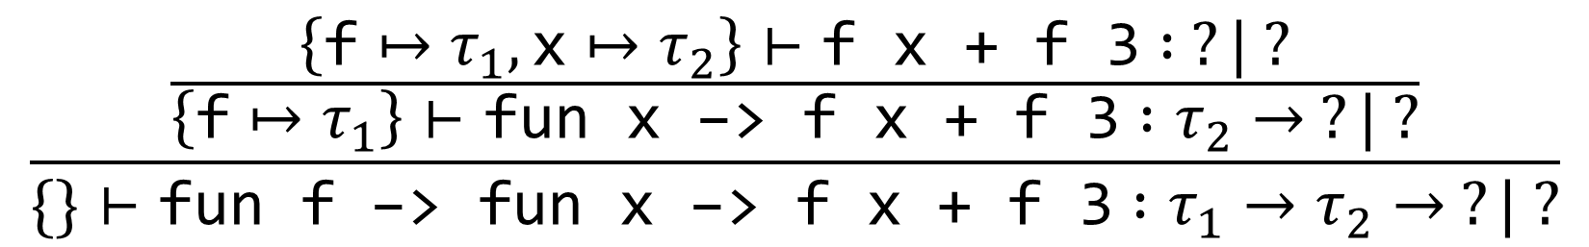
Constraint-Based Type Inference: Example
$$\frac{Γ\left[x↦τ_{1}\right]⊢l :τ_{2} | S τ_{1} fresh}{Γ⊢\text{fun} x \text{−>} l :τ_{1}→τ_{2} | S}$$
$$\frac{\frac{\left\{\text{f}↦τ_{1},\text{x}↦τ_{2}\right\}⊢\text{f} \text{x}\text{ + }\text{f}\text{ 3} : ?| ?}{\left\{\text{f}↦τ_{1}\right\}⊢\text{fun} \text{x}\text{ −> }\text{f} \text{x}\text{ + }\text{f}\text{ 3} :τ_{2}→ ?| ?}}{\{\}⊢\text{fun} \text{f}\text{ −> }\text{fun} \text{x}\text{ −> }\text{f} \text{x}\text{ + }\text{f}\text{ 3} :τ_{1}→τ_{2}→ ?| ?}$$

Slide 36

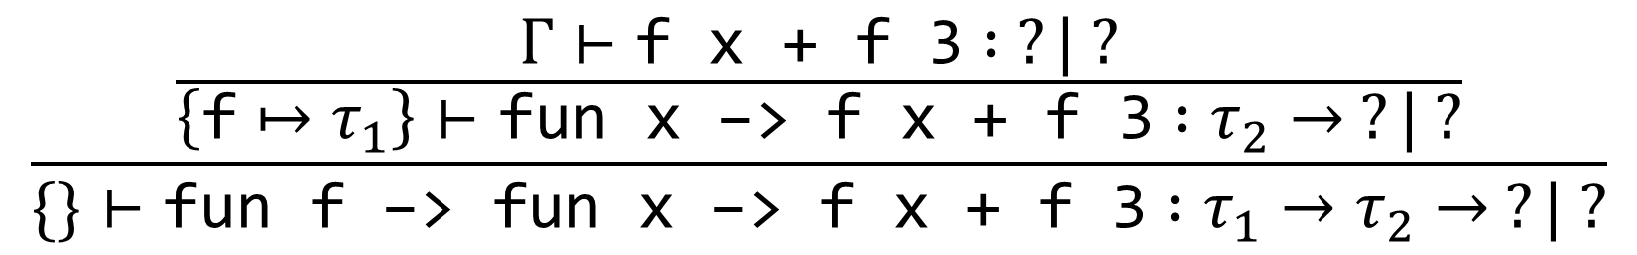
Constraint-Based Type Inference: Example
$$\frac{Γ\left[x↦τ_{1}\right]⊢l :τ_{2} | S τ_{1} fresh}{Γ⊢\text{fun} x \text{−>} l :τ_{1}→τ_{2} | S}$$
$$\frac{\frac{Γ⊢\text{f} \text{x}\text{ + }\text{f}\text{ 3} : ?| ?}{\left\{\text{f}↦τ_{1}\right\}⊢\text{fun} \text{x}\text{ −> }\text{f} \text{x}\text{ + }\text{f}\text{ 3} :τ_{2}→ ?| ?}}{\{\}⊢\text{fun} \text{f}\text{ −> }\text{fun} \text{x}\text{ −> }\text{f} \text{x}\text{ + }\text{f}\text{ 3} :τ_{1}→τ_{2}→ ?| ?}$$
$$Γ=\{\text{f}↦τ_{1},\text{x}↦τ_{2}\}$$

Slide 37
Constraint-Based Type Inference: Example
Exercise: Which rule would we apply next?
$$\frac{\frac{Γ⊢\text{f} \text{x}\text{ + }\text{f}\text{ 3} : ?| ?}{\left\{\text{f}↦τ_{1}\right\}⊢\text{fun} \text{x}\text{ −> }\text{f} \text{x}\text{ + }\text{f}\text{ 3} :τ_{2}→ ?| ?}}{\{\}⊢\text{fun} \text{f}\text{ −> }\text{fun} \text{x}\text{ −> }\text{f} \text{x}\text{ + }\text{f}\text{ 3} :τ_{1}→τ_{2}→ ?| ?}$$
$$Γ=\{\text{f}↦τ_{1},\text{x}↦τ_{2}\}$$

Slide 38
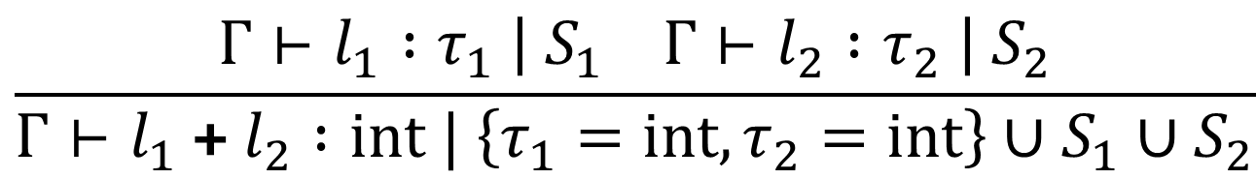
Constraint-Based Type Inference: Example
$$\frac{Γ⊢l_{1} :τ_{1} \left| S_{1} Γ⊢l_{2} :τ_{2} \right| S_{2}}{Γ⊢l_{1} \text{+} l_{2} :int | \left\{τ_{1}=int,τ_{2}=int\right\}∪S_{1}∪S_{2}}$$
$$\frac{\frac{Γ⊢\text{f} \text{x}\text{ + }\text{f}\text{ 3} : ?| ?}{\left\{\text{f}↦τ_{1}\right\}⊢\text{fun} \text{x}\text{ −> }\text{f} \text{x}\text{ + }\text{f}\text{ 3} :τ_{2}→ ?| ?}}{\{\}⊢\text{fun} \text{f}\text{ −> }\text{fun} \text{x}\text{ −> }\text{f} \text{x}\text{ + }\text{f}\text{ 3} :τ_{1}→τ_{2}→ ?| ?}$$
$$Γ=\{\text{f}↦τ_{1},\text{x}↦τ_{2}\}$$

Slide 39
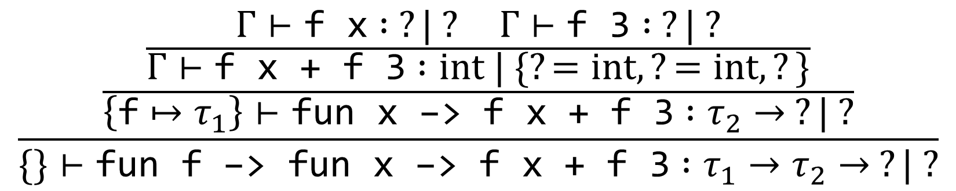
Constraint-Based Type Inference: Example
$$\frac{Γ⊢l_{1} :τ_{1} \left| S_{1} Γ⊢l_{2} :τ_{2} \right| S_{2}}{Γ⊢l_{1} \text{+} l_{2} :int | \left\{τ_{1}=int,τ_{2}=int\right\}∪S_{1}∪S_{2}}$$
$$\frac{\frac{\frac{Γ⊢\text{f} \text{x} : ?| ? Γ⊢\text{f}\text{ 3} : ?| ?}{Γ⊢\text{f} \text{x}\text{ + }\text{f}\text{ 3} :int | \{?=int,?=int,?\}}}{\left\{\text{f}↦τ_{1}\right\}⊢\text{fun} \text{x}\text{ −> }\text{f} \text{x}\text{ + }\text{f}\text{ 3} :τ_{2}→ ?| ?}}{\{\}⊢\text{fun} \text{f}\text{ −> }\text{fun} \text{x}\text{ −> }\text{f} \text{x}\text{ + }\text{f}\text{ 3} :τ_{1}→τ_{2}→ ?| ?}$$
$$Γ=\{\text{f}↦τ_{1},\text{x}↦τ_{2}\}$$

Slide 40
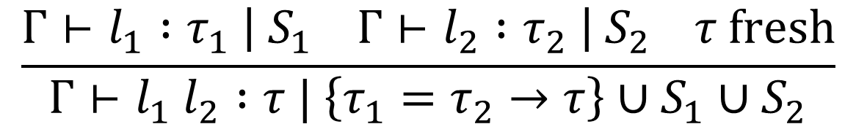
Constraint-Based Type Inference: Example
$$\frac{Γ⊢l_{1} :τ_{1} \left| S_{1} Γ⊢l_{2} :τ_{2} \right| S_{2} τ fresh}{Γ⊢l_{1} l_{2} :τ | \left\{τ_{1}=τ_{2}→τ\right\}∪S_{1}∪S_{2}}$$
$$\frac{\frac{\frac{Γ⊢\text{f} \text{x} : ?| ? Γ⊢\text{f}\text{ 3} : ?| ?}{Γ⊢\text{f} \text{x}\text{ + }\text{f}\text{ 3} :int | \{?=int,?=int,?\}}}{\left\{\text{f}↦τ_{1}\right\}⊢\text{fun} \text{x}\text{ −> }\text{f} \text{x}\text{ + }\text{f}\text{ 3} :τ_{2}→ ?| ?}}{\{\}⊢\text{fun} \text{f}\text{ −> }\text{fun} \text{x}\text{ −> }\text{f} \text{x}\text{ + }\text{f}\text{ 3} :τ_{1}→τ_{2}→ ?| ?}$$
$$Γ=\{\text{f}↦τ_{1},\text{x}↦τ_{2}\}$$

Slide 41
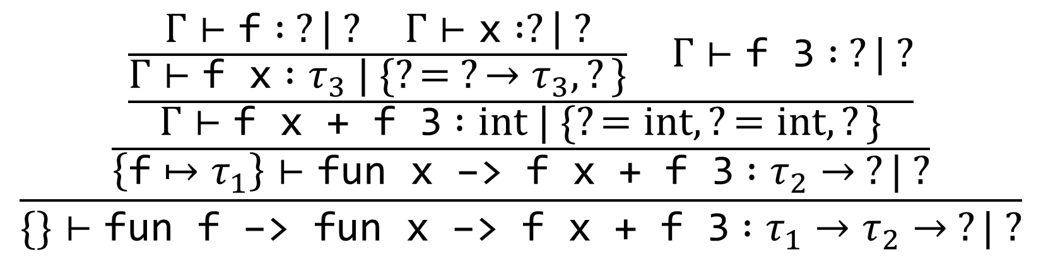
Constraint-Based Type Inference: Example
$$\frac{Γ⊢l_{1} :τ_{1} \left| S_{1} Γ⊢l_{2} :τ_{2} \right| S_{2} τ fresh}{Γ⊢l_{1} l_{2} :τ | \left\{τ_{1}=τ_{2}→τ\right\}∪S_{1}∪S_{2}}$$
$$\frac{\frac{\frac{\frac{Γ⊢\text{f} : ?\left| ? Γ⊢\text{x} :?\right| ?}{Γ⊢\text{f} \text{x} :τ_{3} | \{?= ?→τ_{3},?\}} Γ⊢\text{f}\text{ 3} : ?| ?}{Γ⊢\text{f} \text{x}\text{ + }\text{f}\text{ 3} :int | \{?=int,?=int,?\}}}{\left\{\text{f}↦τ_{1}\right\}⊢\text{fun} \text{x}\text{ −> }\text{f} \text{x}\text{ + }\text{f}\text{ 3} :τ_{2}→ ?| ?}}{\{\}⊢\text{fun} \text{f}\text{ −> }\text{fun} \text{x}\text{ −> }\text{f} \text{x}\text{ + }\text{f}\text{ 3} :τ_{1}→τ_{2}→ ?| ?}$$
$$Γ=\{\text{f}↦τ_{1},\text{x}↦τ_{2}\}$$

Slide 42
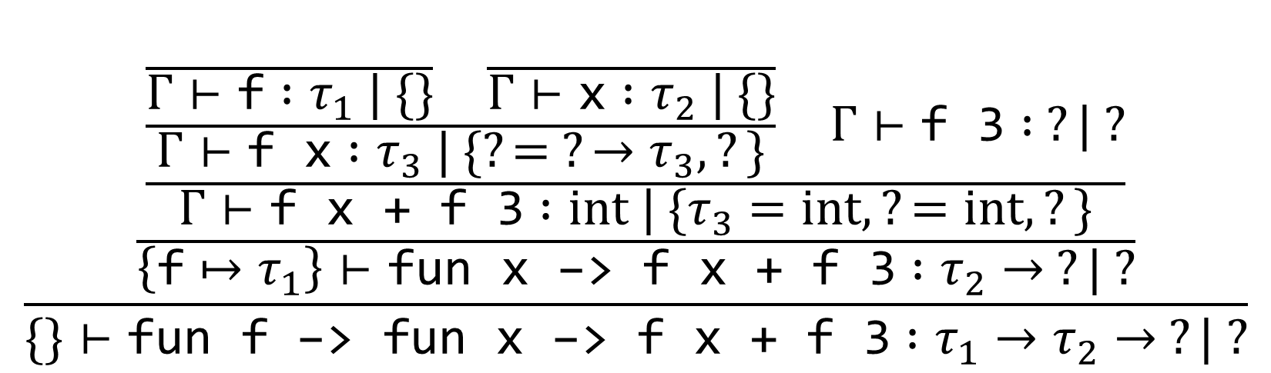
Constraint-Based Type Inference: Example
$$\frac{\frac{\frac{\frac{\frac{}{Γ⊢\text{f} :τ_{1} | \{\}} \frac{}{Γ⊢\text{x} :τ_{2} | \{\}}}{Γ⊢\text{f} \text{x} :τ_{3} | \{?= ?→τ_{3},?\}} Γ⊢\text{f}\text{ 3} : ?| ?}{Γ⊢\text{f} \text{x}\text{ + }\text{f}\text{ 3} :int | \{τ_{3}=int,?=int,?\}}}{\left\{\text{f}↦τ_{1}\right\}⊢\text{fun} \text{x}\text{ −> }\text{f} \text{x}\text{ + }\text{f}\text{ 3} :τ_{2}→ ?| ?}}{\{\}⊢\text{fun} \text{f}\text{ −> }\text{fun} \text{x}\text{ −> }\text{f} \text{x}\text{ + }\text{f}\text{ 3} :τ_{1}→τ_{2}→ ?| ?}$$
$$Γ=\{\text{f}↦τ_{1},\text{x}↦τ_{2}\}$$

Slide 43
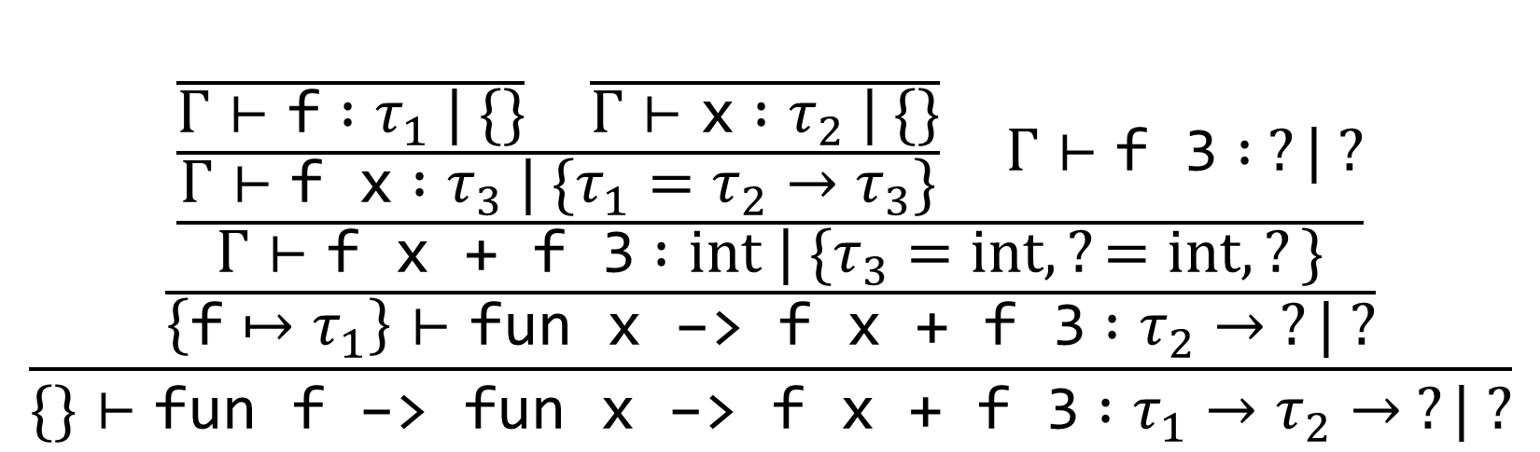
Constraint-Based Type Inference: Example
$$\frac{\frac{\frac{\frac{\frac{}{Γ⊢\text{f} :τ_{1} | \{\}} \frac{}{Γ⊢\text{x} :τ_{2} | \{\}}}{Γ⊢\text{f} \text{x} :τ_{3} | \{τ_{1}=τ_{2}→τ_{3}\}} Γ⊢\text{f}\text{ 3} : ?| ?}{Γ⊢\text{f} \text{x}\text{ + }\text{f}\text{ 3} :int | \{τ_{3}=int,?=int,?\}}}{\left\{\text{f}↦τ_{1}\right\}⊢\text{fun} \text{x}\text{ −> }\text{f} \text{x}\text{ + }\text{f}\text{ 3} :τ_{2}→ ?| ?}}{\{\}⊢\text{fun} \text{f}\text{ −> }\text{fun} \text{x}\text{ −> }\text{f} \text{x}\text{ + }\text{f}\text{ 3} :τ_{1}→τ_{2}→ ?| ?}$$
$$Γ=\{\text{f}↦τ_{1},\text{x}↦τ_{2}\}$$

Slide 44
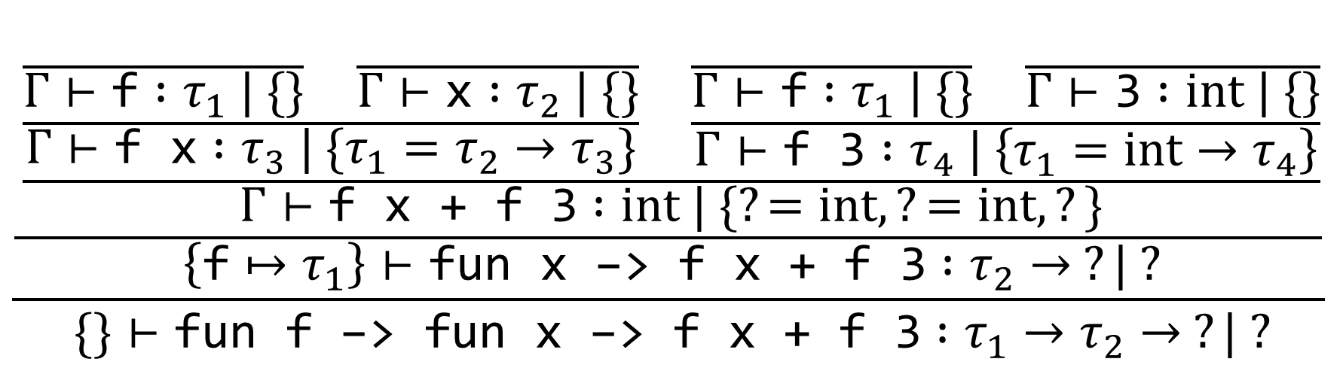
Constraint-Based Type Inference: Example
$$\frac{\frac{\frac{\frac{\frac{}{Γ⊢\text{f} :τ_{1} | \{\}} \frac{}{Γ⊢\text{x} :τ_{2} | \{\}}}{Γ⊢\text{f} \text{x} :τ_{3} | \{τ_{1}=τ_{2}→τ_{3}\}} \frac{\frac{}{Γ⊢\text{f} :τ_{1} | \{\}} \frac{}{Γ⊢\text{3} :int | \{\}}}{Γ⊢\text{f}\text{ 3} :τ_{4} | \left\{τ_{1}=int→τ_{4}\right\}}}{Γ⊢\text{f} \text{x}\text{ + }\text{f}\text{ 3} :int | \{?=int,?=int,?\}}}{\left\{\text{f}↦τ_{1}\right\}⊢\text{fun} \text{x}\text{ −> }\text{f} \text{x}\text{ + }\text{f}\text{ 3} :τ_{2}→ ?| ?}}{\{\}⊢\text{fun} \text{f}\text{ −> }\text{fun} \text{x}\text{ −> }\text{f} \text{x}\text{ + }\text{f}\text{ 3} :τ_{1}→τ_{2}→ ?| ?}$$
$$Γ=\{\text{f}↦τ_{1},\text{x}↦τ_{2}\}$$

Slide 45
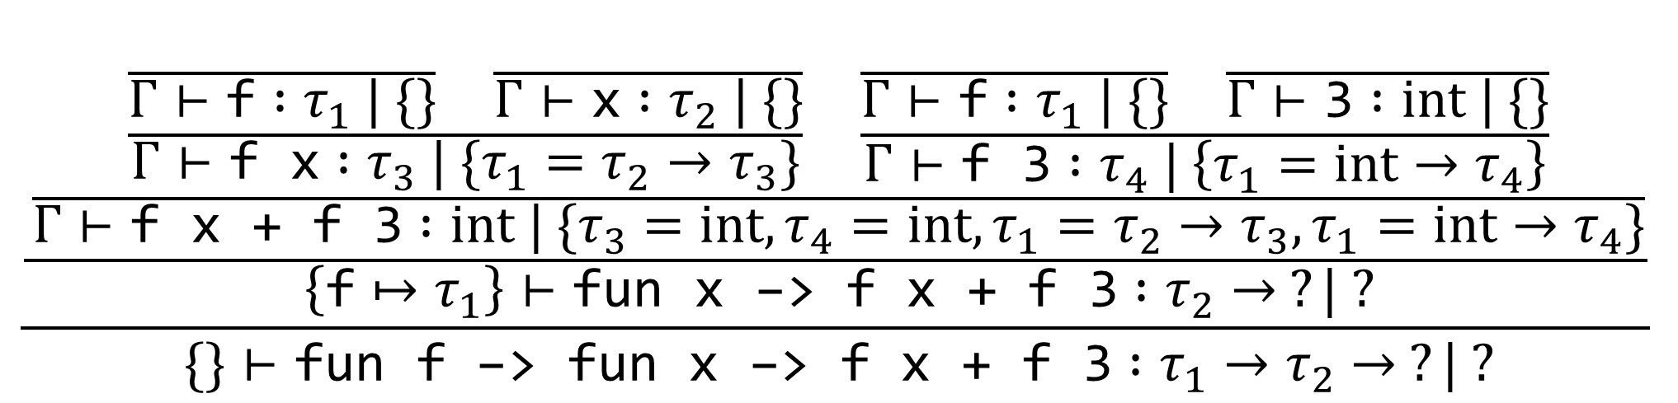
Constraint-Based Type Inference: Example
$$\frac{\frac{\frac{\frac{\frac{}{Γ⊢\text{f} :τ_{1} | \{\}} \frac{}{Γ⊢\text{x} :τ_{2} | \{\}}}{Γ⊢\text{f} \text{x} :τ_{3} | \{τ_{1}=τ_{2}→τ_{3}\}} \frac{\frac{}{Γ⊢\text{f} :τ_{1} | \{\}} \frac{}{Γ⊢\text{3} :int | \{\}}}{Γ⊢\text{f}\text{ 3} :τ_{4} | \left\{τ_{1}=int→τ_{4}\right\}}}{Γ⊢\text{f} \text{x}\text{ + }\text{f}\text{ 3} :int | \{τ_{3}=int,τ_{4}=int,τ_{1}=τ_{2}→τ_{3},τ_{1}=int→τ_{4}\}}}{\left\{\text{f}↦τ_{1}\right\}⊢\text{fun} \text{x}\text{ −> }\text{f} \text{x}\text{ + }\text{f}\text{ 3} :τ_{2}→ ?| ?}}{\{\}⊢\text{fun} \text{f}\text{ −> }\text{fun} \text{x}\text{ −> }\text{f} \text{x}\text{ + }\text{f}\text{ 3} :τ_{1}→τ_{2}→ ?| ?}$$
$$Γ=\{\text{f}↦τ_{1},\text{x}↦τ_{2}\}$$

Slide 46

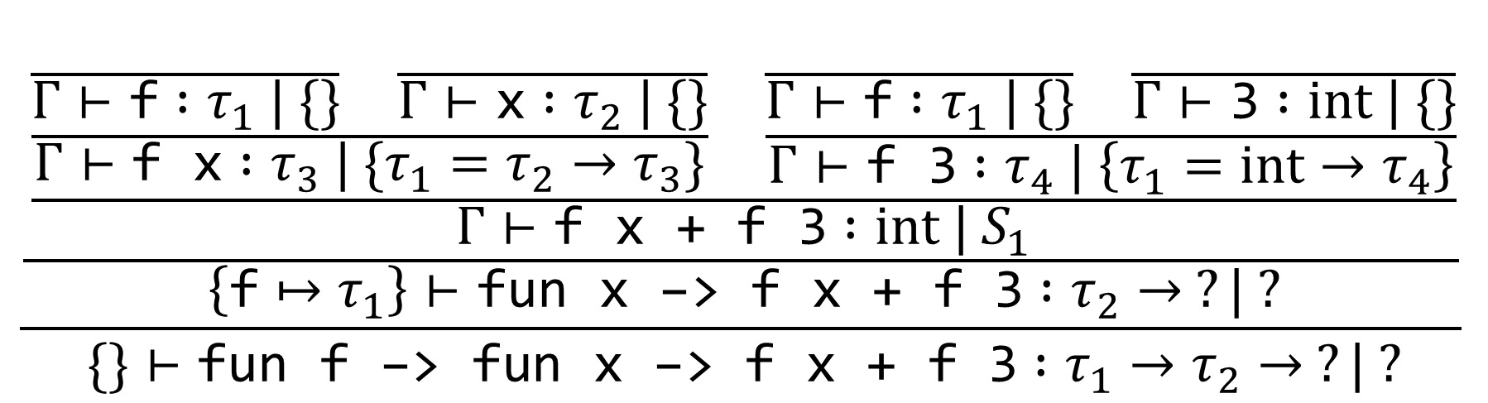
Constraint-Based Type Inference: Example
$$\frac{\frac{\frac{\frac{\frac{}{Γ⊢\text{f} :τ_{1} | \{\}} \frac{}{Γ⊢\text{x} :τ_{2} | \{\}}}{Γ⊢\text{f} \text{x} :τ_{3} | \{τ_{1}=τ_{2}→τ_{3}\}} \frac{\frac{}{Γ⊢\text{f} :τ_{1} | \{\}} \frac{}{Γ⊢\text{3} :int | \{\}}}{Γ⊢\text{f}\text{ 3} :τ_{4} | \left\{τ_{1}=int→τ_{4}\right\}}}{Γ⊢\text{f} \text{x}\text{ + }\text{f}\text{ 3} :int | S_{1}}}{\left\{\text{f}↦τ_{1}\right\}⊢\text{fun} \text{x}\text{ −> }\text{f} \text{x}\text{ + }\text{f}\text{ 3} :τ_{2}→ ?| ?}}{\{\}⊢\text{fun} \text{f}\text{ −> }\text{fun} \text{x}\text{ −> }\text{f} \text{x}\text{ + }\text{f}\text{ 3} :τ_{1}→τ_{2}→ ?| ?}$$
$$Γ=\{\text{f}↦τ_{1},\text{x}↦τ_{2}\}$$
$$S_{1}=\{τ_{3}=int,τ_{4}=int,τ_{1}=τ_{2}→τ_{3},τ_{1}=int→τ_{4}\}$$

Slide 47
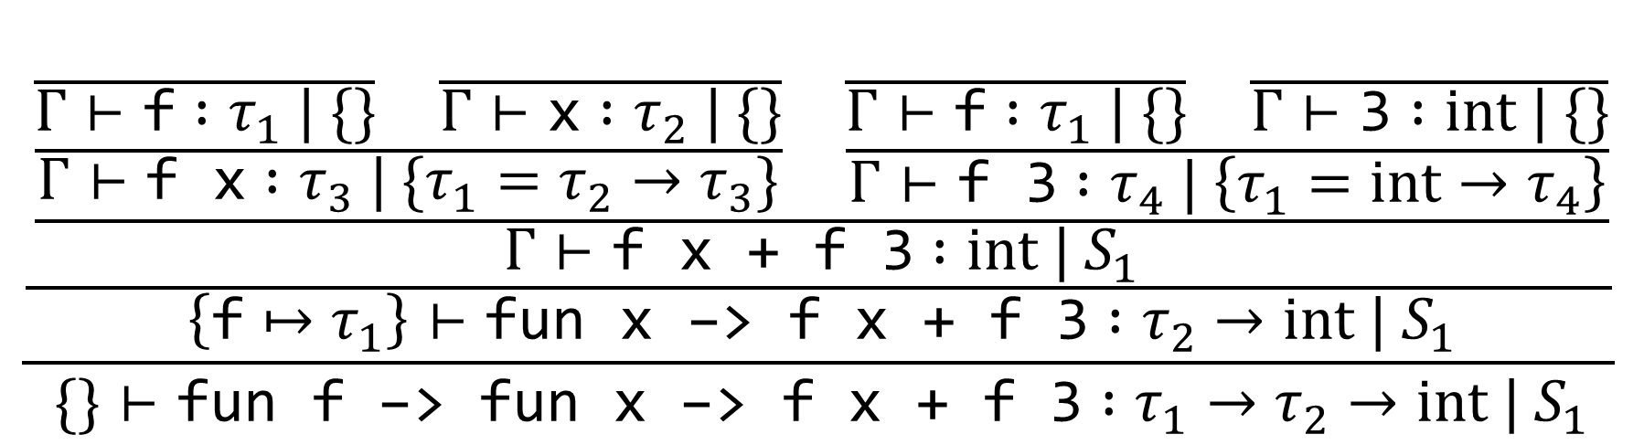
Constraint-Based Type Inference: Example
$$\frac{\frac{\frac{\frac{\frac{}{Γ⊢\text{f} :τ_{1} | \{\}} \frac{}{Γ⊢\text{x} :τ_{2} | \{\}}}{Γ⊢\text{f} \text{x} :τ_{3} | \{τ_{1}=τ_{2}→τ_{3}\}} \frac{\frac{}{Γ⊢\text{f} :τ_{1} | \{\}} \frac{}{Γ⊢\text{3} :int | \{\}}}{Γ⊢\text{f}\text{ 3} :τ_{4} | \left\{τ_{1}=int→τ_{4}\right\}}}{Γ⊢\text{f} \text{x}\text{ + }\text{f}\text{ 3} :int | S_{1}}}{\left\{\text{f}↦τ_{1}\right\}⊢\text{fun} \text{x}\text{ −> }\text{f} \text{x}\text{ + }\text{f}\text{ 3} :τ_{2}→int |{ S}_{1}}}{\{\}⊢\text{fun} \text{f}\text{ −> }\text{fun} \text{x}\text{ −> }\text{f} \text{x}\text{ + }\text{f}\text{ 3} :τ_{1}→τ_{2}→int |{ S}_{1}}$$
$$Γ=\{\text{f}↦τ_{1},\text{x}↦τ_{2}\}$$
$$S_{1}=\{τ_{3}=int,τ_{4}=int,τ_{1}=τ_{2}→τ_{3},τ_{1}=int→τ_{4}\}$$

Slide 48
Notes:
Poll Title: Do not modify the notes in this section to avoid tampering with the Poll Everywhere activity.
More info at polleverywhere.com/support
Questions
https://www.polleverywhere.com/discourses/SRzwhp4zztmGWgIgz520A

Slide 49
HW7 Overview
Implement type inference
get_constraints function implements inference rules
There’s also a “constraint solving” section; for now, it just works

