Slide 1
CS 476 – Programming Language Design
William Mansky

Slide 2

Notes:
Poll Title: Do not modify the notes in this section to avoid tampering with the Poll Everywhere activity.
More info at polleverywhere.com/support
Questions
https://www.polleverywhere.com/discourses/SRzwhp4zztmGWgIgz520A

Slide 3
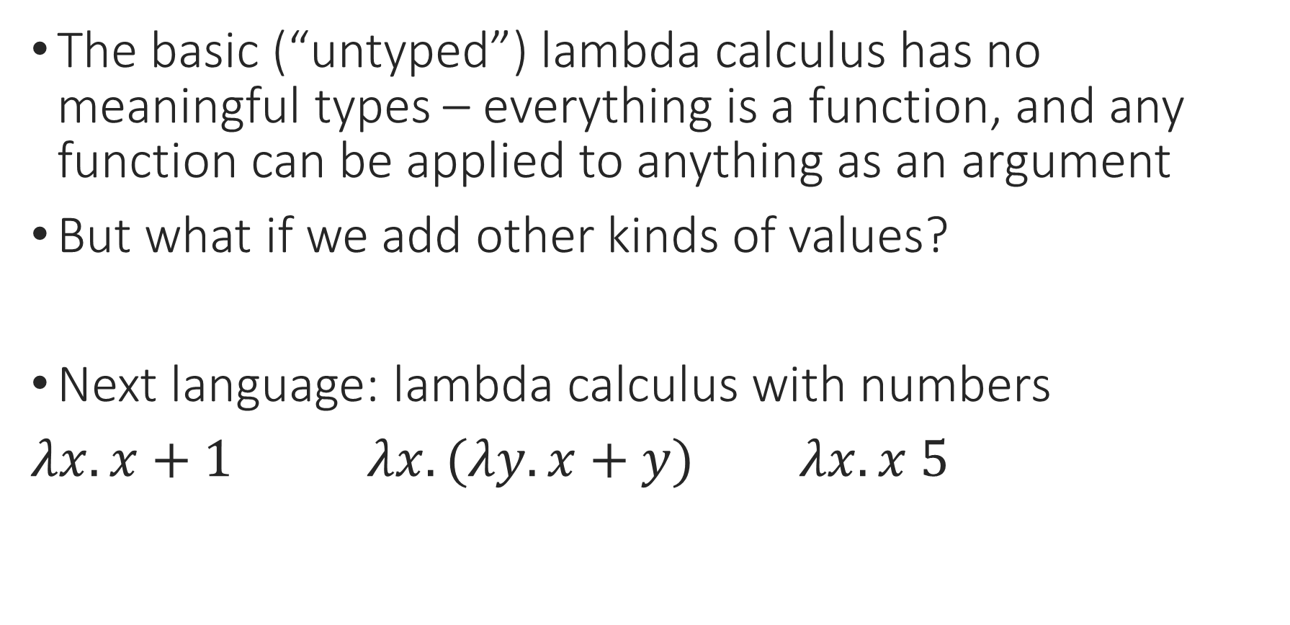
Lambda Calculus: Types
The basic (“untyped”) lambda calculus has no meaningful types – everything is a function, and any function can be applied to anything as an argument
But what if we add other kinds of values?
Next language: lambda calculus with numbers
$λx. x+1$ $λx. (λy.x+y)$ $λx. x 5$
Notes:
Think of function definitions: we don’t evaluate the body of a function until it’s applied.

Slide 4
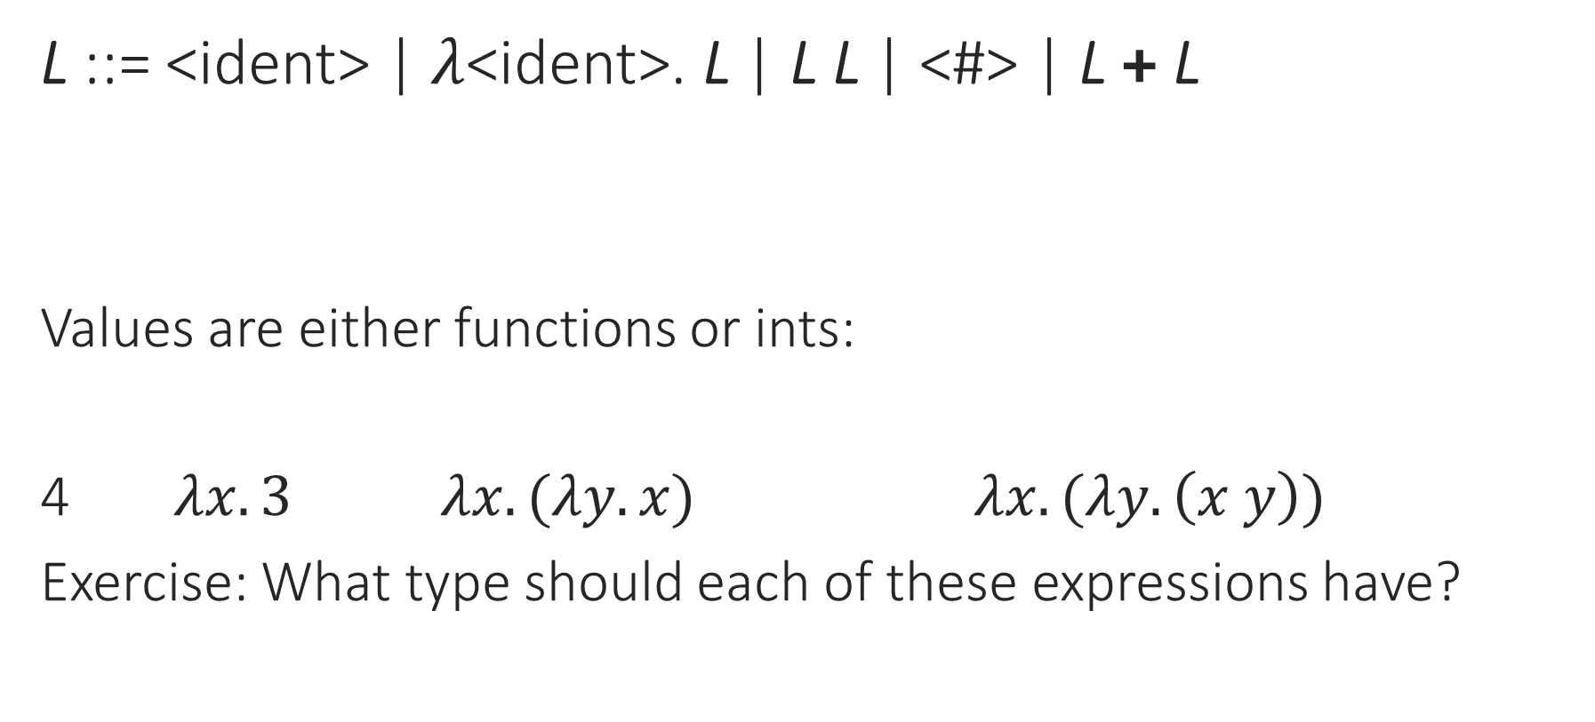
Lambda Calculus + Ints
L ::= <ident> | $λ$<ident>. L | L L | <#> | L + L
Values are either functions or ints:
4 $λx. 3$ $λx. (λy. x)$ $λx. (λy. \left(x y\right))$
Exercise: What type should each of these expressions have?
Notes:
Now, what are the types?

Slide 5
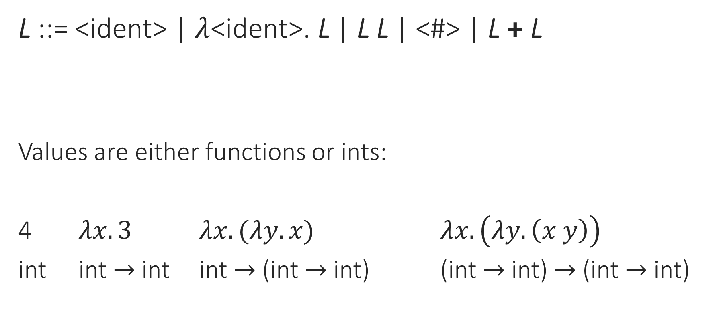
Lambda Calculus + Ints
L ::= <ident> | $λ$<ident>. L | L L | <#> | L + L
Values are either functions or ints:
4 $λx. 3$ $λx. (λy. x)$ $λx. \left(λy. \left(x y\right)\right)$
int int $→$ int int $→$ (int $→$ int) (int $→$ int) $→$ (int $→$ int)
Notes:
Now, what are the types?

Slide 6
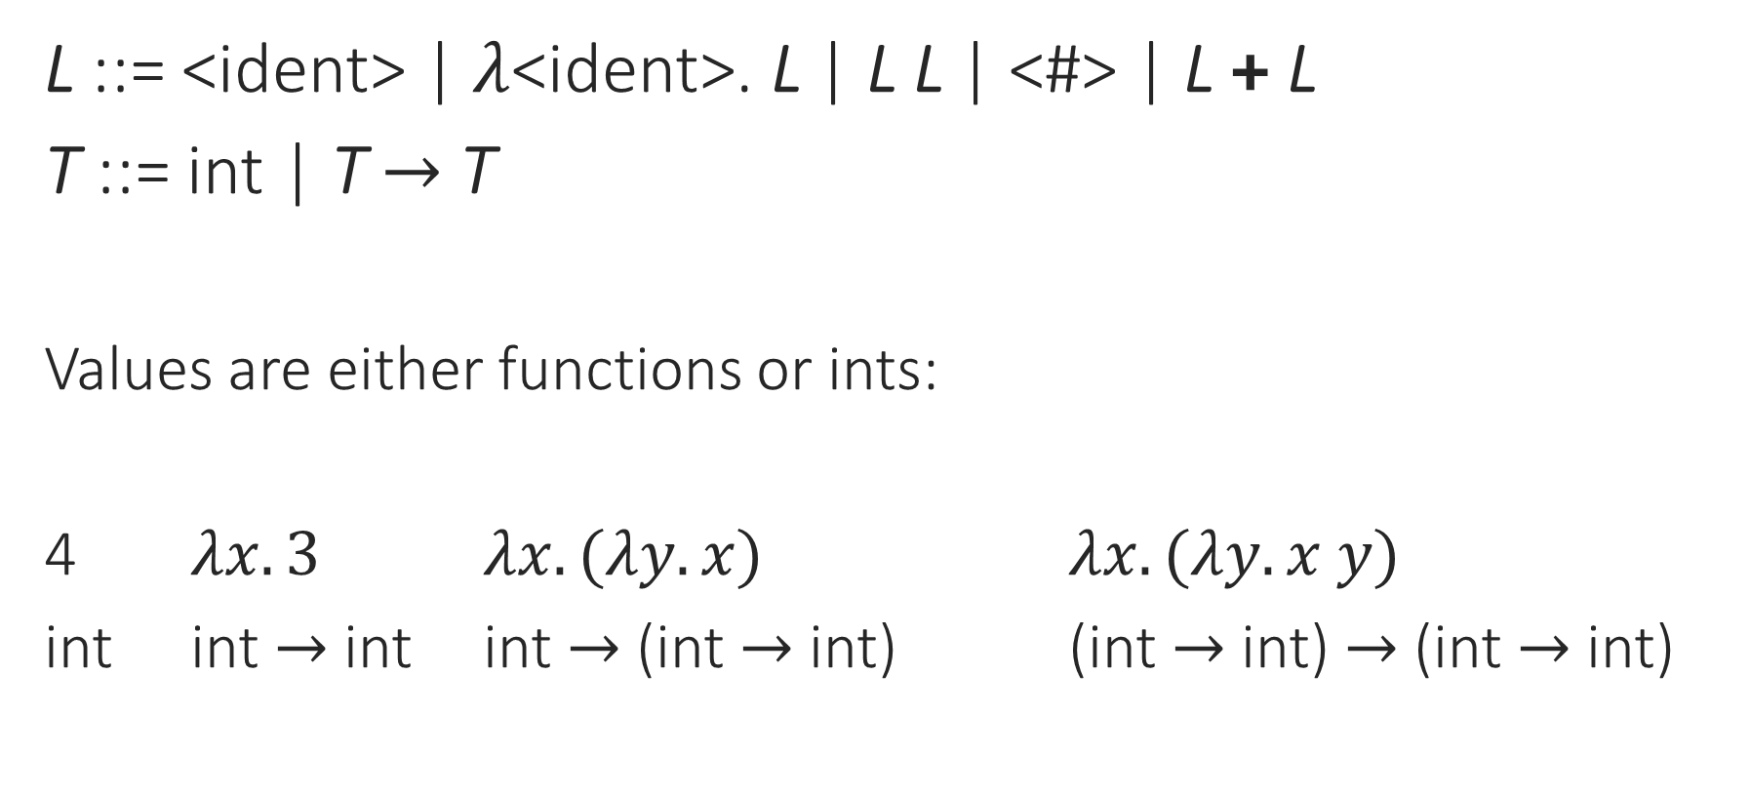
Lambda Calculus + Ints
L ::= <ident> | $λ$<ident>. L | L L | <#> | L + L
T ::= int | T $→$ T
Values are either functions or ints:
4 $λx. 3$ $λx. (λy. x)$ $λx. (λy. x y)$
int int $→$ int int $→$ (int $→$ int) (int $→$ int) $→$ (int $→$ int)
Notes:
Now, what are the types?
Or are they? \x. \y. x, for instance, could have many different types.

Slide 7
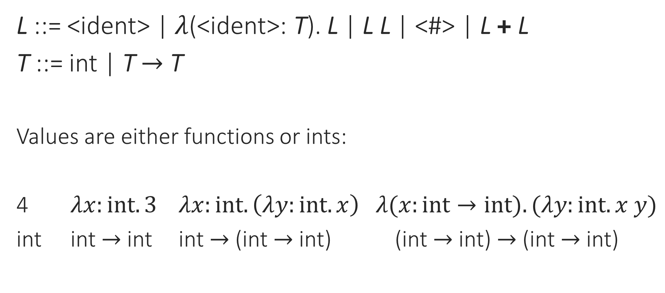
Simply Typed Lambda Calculus
L ::= <ident> | $λ$(<ident>: T). L | L L | <#> | L + L
T ::= int | T $→$ T
Values are either functions or ints:
4 $λx:int. 3$ $λx:int. \left(λy:int. x\right) λ(x:int→int). (λy:int. x y)$
int int $→$ int int $→$ (int $→$ int) (int $→$ int) $→$ (int $→$ int)

Slide 8
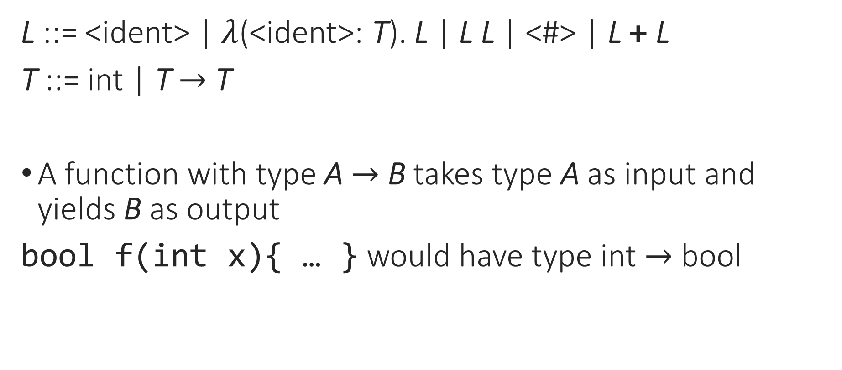
Simply Typed Lambda Calculus
L ::= <ident> | $λ$(<ident>: T). L | L L | <#> | L + L
T ::= int | T $→$ T
A function with type A $→$ B takes type A as input and yields B as output
bool f(int x){ … } would have type int $→$ bool

Slide 9
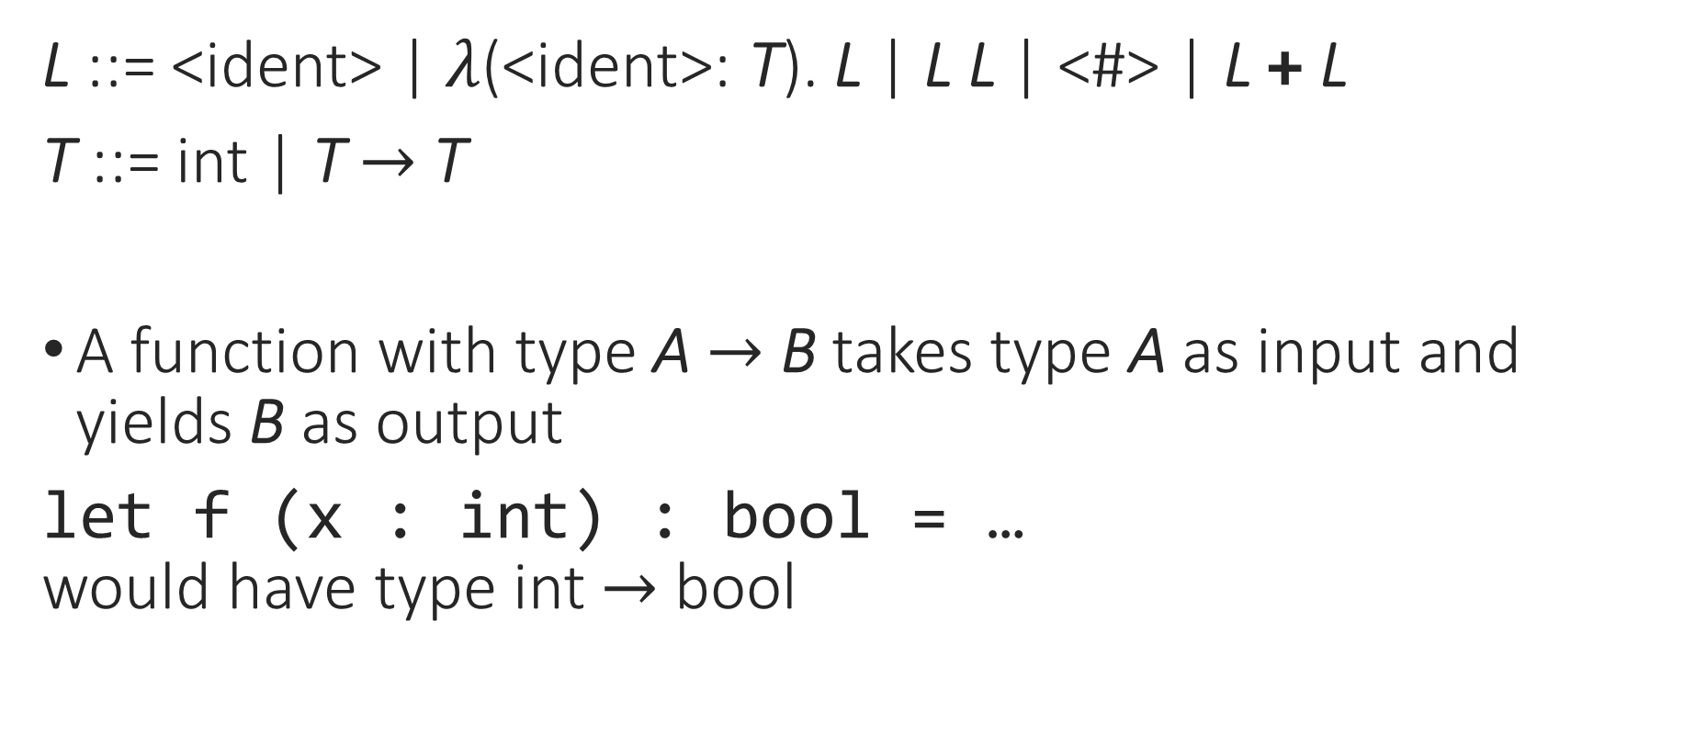
Simply Typed Lambda Calculus
L ::= <ident> | $λ$(<ident>: T). L | L L | <#> | L + L
T ::= int | T $→$ T
A function with type A $→$ B takes type A as input and yields B as output
let f (x : int) : bool = …
would have type int $→$ bool

Slide 10
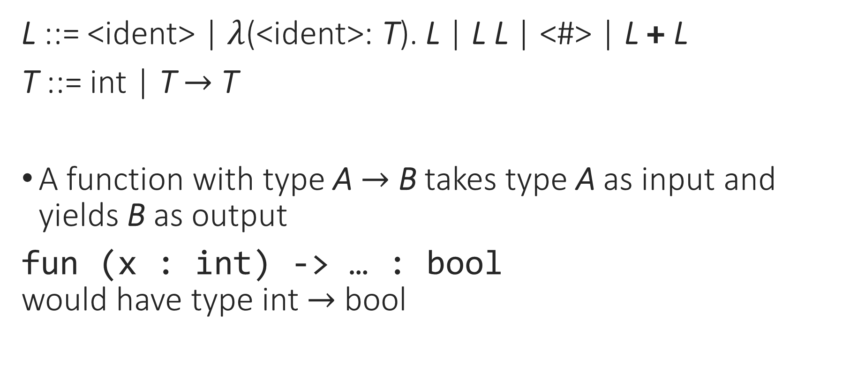
Simply Typed Lambda Calculus
L ::= <ident> | $λ$(<ident>: T). L | L L | <#> | L + L
T ::= int | T $→$ T
A function with type A $→$ B takes type A as input and yields B as output
fun (x : int) -> … : bool
would have type int $→$ bool

Slide 11
Simply Typed Lambda Calculus
L ::= <ident> | $λ$(<ident>: T). L | L L | <#> | L + L
T ::= int | T $→$ T
Values are either functions or ints:
4 $λx:int. 3$ $λx:int. \left(λy:int. x\right) λ(x:int→int). (λy:int. x y)$
int int $→$ int int $→$ (int $→$ int) (int $→$ int) $→$ (int $→$ int)
Notes:
It’s worth breaking down that last one a little more.

Slide 12

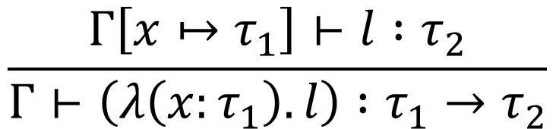
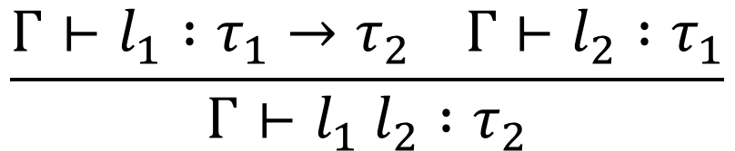

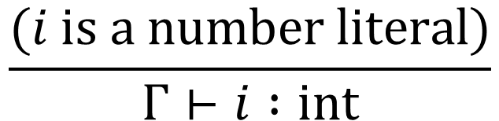
Simply Typed Lambda Calculus: Types
L ::= <ident> | $λ$(<ident>: T). L | L L | <#> | L + L
T ::= int | T $→$ T
$$\frac{(i is a number literal)}{Γ⊢i :int}$$
$$\frac{(Γ\left(x\right)=τ)}{Γ⊢x :τ}$$
$$\frac{Γ⊢l_{1} :τ_{1}→τ_{2} Γ⊢l_{2} :τ_{1}}{Γ⊢l_{1} l_{2} :τ_{2}}$$
$$\frac{Γ\left[x↦τ_{1}\right]⊢l :τ_{2}}{Γ⊢\left(λ\left(x:τ_{1}\right). l\right) :τ_{1}→τ_{2}}$$
Notes:
Let’s write this in OCaml! (code demo)

Slide 13
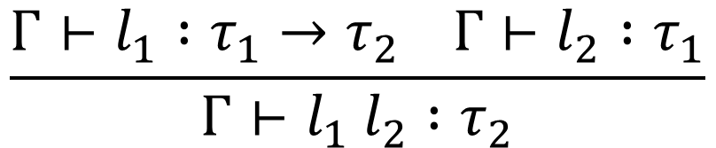
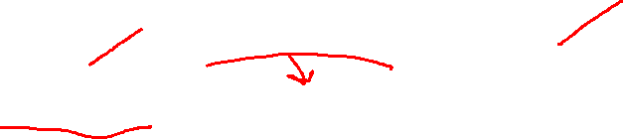
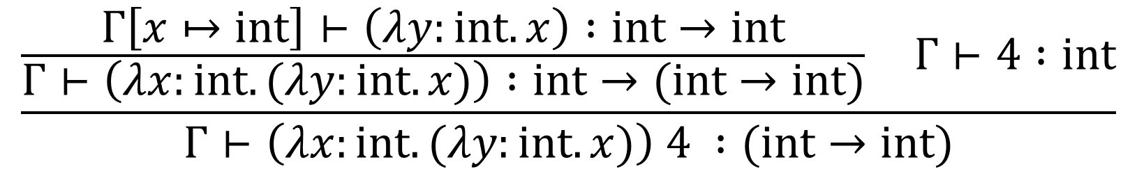
Simply Typed Lambda Calculus: Types
$$\frac{\frac{Γ\left[x↦int\right]⊢\left(λy:int. x\right) :int→int}{Γ⊢\left(λx:int. (λy:int. x)\right) :int→(int→int)} Γ⊢4 :int}{Γ⊢\left(λx:int. (λy:int. x)\right) 4 :(int→int)}$$
$$\frac{Γ⊢l_{1} :τ_{1}→τ_{2} Γ⊢l_{2} :τ_{1}}{Γ⊢l_{1} l_{2} :τ_{2}}$$
Notes:
Lambda rule: typecheck the function body while assuming that the parameter has its declared type; then the type of the function is parameter type -> body type.

Slide 14
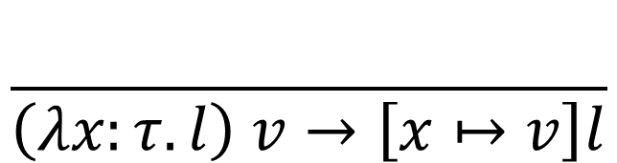


Simply Typed Lambda Calculus: Semantics
L ::= <ident> | $λ$(<ident>: T). L | L L | <#> | L + L
T ::= int | T $→$ T
$$\frac{l_{1}→l_{1}^{′}}{l_{1} l_{2}→l_{1}^{′} l_{2}}$$
$$\frac{}{\left(λx:τ. l\right) v→\left[x↦v\right]l}$$
$$\frac{l_{2}→l_{2}^{′}}{v l_{2}→v l_{2}^{′}}$$

Slide 15
Notes:
Poll Title: Do not modify the notes in this section to avoid tampering with the Poll Everywhere activity.
More info at polleverywhere.com/support
Questions
https://www.polleverywhere.com/discourses/SRzwhp4zztmGWgIgz520A

Slide 16



Limitations of Simple Types
Not every lambda-term is well typed
$$4 (λx. x)$$
$$\left(λx. x x\right) (λx. x x)$$
$$Γ⊢\left(λx. x x\right) \left(λx. x x\right) :τ$$
Notes:
Remember, type systems are usually conservative: they rule out useful programs.

Slide 17
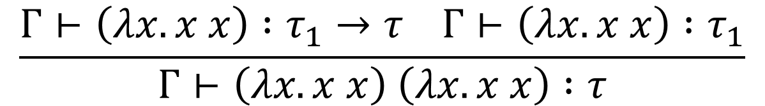
Limitations of Simple Types
Not every lambda-term is well typed
$$4 (λx. x)$$
$$\left(λx. x x\right) (λx. x x)$$
$$\frac{Γ⊢\left(λx. x x\right) :τ_{1}→τ Γ⊢\left(λx. x x\right) :τ_{1}}{Γ⊢\left(λx. x x\right) \left(λx. x x\right) :τ}$$

Slide 18
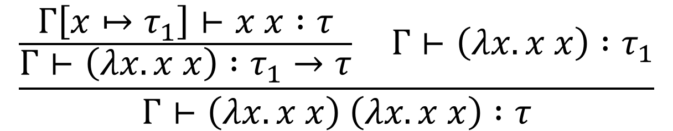
Limitations of Simple Types
Not every lambda-term is well typed
$$4 (λx. x)$$
$$\left(λx. x x\right) (λx. x x)$$
$$\frac{\frac{Γ\left[x↦τ_{1}\right]⊢x x :τ}{Γ⊢\left(λx. x x\right) :τ_{1}→τ} Γ⊢\left(λx. x x\right) :τ_{1}}{Γ⊢\left(λx. x x\right) \left(λx. x x\right) :τ}$$

Slide 19
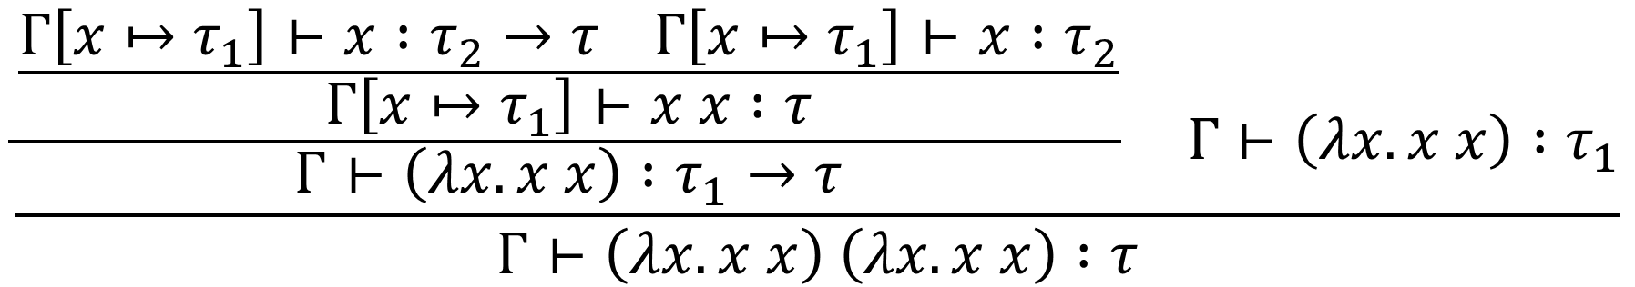
Limitations of Simple Types
Not every lambda-term is well typed
$$4 (λx. x)$$
$$\left(λx. x x\right) (λx. x x)$$
$$\frac{\frac{\frac{Γ\left[x↦τ_{1}\right]⊢x :τ_{2}→τ Γ\left[x↦τ_{1}\right]⊢x :τ_{2}}{Γ\left[x↦τ_{1}\right]⊢x x :τ}}{Γ⊢\left(λx. x x\right) :τ_{1}→τ} Γ⊢\left(λx. x x\right) :τ_{1}}{Γ⊢\left(λx. x x\right) \left(λx. x x\right) :τ}$$

Slide 20

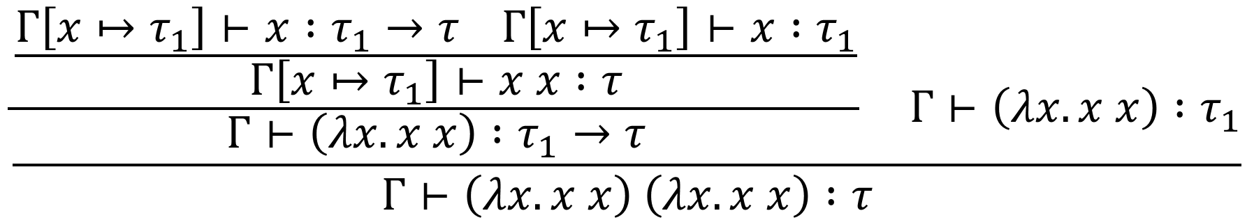
Limitations of Simple Types
Not every lambda-term is well typed
$τ_{1}$ can’t be the same as $τ_{1}→τ$!
$$4 (λx. x)$$
$$\left(λx. x x\right) (λx. x x)$$
$$\frac{\frac{\frac{Γ\left[x↦τ_{1}\right]⊢x :τ_{1}→τ Γ\left[x↦τ_{1}\right]⊢x :τ_{1}}{Γ\left[x↦τ_{1}\right]⊢x x :τ}}{Γ⊢\left(λx. x x\right) :τ_{1}→τ} Γ⊢\left(λx. x x\right) :τ_{1}}{Γ⊢\left(λx. x x\right) \left(λx. x x\right) :τ}$$

Slide 21
Limitations of Simple Types
Not every lambda-term is well typed
Untyped lambda terms can run forever, but simply-typed lambda terms always terminate!
  This means simply-typed lambda calculus is not Turing-complete
  Many interesting programs (ones that require loops or recursion) can’t be written in STLC
$$4 (λx. x)$$
$$\left(λx. x x\right) (λx. x x)$$
Notes:
Does this mean that typed functional languages can’t be Turing-complete?

Slide 22
Notes:
Poll Title: Do not modify the notes in this section to avoid tampering with the Poll Everywhere activity.
More info at polleverywhere.com/support
Questions
https://www.polleverywhere.com/discourses/SRzwhp4zztmGWgIgz520A

Slide 23
Limitations of Simple Types
Not every lambda-term is well typed
Untyped lambda terms can run forever, but simply-typed lambda terms always terminate!
  This means simply-typed lambda calculus is not Turing-complete
  Many interesting programs (ones that require loops or recursion) can’t be written in STLC
Typed languages don’t automatically include loops/recursion
But we can add it in as a separate feature

Slide 24
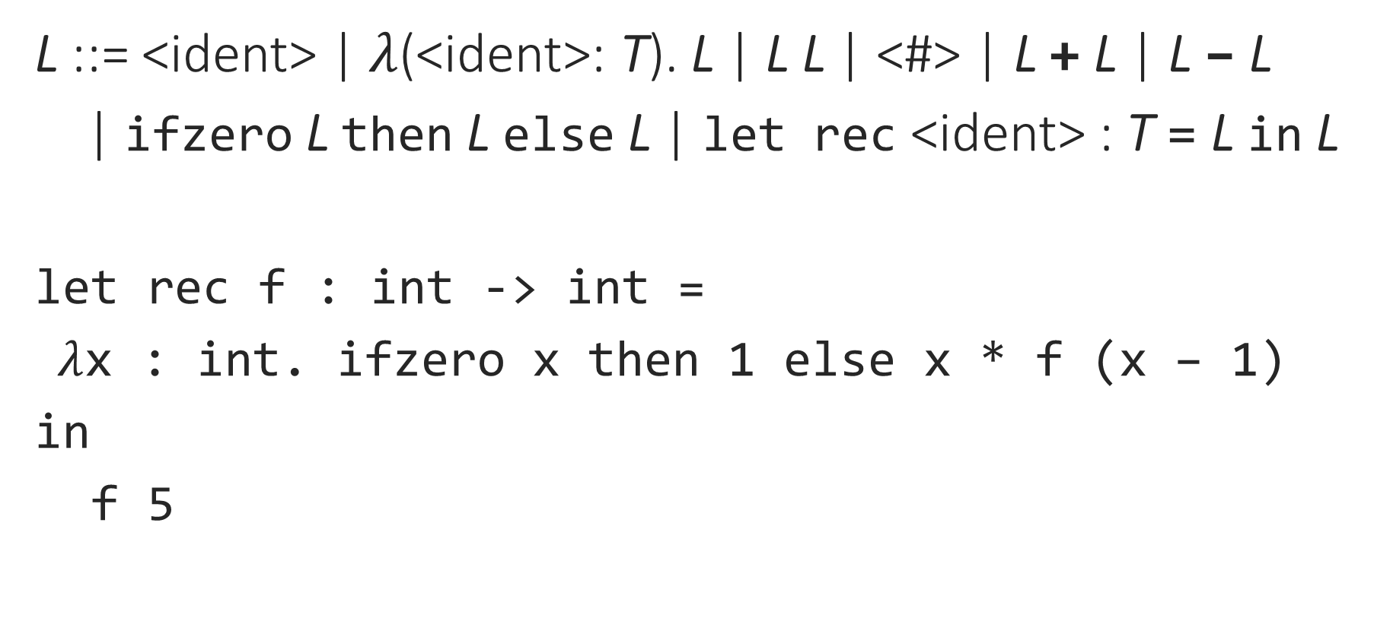
Typed Lambda Calculus with Recursion
L ::= <ident> | $λ$(<ident>: T). L | L L | <#> | L + L | L – L
| ifzero L then L else L | let rec <ident> : T = L in L
let rec f : int -> int =
$λ$x : int. ifzero x then 1 else x * f (x – 1)
in
f 5
Notes:
This is sometimes called PCF, or “Programming Computable Functions”, and is the direct basis for most functional languages.

Slide 25

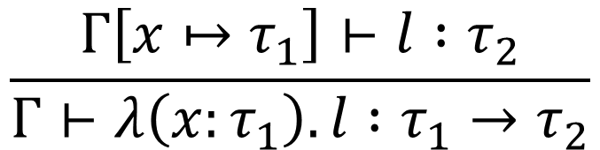
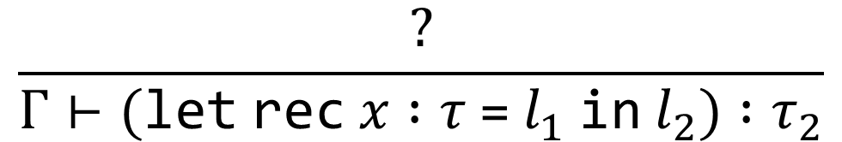
Typed Lambda Calculus with Recursion
L ::= <ident> | $λ$(<ident>: T). L | L L | <#> | L + L | L – L
| ifzero L then L else L | let rec <ident> : T = L in L
Exercise: How would you typecheck a let rec?
$$\frac{(i is a number literal)}{Γ⊢i :int}$$
$$\frac{(Γ\left(x\right)=τ)}{Γ⊢x :τ}$$
$$\frac{Γ\left[x↦τ_{1}\right]⊢l :τ_{2}}{Γ⊢λ\left(x:τ_{1}\right). l :τ_{1}→τ_{2}}$$
$$\frac{?}{Γ⊢(\text{let} \text{rec} x :τ \text{=} l_{1} \text{in} l_{2}) :τ_{2}}$$

Slide 26

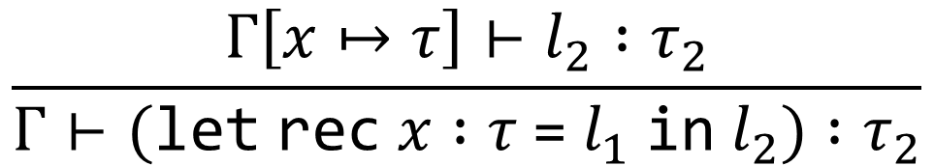
Typed Lambda Calculus with Recursion
L ::= <ident> | $λ$(<ident>: T). L | L L | <#> | L + L | L – L
| ifzero L then L else L | let rec <ident> : T = L in L
$$\frac{(i is a number literal)}{Γ⊢i :int}$$
$$\frac{(Γ\left(x\right)=τ)}{Γ⊢x :τ}$$
$$\frac{Γ\left[x↦τ_{1}\right]⊢l :τ_{2}}{Γ⊢λ\left(x:τ_{1}\right). l :τ_{1}→τ_{2}}$$
$$\frac{Γ\left[x↦τ\right]⊢l_{2} :τ_{2}}{Γ⊢(\text{let} \text{rec} x :τ \text{=} l_{1} \text{in} l_{2}) :τ_{2}}$$

Slide 27
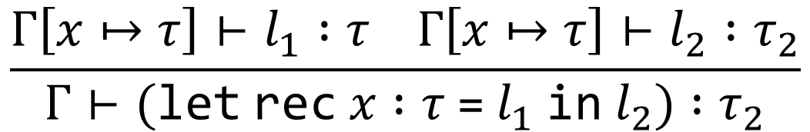
Typed Lambda Calculus with Recursion
L ::= <ident> | $λ$(<ident>: T). L | L L | <#> | L + L | L – L
| ifzero L then L else L | let rec <ident> : T = L in L
$$\frac{(i is a number literal)}{Γ⊢i :int}$$
$$\frac{(Γ\left(x\right)=τ)}{Γ⊢x :τ}$$
$$\frac{Γ\left[x↦τ_{1}\right]⊢l :τ_{2}}{Γ⊢λ\left(x:τ_{1}\right). l :τ_{1}→τ_{2}}$$
$$\frac{Γ\left[x↦τ\right]⊢l_{1} :τ Γ\left[x↦τ\right]⊢l_{2} :τ_{2}}{Γ⊢(\text{let} \text{rec} x :τ \text{=} l_{1} \text{in} l_{2}) :τ_{2}}$$

Slide 28
Notes:
Poll Title: Do not modify the notes in this section to avoid tampering with the Poll Everywhere activity.
More info at polleverywhere.com/support
Questions
https://www.polleverywhere.com/discourses/SRzwhp4zztmGWgIgz520A

Slide 29
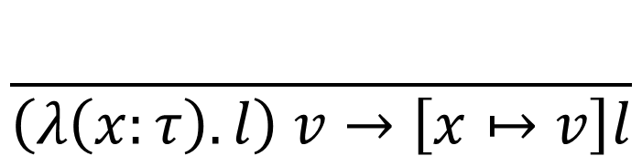
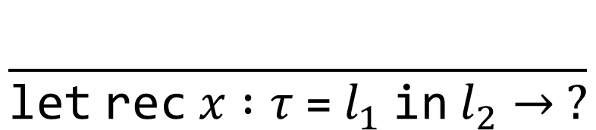


Typed Lambda Calculus with Recursion
L ::= <ident> | $λ$(<ident>: T). L | L L | <#> | L + L | L – L
| ifzero L then L else L | let rec <ident> : T = L in L
$$\frac{l_{1}→l_{1}^{′}}{l_{1} l_{2}→l_{1}^{′} l_{2}}$$
$$\frac{}{\left(λ\left(x:τ\right). l\right) v→\left[x↦v\right]l}$$
$$\frac{l_{2}→l_{2}^{′}}{v l_{2}→v l_{2}^{′}}$$
$$\frac{}{\text{let} \text{rec} x :τ \text{=} l_{1} \text{in} l_{2}→ ?}$$

Slide 30
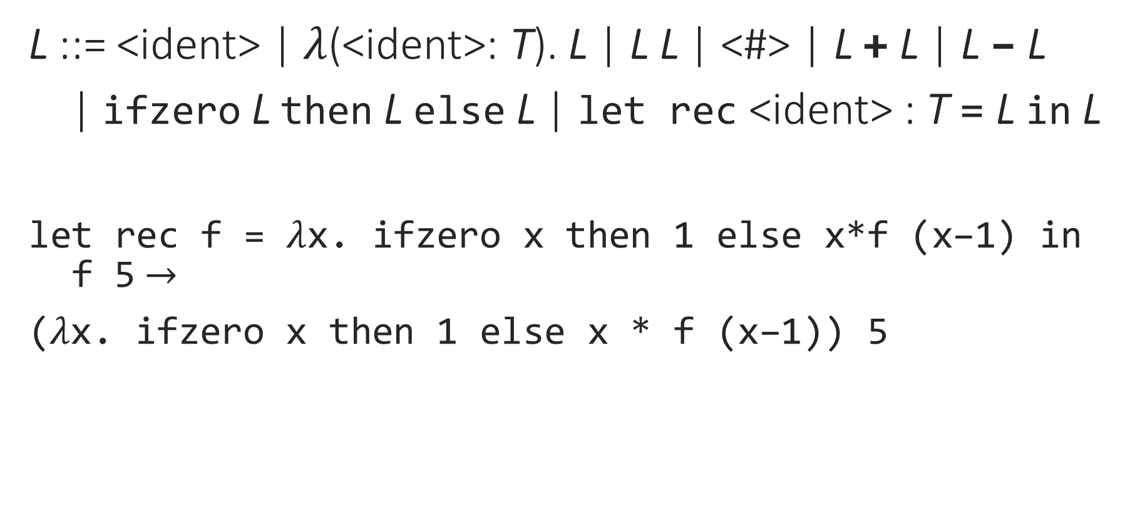
Typed Lambda Calculus with Recursion
L ::= <ident> | $λ$(<ident>: T). L | L L | <#> | L + L | L – L
| ifzero L then L else L | let rec <ident> : T = L in L
let rec f = $λ$x. ifzero x then 1 else x*f (x–1) in
f 5 $→$
($λ$x. ifzero x then 1 else x * f (x–1)) 5

Slide 31
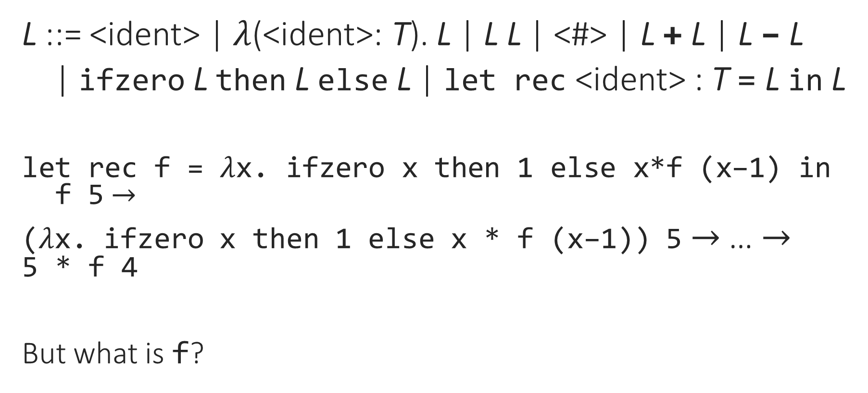
Typed Lambda Calculus with Recursion
L ::= <ident> | $λ$(<ident>: T). L | L L | <#> | L + L | L – L
| ifzero L then L else L | let rec <ident> : T = L in L
let rec f = $λ$x. ifzero x then 1 else x*f (x–1) in
f 5 $→$
($λ$x. ifzero x then 1 else x * f (x–1)) 5 $→$ … $→$
5 * f 4
But what is f?

Slide 32
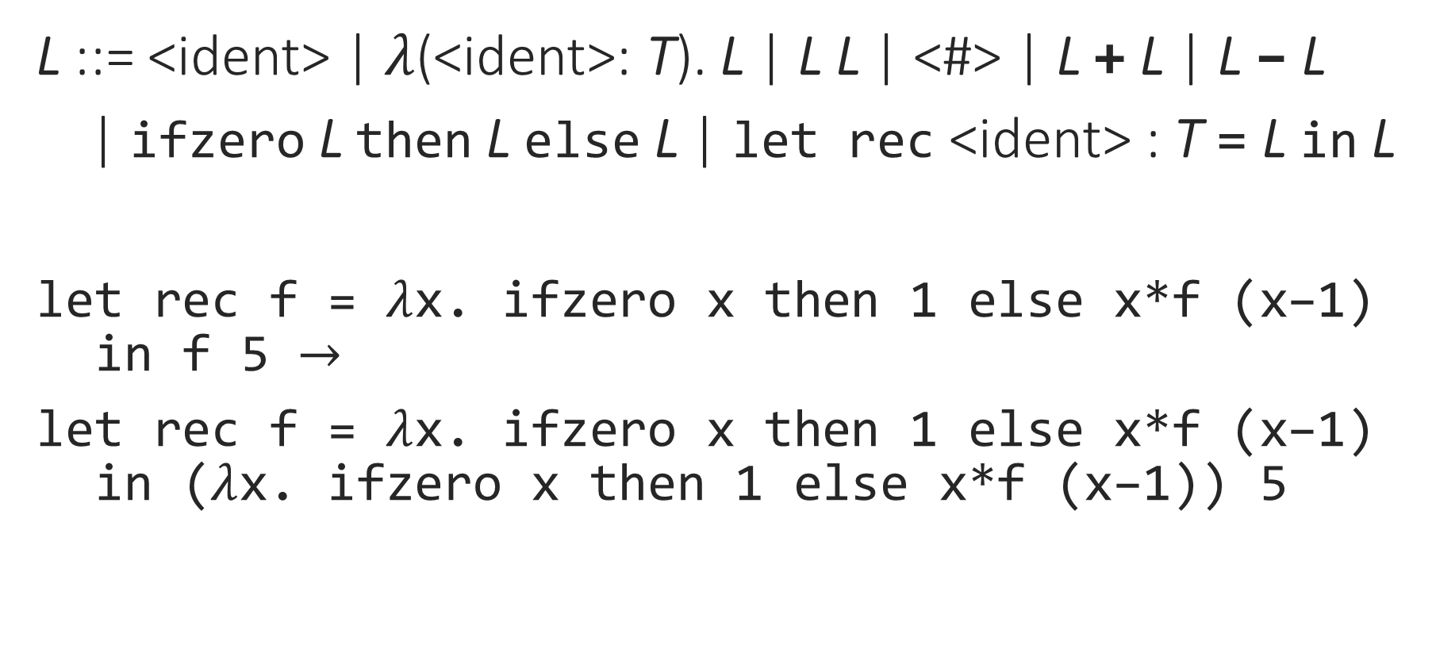
Typed Lambda Calculus with Recursion
L ::= <ident> | $λ$(<ident>: T). L | L L | <#> | L + L | L – L
| ifzero L then L else L | let rec <ident> : T = L in L
let rec f = $λ$x. ifzero x then 1 else x*f (x–1)
in f 5 $→$
let rec f = $λ$x. ifzero x then 1 else x*f (x–1)
in ($λ$x. ifzero x then 1 else x*f (x–1)) 5

Slide 33
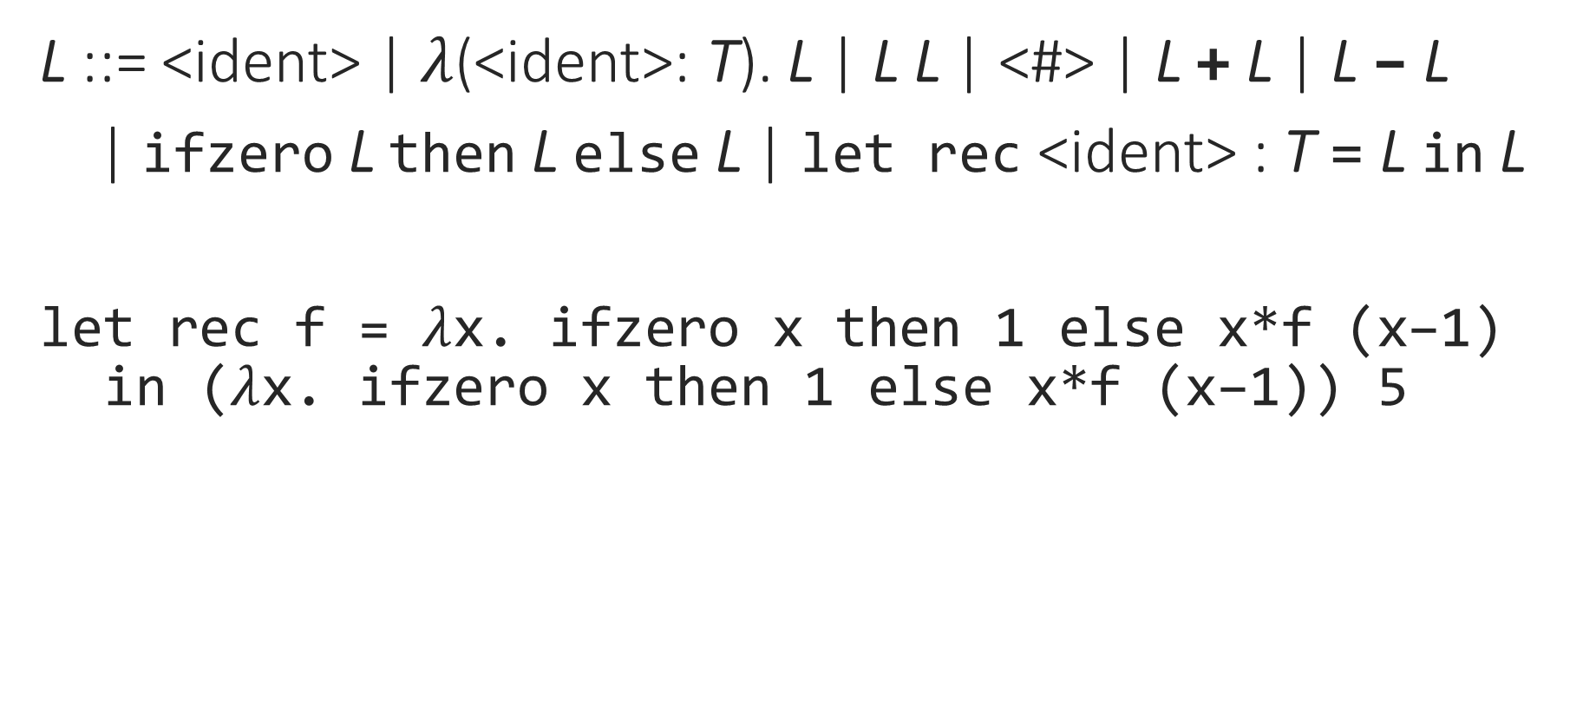
Typed Lambda Calculus with Recursion
L ::= <ident> | $λ$(<ident>: T). L | L L | <#> | L + L | L – L
| ifzero L then L else L | let rec <ident> : T = L in L
let rec f = $λ$x. ifzero x then 1 else x*f (x–1)
in ($λ$x. ifzero x then 1 else x*f (x–1)) 5

Slide 34
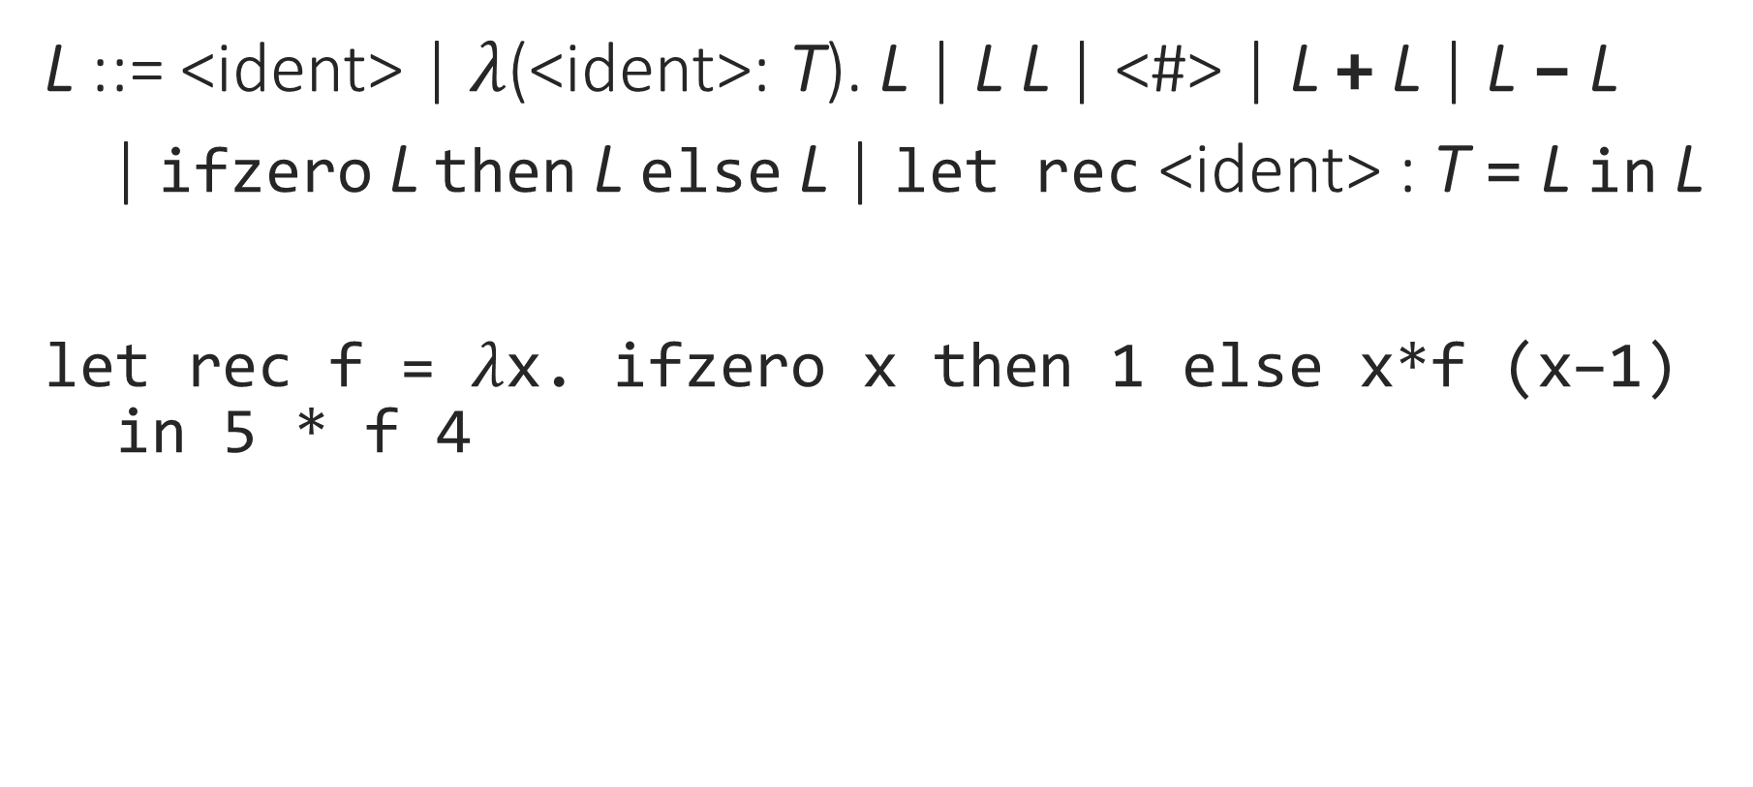
Typed Lambda Calculus with Recursion
L ::= <ident> | $λ$(<ident>: T). L | L L | <#> | L + L | L – L
| ifzero L then L else L | let rec <ident> : T = L in L
let rec f = $λ$x. ifzero x then 1 else x*f (x–1)
in 5 * f 4

Slide 35
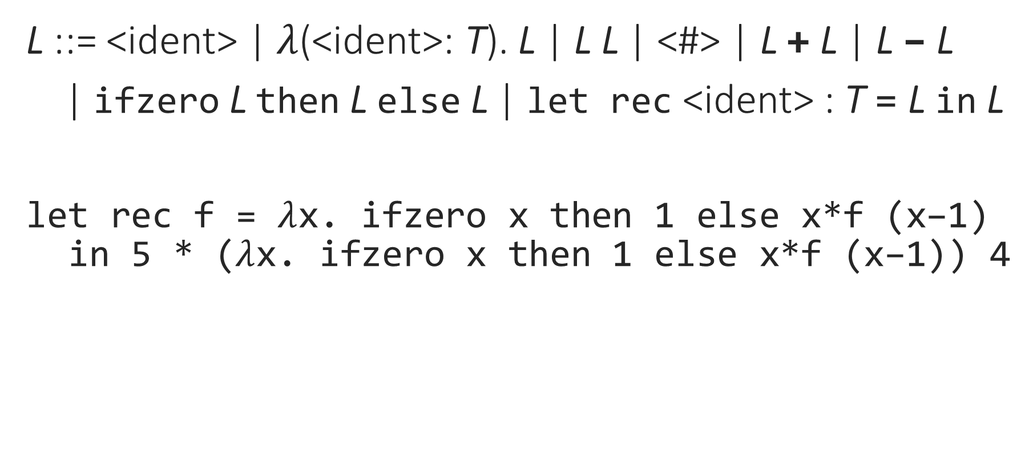
Typed Lambda Calculus with Recursion
L ::= <ident> | $λ$(<ident>: T). L | L L | <#> | L + L | L – L
| ifzero L then L else L | let rec <ident> : T = L in L
let rec f = $λ$x. ifzero x then 1 else x*f (x–1)
in 5 * ($λ$x. ifzero x then 1 else x*f (x–1)) 4

Slide 36
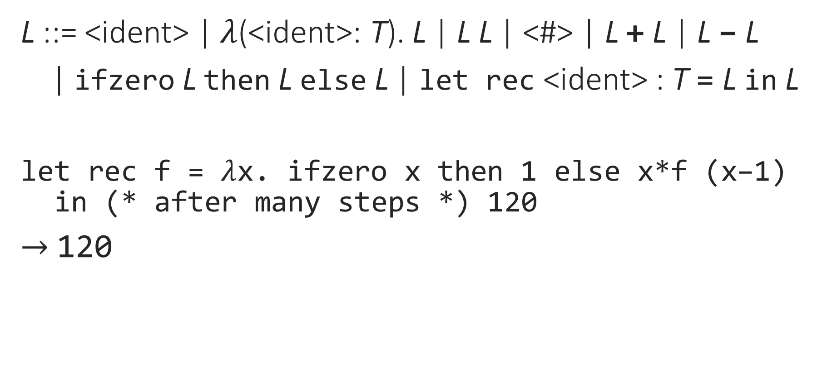
Typed Lambda Calculus with Recursion
L ::= <ident> | $λ$(<ident>: T). L | L L | <#> | L + L | L – L
| ifzero L then L else L | let rec <ident> : T = L in L
let rec f = $λ$x. ifzero x then 1 else x*f (x–1)
in (* after many steps *) 120
$→$ 120

Slide 37
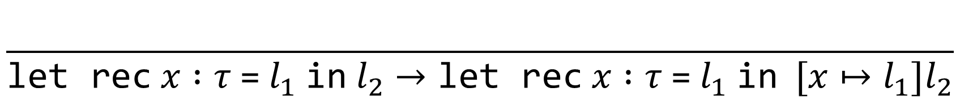
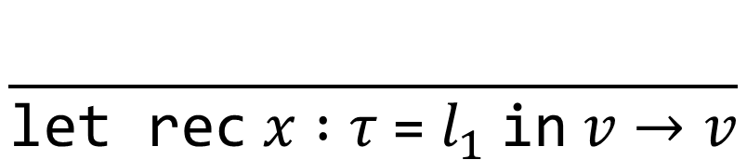
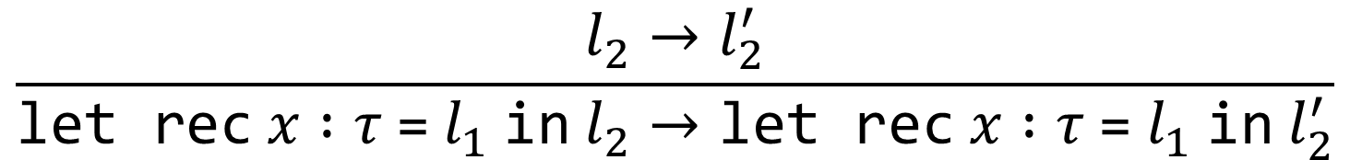
Typed Lambda Calculus with Recursion
L ::= <ident> | $λ$(<ident>: T). L | L L | <#> | L + L | L – L
| ifzero L then L else L | let rec <ident> : T = L in L
$$\frac{}{\text{let} \text{rec} x :τ \text{=} l_{1} \text{in} l_{2}→\text{let} \text{rec} x :τ \text{=} l_{1} \text{in} [x↦l_{1}]l_{2}}$$
$$\frac{l_{2}→l_{2}^{′}}{\text{let} \text{rec} x :τ \text{=} l_{1} \text{in} l_{2}→\text{let} \text{rec} x :τ \text{=} l_{1} \text{in} l_{2}^{′}}$$
$$\frac{}{\text{let} \text{rec} x :τ \text{=} l_{1} \text{in} v→v}$$

Slide 38
Notes:
Poll Title: Do not modify the notes in this section to avoid tampering with the Poll Everywhere activity.
More info at polleverywhere.com/support
Questions
https://www.polleverywhere.com/discourses/SRzwhp4zztmGWgIgz520A

