Slide 1
CS 476 – Programming Language Design
William Mansky

Slide 2

Notes:
Poll Title: Do not modify the notes in this section to avoid tampering with the Poll Everywhere activity.
More info at polleverywhere.com/support
Questions
https://www.polleverywhere.com/discourses/SRzwhp4zztmGWgIgz520A

Slide 3
Structure of a language
Syntax
  Concrete: what do programs look like?
  Abstract: what are the pieces of a program?
Semantics
  Static: which programs make sense? what can we expect from them?
  Dynamic: what do programs do when we run them?
Pragmatics
  Implementation: how can we actually make the semantics happen?
  IDE, tool support, etc.
Notes:
We’ll focus mainly on these points: (abstract syntax, semantics, a bit of implementation)

Slide 4
Static Semantics: Types
Exercise: what are types for? Why is it useful to have a type system in a programming language?
Notes:
Let’s step back from implementation, now, and do a bit more design. As we saw in the first interpreter, some expressions have values and others don’t.

Slide 5
Static Semantics: Types
Type systems do several things:
Help programmers tell different kinds of program expressions apart
Stop bad programs from running/catch errors early
Tell us what kind of value to expect from a piece of code
Give useful information to the compiler/interpreter
Notes:
Let’s step back from implementation, now, and do a bit more design. As we saw in the first interpreter, some expressions have values and others don’t.

Slide 6
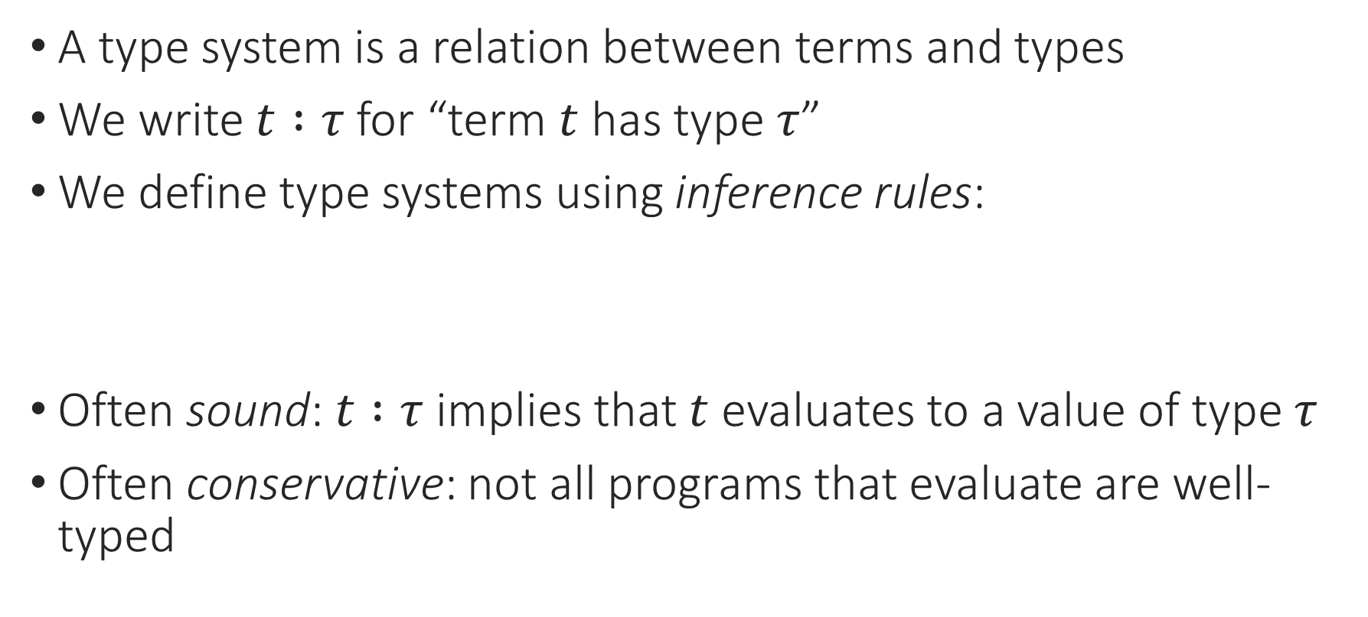

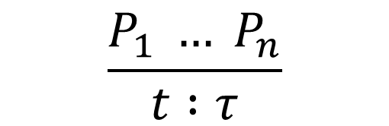
Static Semantics: Types
A type system is a relation between terms and types
We write $t :τ$ for “term $t$ has type $τ$”
We define type systems using inference rules:
Often sound: $t :τ$ implies that $t$ evaluates to a value of type $τ$
Often conservative: not all programs that evaluate are well-typed
“tau”
$$\frac{P_{1} … P_{n}}{t :τ}$$
$$\frac{e_{1} :int e_{2} :int }{e_{1} \text{+} e_{2} :int}$$
Notes:
Do some more general inference rule practice!
Let’s step back from implementation, now, and do a bit more design. As we saw in the first interpreter, some expressions have values and others don’t.

Slide 7
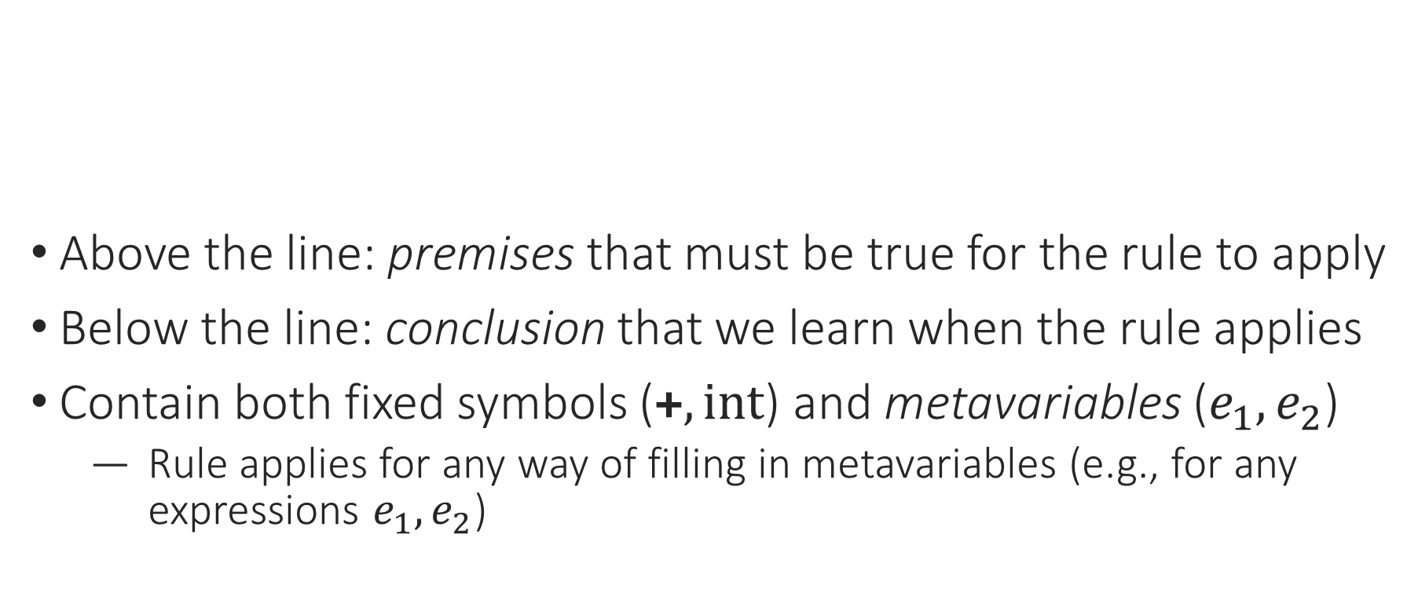

Static Semantics: Inference Rules
Above the line: premises that must be true for the rule to apply
Below the line: conclusion that we learn when the rule applies
Contain both fixed symbols ($\text{+}, int$) and metavariables ($e_{1},e_{2}$)
  Rule applies for any way of filling in metavariables (e.g., for any expressions $e_{1},e_{2}$)
$$\frac{e_{1} :int e_{2} :int }{e_{1} \text{+} e_{2} :int}$$
Notes:
Do some more general inference rule practice!
Let’s step back from implementation, now, and do a bit more design. As we saw in the first interpreter, some expressions have values and others don’t.

Slide 8
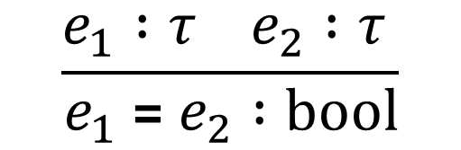
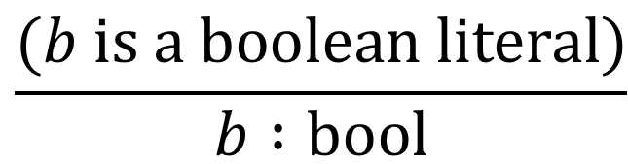
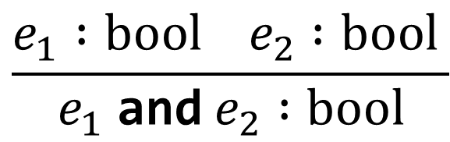
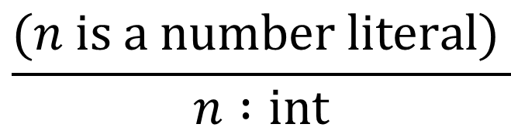

Expressions: Types
Types: int, bool
Rules:
$$\frac{(n is a number literal) }{n :int}$$
$$\frac{e_{1} :int e_{2} :int }{e_{1} \text{+} e_{2} :int}$$
$$\frac{(b is a boolean literal)}{b :bool}$$
$$\frac{e_{1} :bool e_{2} :bool }{e_{1} \text{and} e_{2} :bool}$$
$$\frac{e_{1} :τ e_{2} :τ }{e_{1} \text{=} e_{2} :bool}$$
Notes:
Let’s step back from implementation, now, and do a bit more design. As we saw in the first interpreter, some expressions have values and others don’t.

Slide 9
Notes:
Poll Title: Do not modify the notes in this section to avoid tampering with the Poll Everywhere activity.
More info at polleverywhere.com/support
Questions
https://www.polleverywhere.com/discourses/SRzwhp4zztmGWgIgz520A

Slide 10
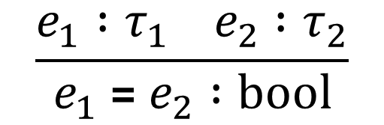
Expressions: Types
Types: int, bool
Rules:
$$\frac{(n is a number literal) }{n :int}$$
$$\frac{e_{1} :int e_{2} :int }{e_{1} \text{+} e_{2} :int}$$
$$\frac{(b is a boolean literal)}{b :bool}$$
$$\frac{e_{1} :bool e_{2} :bool }{e_{1} \text{and} e_{2} :bool}$$
$$\frac{e_{1} :τ_{1} e_{2} :τ_{2}}{e_{1} \text{=} e_{2} :bool}$$
Notes:
Let’s step back from implementation, now, and do a bit more design. As we saw in the first interpreter, some expressions have values and others don’t.

Slide 11
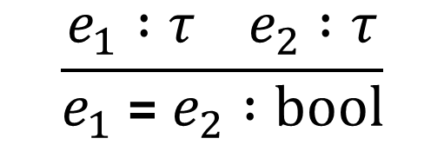
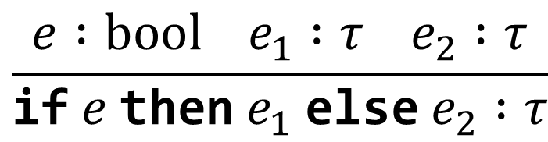
Expressions: Types
Types: int, bool
Rules:
$$\frac{(n is a number literal) }{n :int}$$
$$\frac{e_{1} :int e_{2} :int }{e_{1} \text{+} e_{2} :int}$$
$$\frac{(b is a boolean literal)}{b :bool}$$
$$\frac{e_{1} :bool e_{2} :bool }{e_{1} \text{and} e_{2} :bool}$$
$$\frac{e_{1} :τ e_{2} :τ}{e_{1} \text{=} e_{2} :bool}$$
$$\frac{e :bool e_{1} :τ e_{2} :τ}{\text{if} e \text{then} e_{1} \text{else} e_{2} :τ}$$
Notes:
Let’s step back from implementation, now, and do a bit more design. As we saw in the first interpreter, some expressions have values and others don’t.

Slide 12
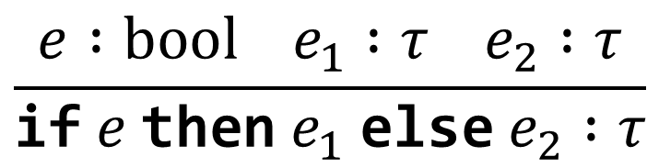
Proof Trees
$$\frac{e :bool e_{1} :τ e_{2} :τ}{\text{if} e \text{then} e_{1} \text{else} e_{2} :τ}$$
$$\text{if}\text{ 3 = 5} \text{then}\text{ 1 }\text{else}\text{ 2} :int$$
Notes:
How do we apply these rules to an expression?
What’s at the top level? Show OCaml type

Slide 13
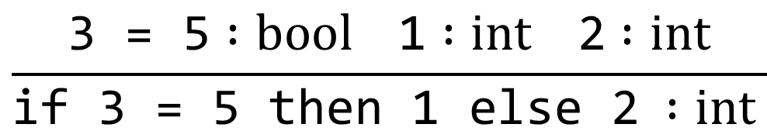
Proof Trees
$$\frac{e :bool e_{1} :τ e_{2} :τ}{\text{if} e \text{then} e_{1} \text{else} e_{2} :τ}$$
$$\frac{\text{3} \text{=} \text{5} :bool \text{1} :int \text{2} :int}{\text{if}\text{ 3 = 5} \text{then}\text{ 1 }\text{else}\text{ 2} :int }$$
Notes:
How do we apply these rules to an expression?

Slide 14
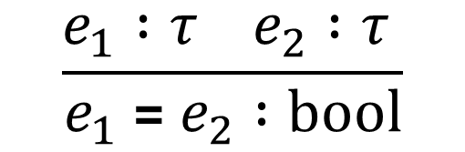
Proof Trees
$$\frac{e_{1} :τ e_{2} :τ }{e_{1} \text{=} e_{2} :bool}$$
$$\frac{\text{3} \text{=} \text{5} :bool \text{1} :int \text{2} :int}{\text{if}\text{ 3 = 5} \text{then}\text{ 1 }\text{else}\text{ 2} :int }$$
Notes:
How do we apply these rules to an expression?

Slide 15
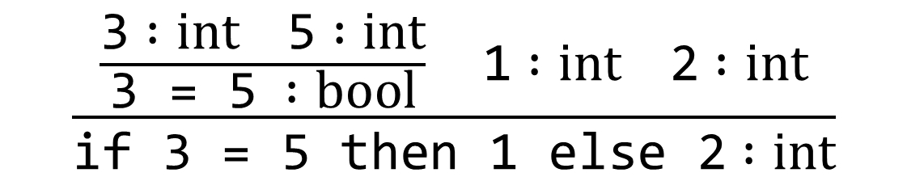
Proof Trees
$$\frac{e_{1} :τ e_{2} :τ }{e_{1} \text{=} e_{2} :bool}$$
$$\frac{\frac{\text{3} :int \text{5} :int}{\text{3} \text{=} \text{5} :bool} \text{1} :int \text{2} :int}{\text{if}\text{ 3 = 5} \text{then}\text{ 1 }\text{else}\text{ 2} :int}$$
Notes:
How do we apply these rules to an expression?

Slide 16
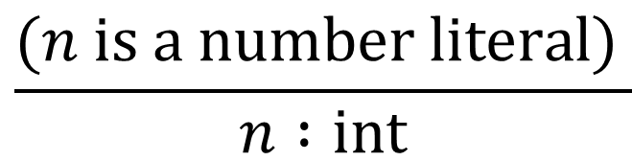
Proof Trees
$$\frac{(n is a number literal) }{n :int}$$
$$\frac{\frac{\text{3} :int \text{5} :int}{\text{3} \text{=} \text{5} :bool} \text{1} :int \text{2} :int}{\text{if}\text{ 3 = 5} \text{then}\text{ 1 }\text{else}\text{ 2} :int}$$
Notes:
How do we apply these rules to an expression?

Slide 17
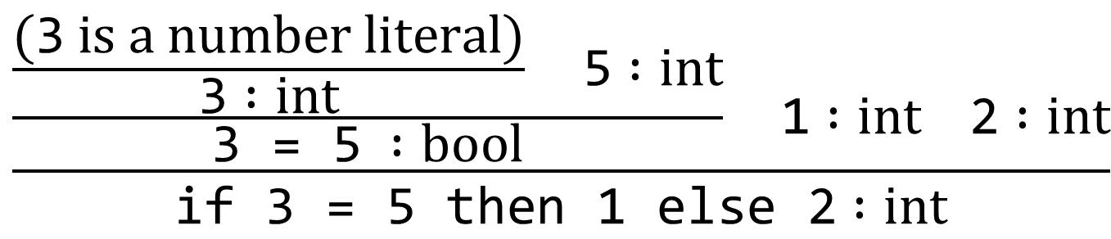
Proof Trees
$$\frac{(n is a number literal) }{n :int}$$
$$\frac{\frac{\frac{(\text{3} is a number literal)}{\text{3} :int} \text{5} :int}{\text{3} \text{=} \text{5} :bool} \text{1} :int \text{2} :int}{\text{if}\text{ 3 = 5} \text{then}\text{ 1 }\text{else}\text{ 2} :int}$$
Notes:
How do we apply these rules to an expression?

Slide 18
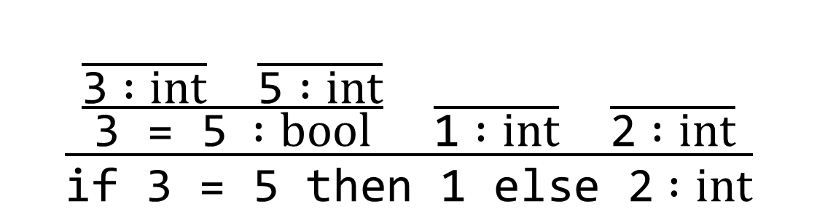
Proof Trees
$$\frac{(n is a number literal) }{n :int}$$
$$\frac{\frac{\frac{}{\text{3} :int} \frac{}{\text{5} :int}}{\text{3} \text{=} \text{5} :bool} \frac{}{\text{1} :int} \frac{}{\text{2} :int}}{\text{if}\text{ 3 = 5} \text{then}\text{ 1 }\text{else}\text{ 2} :int}$$
Notes:
So, this expression is well typed.

Slide 19
Proof Trees
$$\frac{e :bool e_{1} :τ e_{2} :τ}{\text{if} e \text{then} e_{1} \text{else} e_{2} :τ}$$
$$\text{if}\text{ 3 = 5 }\text{then}\text{ 1 }\text{else} \text{false} :int$$
Notes:
How do we apply these rules to an expression?

Slide 20

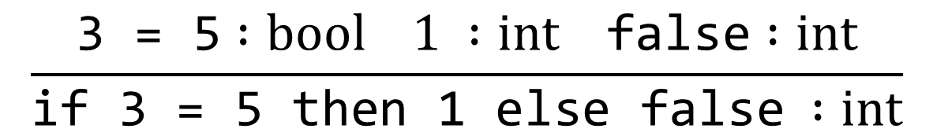
Proof Trees
$$\frac{e :bool e_{1} :τ e_{2} :τ}{\text{if} e \text{then} e_{1} \text{else} e_{2} :τ}$$
$$\frac{\text{3} \text{=} \text{5} :bool 1 :int \text{false} :int}{\text{if}\text{ 3 = 5} \text{then}\text{ 1 }\text{else} \text{false} :int}$$
Notes:
How do we apply these rules to an expression?

Slide 21
Notes:
Poll Title: Do not modify the notes in this section to avoid tampering with the Poll Everywhere activity.
More info at polleverywhere.com/support
Questions
https://www.polleverywhere.com/discourses/SRzwhp4zztmGWgIgz520A

Slide 22
Expressions: Types
Types: int, bool
Rules:
$$\frac{(n is a number literal) }{n :int}$$
$$\frac{e_{1} :int e_{2} :int }{e_{1} \text{+} e_{2} :int}$$
$$\frac{(b is a boolean literal)}{b :bool}$$
$$\frac{e_{1} :bool e_{2} :bool }{e_{1} \text{and} e_{2} :bool}$$
$$\frac{e_{1} :τ e_{2} :τ}{e_{1} \text{=} e_{2} :bool}$$
$$\frac{e :bool e_{1} :τ e_{2} :τ}{\text{if} e \text{then} e_{1} \text{else} e_{2} :τ}$$
Notes:
Let’s step back from implementation, now, and do a bit more design. As we saw in the first interpreter, some expressions have values and others don’t.

Slide 23
Expressions: Type Checking
Every term computes to a value, either int or bool
Types: int, bool
type etype = IntTy | BoolTy
  These are object-level (expression) types, not meta-level (OCaml) types int, bool
Notes:
What do we do with these rules once we have them?

Slide 24
Literals, Values, Types
We have three different kinds of int/bool constructors now:
type exp = Num of int | ... | Bool of bool | … | If of exp * exp * exp
type retval = IntVal of int | BoolVal of bool
type etype = IntTy | BoolTy
An expression is a piece of program code
A retval is the result when we run a program
An etype is information about an expression
  If we get it right, the type of an expression tells us which kind of value it will produce!

Slide 25
Expressions: Type Checking
Every term computes to a value, either int or bool
Types: int, bool
type etype = IntTy | BoolTy
  These are “object-level” (expression) types, not “meta-level” (OCaml) types (int, bool)
A type checker takes an expression and a type, and determines whether the expression has that type
Notes:
What do we do with these rules once we have them?

Slide 26
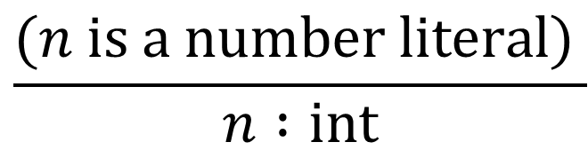
Expressions: Type Checking
type etype = IntTy | BoolTy
  These are “object-level” (expression) types, not “meta-level” (OCaml) types!
let rec typecheck (e : exp) (t : etype) : bool = (* true when e : t *)
match e with
| Num i ->
| Bool b ->
| Add (e1, e2) ->
…
$$\frac{(n is a number literal) }{n :int}$$
Notes:
What do we do with these rules once we have them?

Slide 27
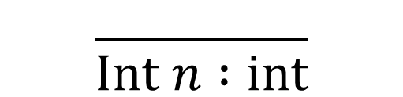
Expressions: Type Checking
type etype = IntTy | BoolTy
  These are “object-level” (expression) types, not “meta-level” (OCaml) types!
let rec typecheck (e : exp) (t : etype) : bool = (* true when e : t *)
match e with
| Num i -> t = IntTy
| Bool b ->
| Add (e1, e2) ->
…
$$\frac{(n is a number literal) }{n :int}$$
$$\frac{ }{Int n :int}$$
Notes:
What do we do with these rules once we have them?

Slide 28
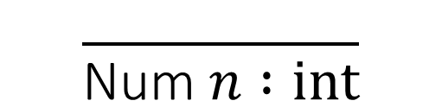
Expressions: Type Checking
type etype = IntTy | BoolTy
  These are “object-level” (expression) types, not “meta-level” (OCaml) types!
let rec typecheck (e : exp) (t : etype) : bool = (* true when e : t *)
match e with
| Num _ -> t = IntTy
| Bool b ->
| Add (e1, e2) ->
…
$$\frac{(n is a number literal) }{n :int}$$
$$\frac{ }{\text{Num} n :int}$$
Notes:
What do we do with these rules once we have them?

Slide 29
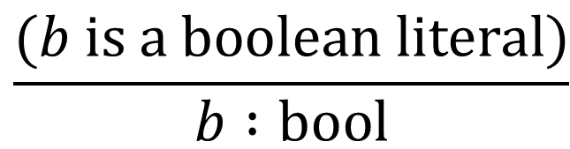
Expressions: Type Checking
type etype = IntTy | BoolTy
  These are “object-level” (expression) types, not “meta-level” (OCaml) types!
let rec typecheck (e : exp) (t : etype) : bool = (* true when e : t *)
match e with
| Num _ -> t = IntTy
| Bool _ -> t = BoolTy
| Add (e1, e2) ->
…
$$\frac{(b is a boolean literal)}{b :bool}$$
Notes:
What do we do with these rules once we have them?

Slide 30

Expressions: Type Checking
type etype = IntTy | BoolTy
  These are “object-level” (expression) types, not “meta-level” (OCaml) types!
let rec typecheck (e : exp) (t : etype) : bool = (* true when e : t *)
match e with
| Num _ -> t = IntTy
| Bool _ -> t = BoolTy
| Add (e1, e2) ->
Exercise: Write OCaml code that implements the type rule for addition.
$$\frac{e_{1} :int e_{2} :int }{e_{1} \text{+} e_{2} :int}$$
Notes:
What do we do with these rules once we have them?

Slide 31

Expressions: Type Checking
type etype = IntTy | BoolTy
  These are “object-level” (expression) types, not “meta-level” (OCaml) types!
let rec typecheck (e : exp) (t : etype) : bool = (* true when e : t *)
match e with
| Num _ -> t = IntTy
| Bool _ -> t = BoolTy
| Add (e1, e2) ->
…
$$\frac{e_{1} :int e_{2} :int }{e_{1} \text{+} e_{2} :int}$$
Notes:
What do we do with these rules once we have them?

Slide 32
Expressions: Type Checking
type etype = IntTy | BoolTy
  These are “object-level” (expression) types, not “meta-level” (OCaml) types!
let rec typecheck (e : exp) (t : etype) : bool = (* true when e : t *)
match e with
| Num _ -> t = IntTy
| Bool _ -> t = BoolTy
| Add (e1, e2) -> typecheck e1 IntTy && typecheck e2 IntTy
…
$$\frac{e_{1} :int e_{2} :int }{e_{1} \text{+} e_{2} :int}$$
Notes:
Compare to what happens if we match e1/e2 with the Int constructor.

Slide 33

Expressions: Type Checking
type etype = IntTy | BoolTy
  These are “object-level” (expression) types, not “meta-level” (OCaml) types!
let rec typecheck (e : exp) (t : etype) : bool = (* true when e : t *)
match e with
| Num _ -> t = IntTy
| Bool _ -> t = BoolTy
| Add (e1, e2) -> typecheck e1 IntTy && typecheck e2 IntTy
…
$$\frac{e_{1} :int e_{2} :int }{e_{1} \text{+} e_{2} :int}$$
Notes:
What do we do with these rules once we have them?

Slide 34
Expressions: Type Checking
type etype = IntTy | BoolTy
  These are “object-level” (expression) types, not “meta-level” (OCaml) types!
let rec typecheck (e : exp) (t : etype) : bool = (* true when e : t *)
match e with
| Num _ -> t = IntTy
| Bool _ -> t = BoolTy
| Add (e1, e2) -> typecheck e1 IntTy && typecheck e2 IntTy && t = IntTy
$$\frac{e_{1} :int e_{2} :int }{e_{1} \text{+} e_{2} :int}$$
Notes:
What do we do with these rules once we have them?

Slide 35
Notes:
Poll Title: Do not modify the notes in this section to avoid tampering with the Poll Everywhere activity.
More info at polleverywhere.com/support
Questions
https://www.polleverywhere.com/discourses/SRzwhp4zztmGWgIgz520A

