Slide 1
CS 476 – Programming Language Design
William Mansky

Slide 2

Notes:
Poll Title: Do not modify the notes in this section to avoid tampering with the Poll Everywhere activity.
More info at polleverywhere.com/support
Questions
https://www.polleverywhere.com/discourses/SRzwhp4zztmGWgIgz520A

Slide 3
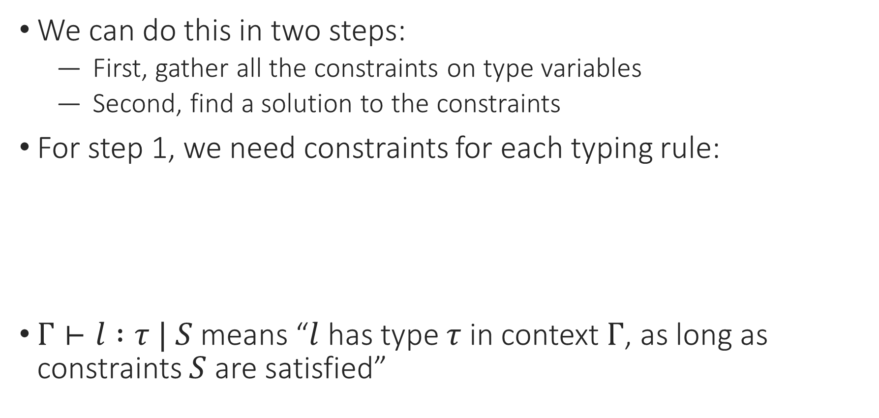
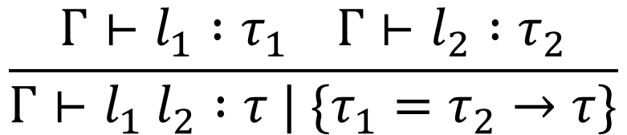
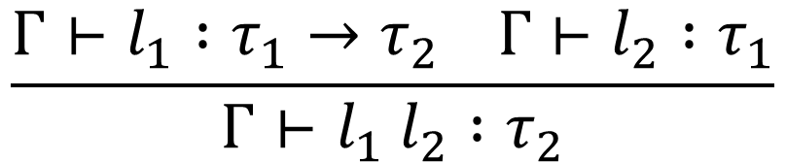
Constraint-Based Type Inference
We can do this in two steps:
  First, gather all the constraints on type variables
  Second, find a solution to the constraints
For step 1, we need constraints for each typing rule:
$Γ⊢l :τ | S$ means “$l$ has type $τ$ in context $Γ$, as long as constraints $S$ are satisfied”
$$\frac{Γ⊢l_{1} :τ_{1}→τ_{2} Γ⊢l_{2} :τ_{1}}{Γ⊢l_{1} l_{2} :τ_{2}}$$
$$\frac{Γ⊢l_{1} :τ_{1} Γ⊢l_{2} :τ_{2}}{Γ⊢l_{1} l_{2} :τ | \{τ_{1}=τ_{2}→τ\}}$$

Slide 4
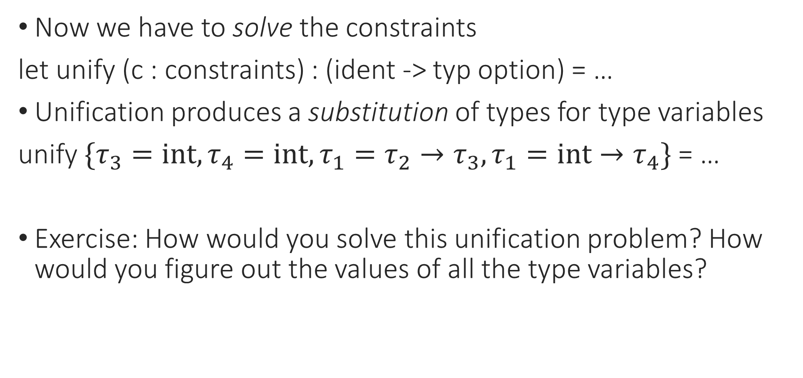
Unification
Now we have to solve the constraints
let unify (c : constraints) : (ident -> typ option) = …
Unification produces a substitution of types for type variables
unify $\{τ_{3}=int,τ_{4}=int,τ_{1}=τ_{2}→τ_{3},τ_{1}=int→τ_{4}\}$ = …
Exercise: How would you solve this unification problem? How would you figure out the values of all the type variables?

Slide 5
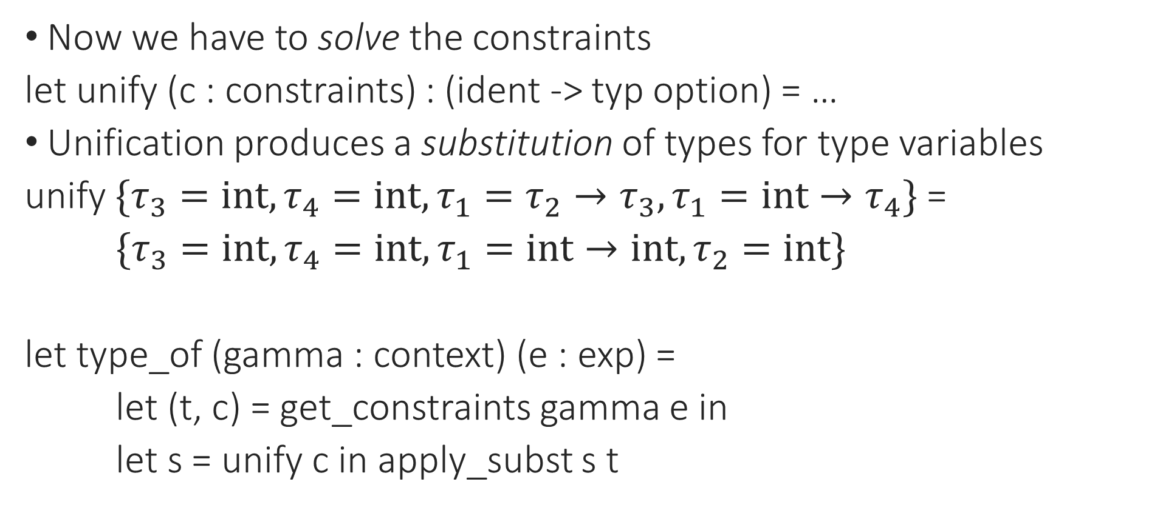
Constraint-Based Type Inference
Now we have to solve the constraints
let unify (c : constraints) : (ident -> typ option) = …
Unification produces a substitution of types for type variables
unify $\{τ_{3}=int,τ_{4}=int,τ_{1}=τ_{2}→τ_{3},τ_{1}=int→τ_{4}\}$ =
$\{τ_{3}=int,τ_{4}=int,τ_{1}=int→int,τ_{2}=int\}$
let type_of (gamma : context) (e : exp) =
let (t, c) = get_constraints gamma e in
let s = unify c in apply_subst s t
Notes:
Note that this process is totally separate from the original program! At this point, we’re just looking at the generated type constraints.

Slide 6
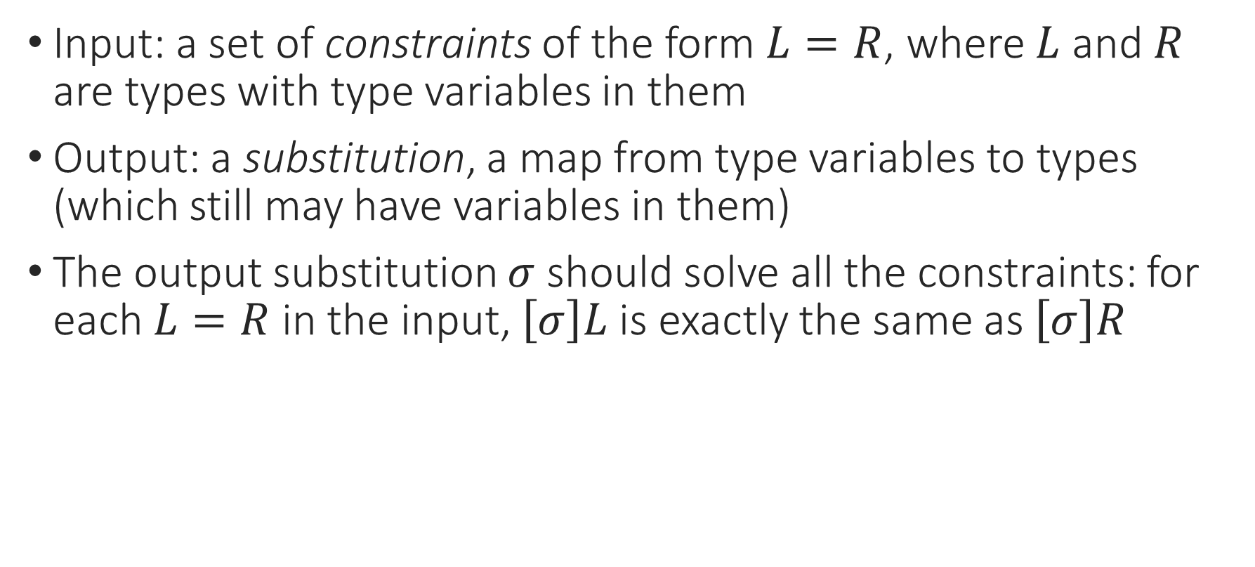
Unification
Input: a set of constraints of the form $L=R$, where $L$ and $R$ are types with type variables in them
Output: a substitution, a map from type variables to types (which still may have variables in them)
The output substitution $σ$ should solve all the constraints: for each $L=R$ in the input, $\left[σ\right]L$ is exactly the same as $\left[σ\right]R$

Slide 7
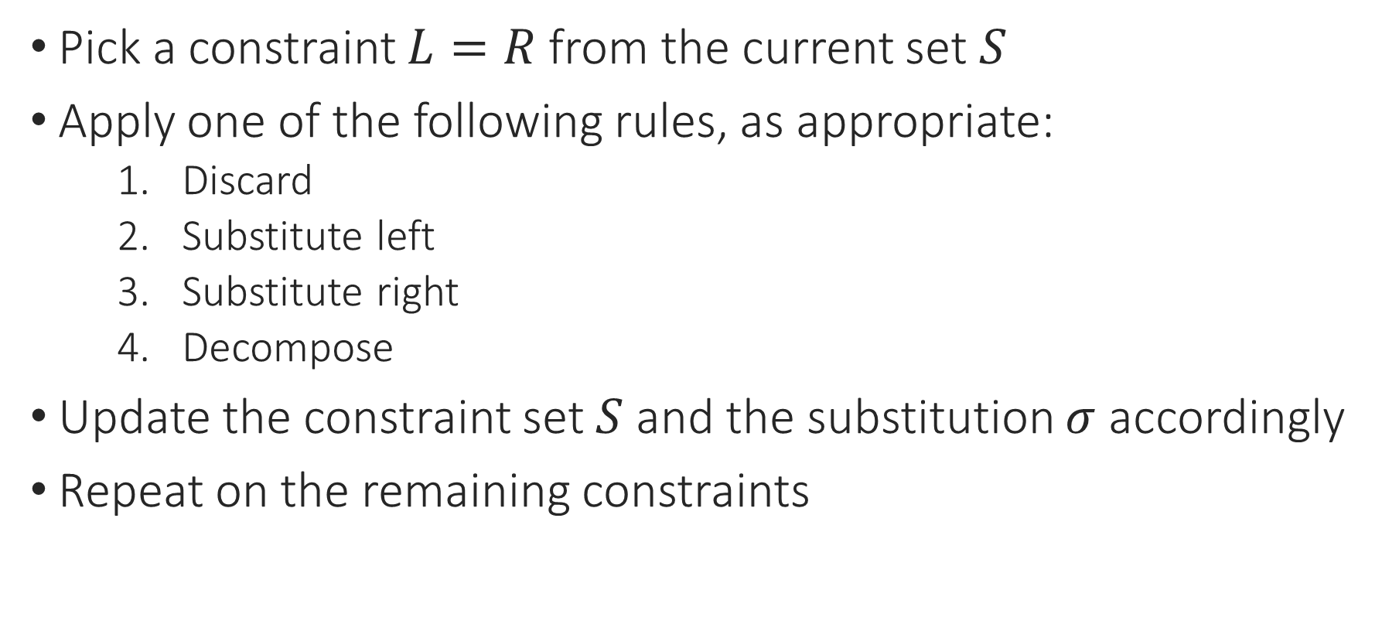
The Unification Algorithm
Pick a constraint $L=R$ from the current set $S$
Apply one of the following rules, as appropriate:
  Discard
  Substitute left
  Substitute right
  Decompose
Update the constraint set $S$ and the substitution $σ$ accordingly
Repeat on the remaining constraints

Slide 8
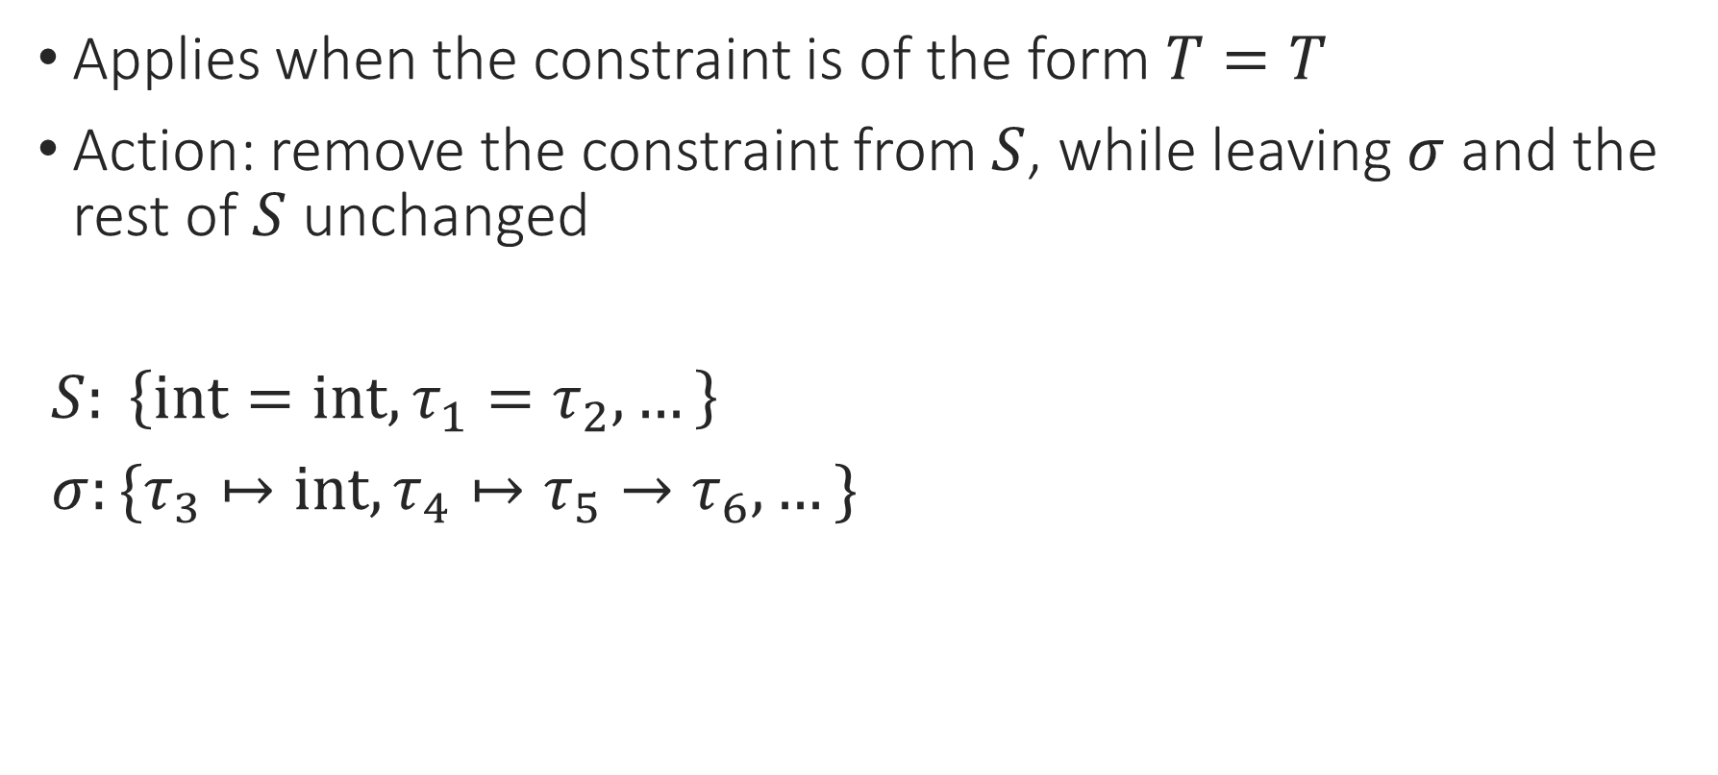
The Unification Algorithm: Discard
Applies when the constraint is of the form $T=T$
Action: remove the constraint from $S$, while leaving $σ$ and the rest of $S$ unchanged
$S: \left\{int=int, τ_{1}=τ_{2},…\right\}$
$σ:\{τ_{3}↦int, τ_{4}↦τ_{5}→τ_{6},…\}$

Slide 9
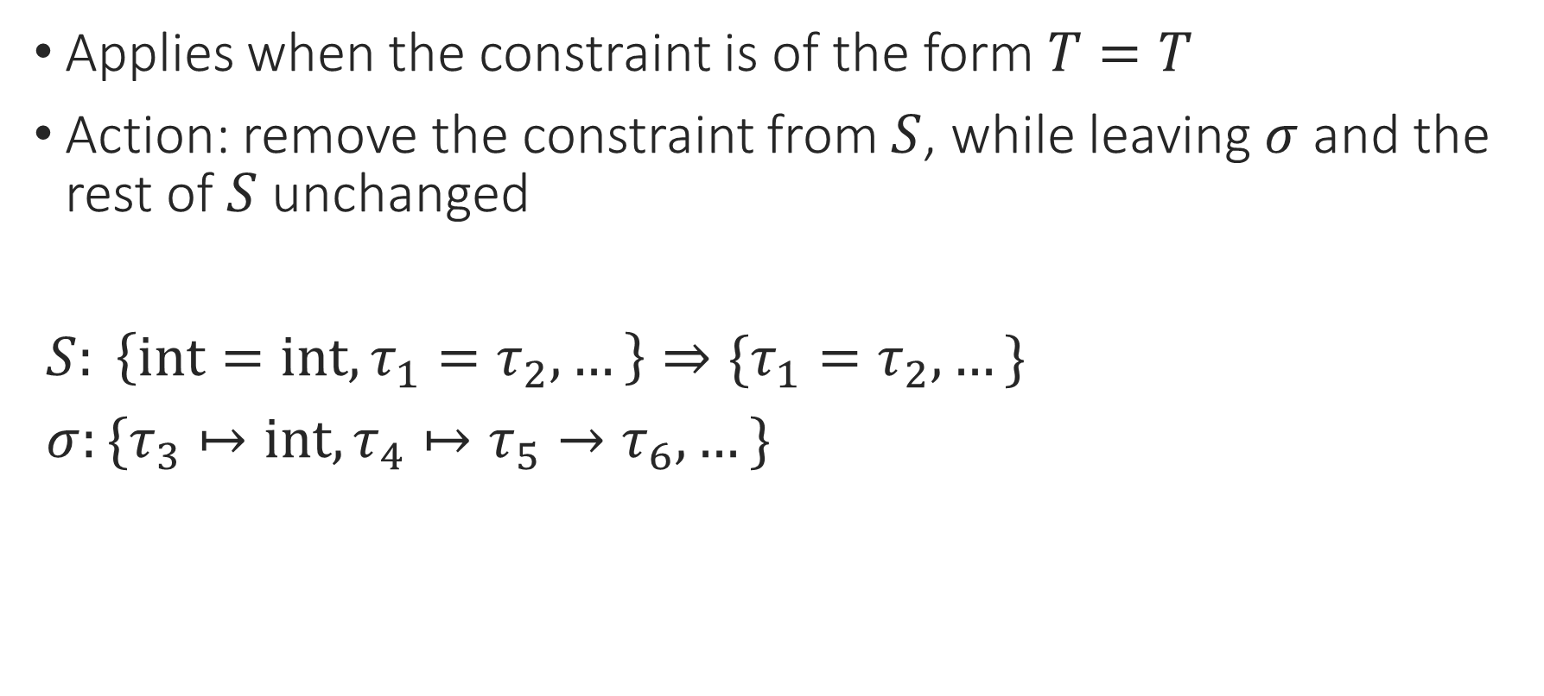
The Unification Algorithm: Discard
Applies when the constraint is of the form $T=T$
Action: remove the constraint from $S$, while leaving $σ$ and the rest of $S$ unchanged
$S: \left\{int=int, τ_{1}=τ_{2},…\right\}⇒\{τ_{1}=τ_{2},…\}$
$σ:\{τ_{3}↦int, τ_{4}↦τ_{5}→τ_{6},…\}$

Slide 10
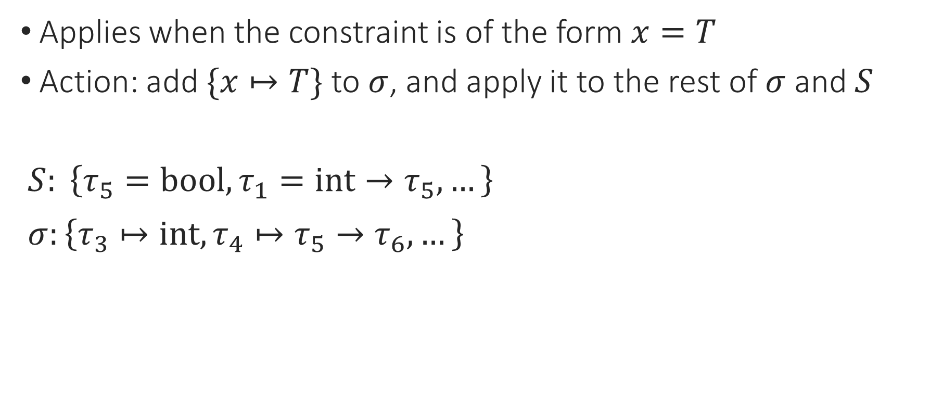
The Unification Algorithm: Substitute (L)
Applies when the constraint is of the form $x=T$
Action: add $\{x↦T\}$ to $σ$, and apply it to the rest of $σ$ and $S$
$S: \left\{τ_{5}=bool, τ_{1}=int→τ_{5},…\right\}$
$σ:\left\{τ_{3}↦int, τ_{4}↦τ_{5}→τ_{6},…\right\}$

Slide 11
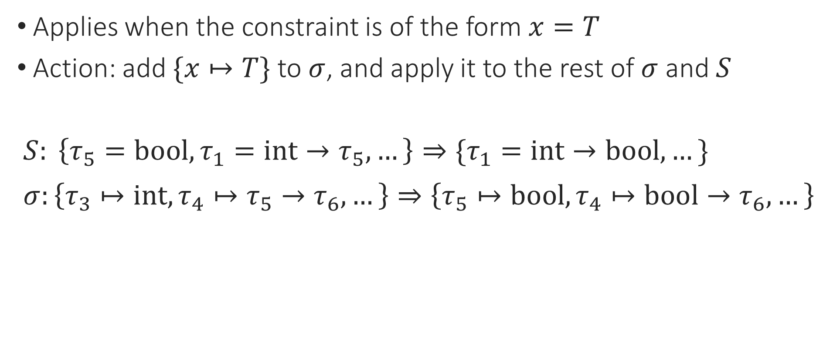
The Unification Algorithm: Substitute (L)
Applies when the constraint is of the form $x=T$
Action: add $\{x↦T\}$ to $σ$, and apply it to the rest of $σ$ and $S$
$S: \left\{τ_{5}=bool, τ_{1}=int→τ_{5},…\right\}⇒\{τ_{1}=int→bool,…\}$
$σ:\left\{τ_{3}↦int, τ_{4}↦τ_{5}→τ_{6},…\right\}⇒\left\{τ_{5}↦bool, τ_{4}↦bool→τ_{6},…\right\}$

Slide 12
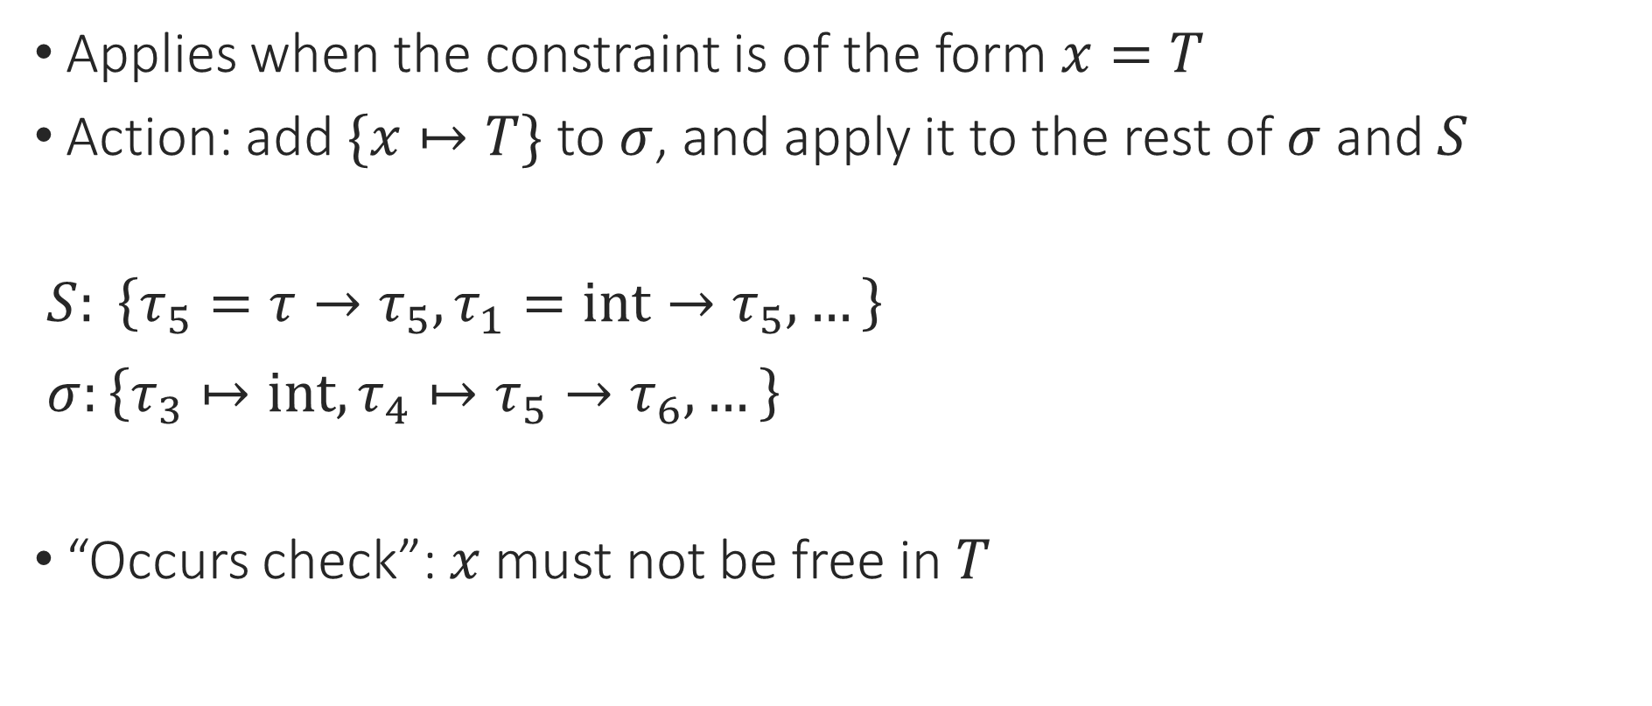
The Unification Algorithm: Substitute (L)
Applies when the constraint is of the form $x=T$
Action: add $\{x↦T\}$ to $σ$, and apply it to the rest of $σ$ and $S$
$S: \left\{τ_{5}=τ→τ_{5}, τ_{1}=int→τ_{5},…\right\}$
$σ:\left\{τ_{3}↦int, τ_{4}↦τ_{5}→τ_{6},…\right\}$
“Occurs check”: $x$ must not be free in $T$

Slide 13
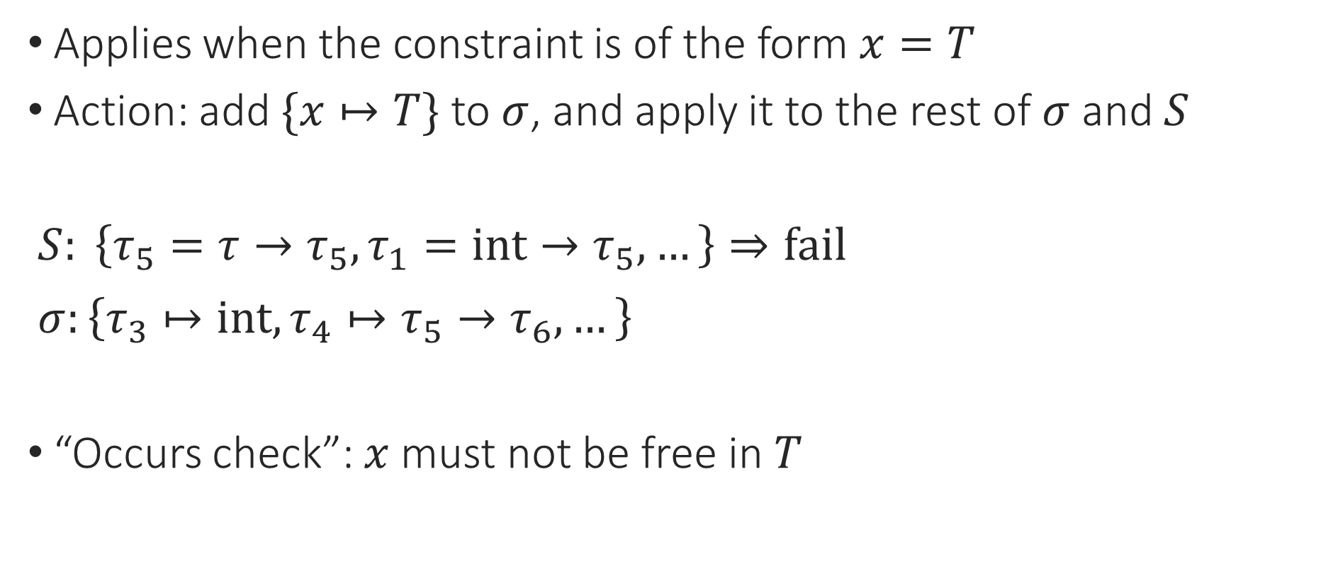
The Unification Algorithm: Substitute (L)
Applies when the constraint is of the form $x=T$
Action: add $\{x↦T\}$ to $σ$, and apply it to the rest of $σ$ and $S$
$S: \left\{τ_{5}=τ→τ_{5}, τ_{1}=int→τ_{5},…\right\}⇒fail$
$σ:\left\{τ_{3}↦int, τ_{4}↦τ_{5}→τ_{6},…\right\}$
“Occurs check”: $x$ must not be free in $T$

Slide 14
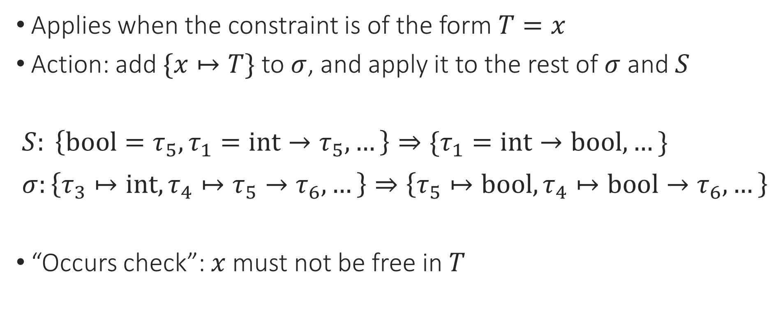
The Unification Algorithm: Substitute (R)
Applies when the constraint is of the form $T=x$
Action: add $\{x↦T\}$ to $σ$, and apply it to the rest of $σ$ and $S$
$S: \left\{bool=τ_{5}, τ_{1}=int→τ_{5},…\right\}⇒\{τ_{1}=int→bool,…\}$
$σ:\left\{τ_{3}↦int, τ_{4}↦τ_{5}→τ_{6},…\right\}⇒\left\{τ_{5}↦bool, τ_{4}↦bool→τ_{6},…\right\}$
“Occurs check”: $x$ must not be free in $T$

Slide 15
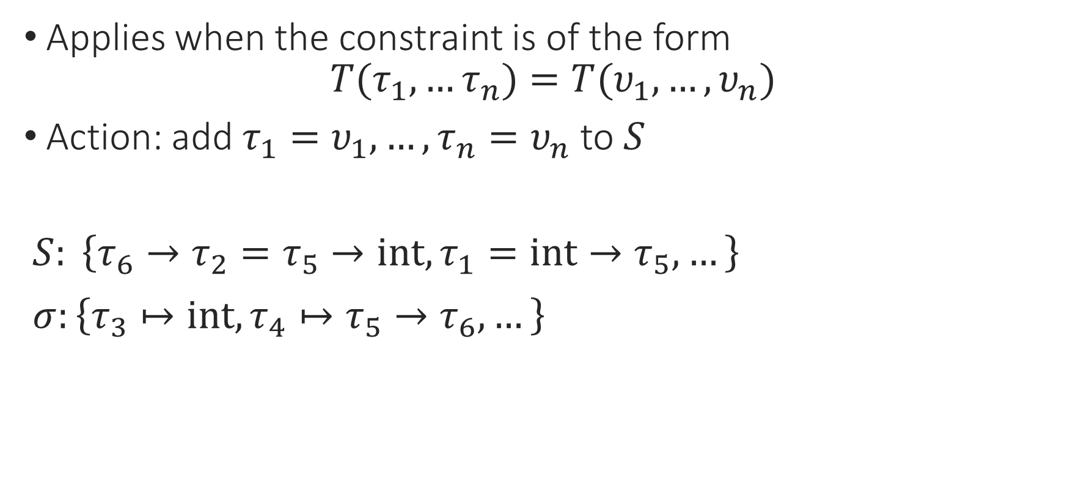
The Unification Algorithm: Decompose
Applies when the constraint is of the form
$$T(τ_{1},…τ_{n})=T(υ_{1},…,υ_{n})$$
Action: add $τ_{1}=υ_{1},…,τ_{n}=υ_{n}$ to $S$
$S: \left\{τ_{6}→τ_{2}=τ_{5}→int, τ_{1}=int→τ_{5},…\right\}$
$σ:\left\{τ_{3}↦int, τ_{4}↦τ_{5}→τ_{6},…\right\}$

Slide 16
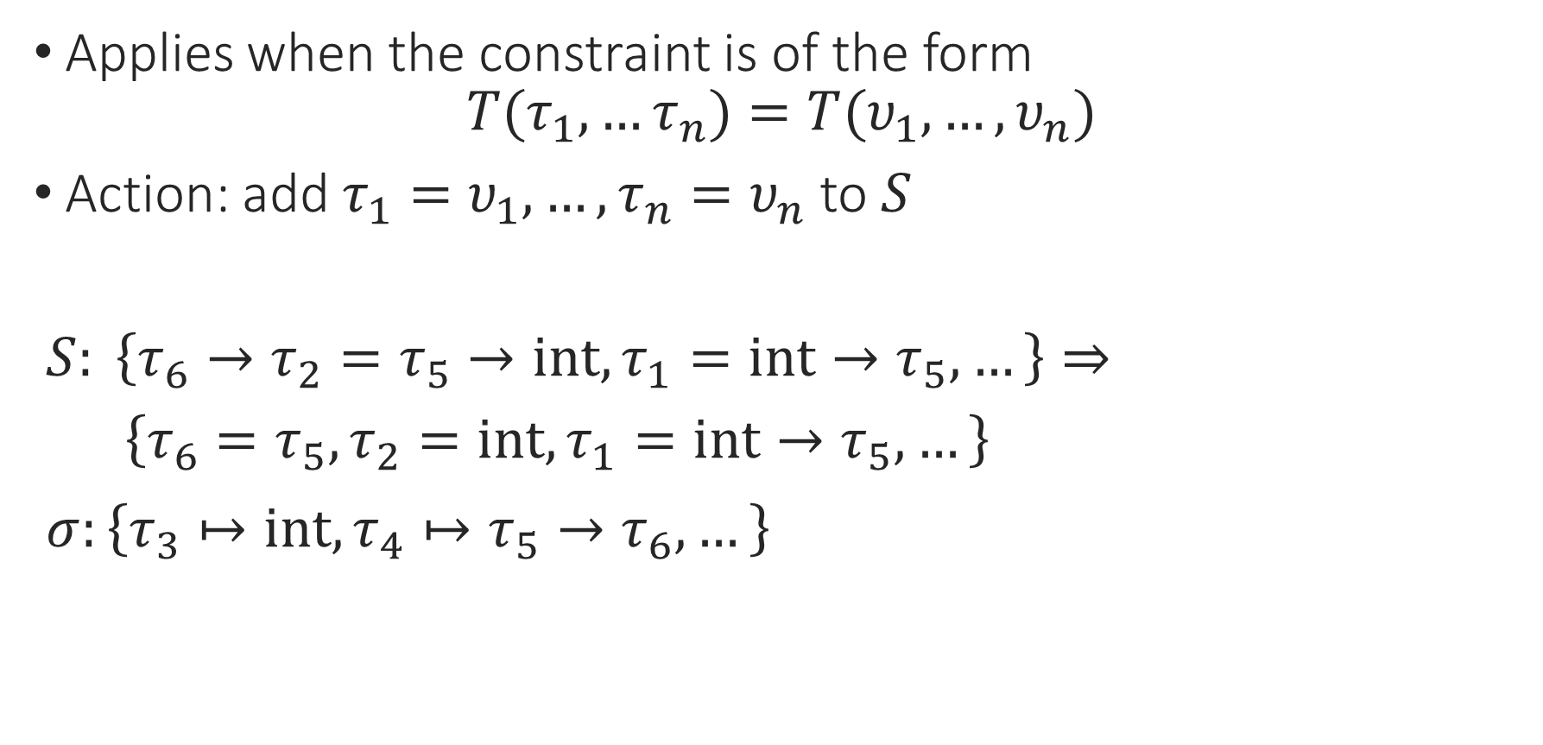
The Unification Algorithm: Decompose
Applies when the constraint is of the form
$$T(τ_{1},…τ_{n})=T(υ_{1},…,υ_{n})$$
Action: add $τ_{1}=υ_{1},…,τ_{n}=υ_{n}$ to $S$
$S: \left\{τ_{6}→τ_{2}=τ_{5}→int, τ_{1}=int→τ_{5},…\right\}⇒$
$\left\{τ_{6}=τ_{5},τ_{2}=int, τ_{1}=int→τ_{5},…\right\}$
$σ:\left\{τ_{3}↦int, τ_{4}↦τ_{5}→τ_{6},…\right\}$

Slide 17

The Unification Algorithm: Decompose
Applies when the constraint is of the form
$$T(τ_{1},…τ_{n})=T(υ_{1},…,υ_{n})$$
Action: add $τ_{1}=υ_{1},…,τ_{n}=υ_{n}$ to $S$
$S: \left\{τ_{6}→τ_{2}=τ_{5}∗int, τ_{1}=int→τ_{5},…\right\}$
$σ:\left\{τ_{3}↦int, τ_{4}↦τ_{5}→τ_{6},…\right\}$

Slide 18
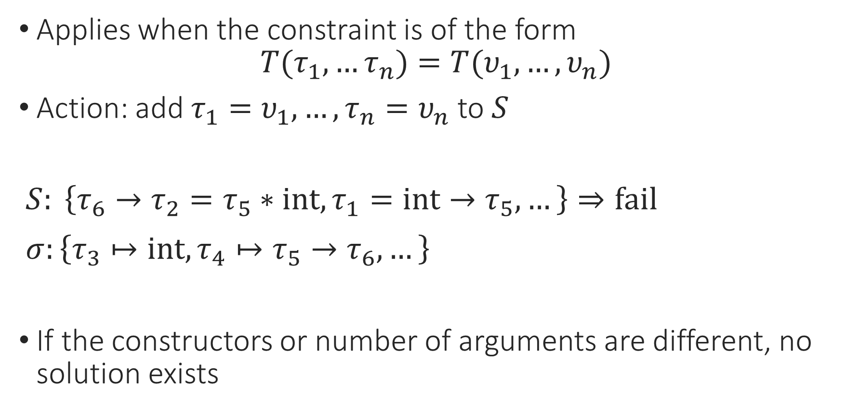
The Unification Algorithm: Decompose
Applies when the constraint is of the form
$$T(τ_{1},…τ_{n})=T(υ_{1},…,υ_{n})$$
Action: add $τ_{1}=υ_{1},…,τ_{n}=υ_{n}$ to $S$
$S: \left\{τ_{6}→τ_{2}=τ_{5}∗int, τ_{1}=int→τ_{5},…\right\}⇒fail$
$σ:\left\{τ_{3}↦int, τ_{4}↦τ_{5}→τ_{6},…\right\}$
If the constructors or number of arguments are different, no solution exists

Slide 19
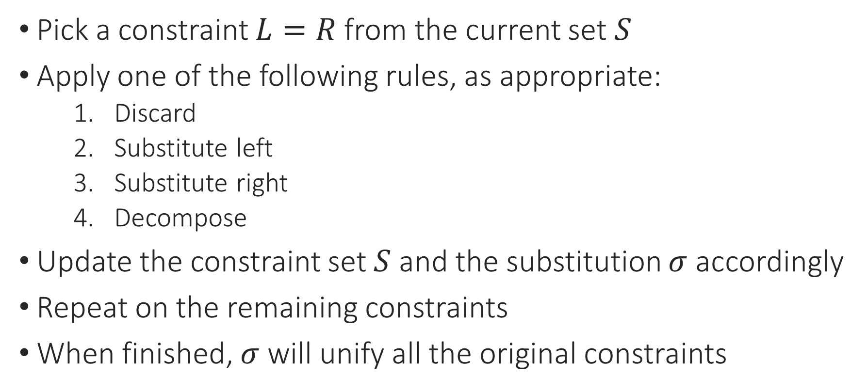
The Unification Algorithm
Pick a constraint $L=R$ from the current set $S$
Apply one of the following rules, as appropriate:
  Discard
  Substitute left
  Substitute right
  Decompose
Update the constraint set $S$ and the substitution $σ$ accordingly
Repeat on the remaining constraints
When finished, $σ$ will unify all the original constraints
Notes:
And this algorithm does actually terminate for all inputs.

Slide 20
Notes:
Poll Title: Do not modify the notes in this section to avoid tampering with the Poll Everywhere activity.
More info at polleverywhere.com/support
Questions
https://www.polleverywhere.com/discourses/SRzwhp4zztmGWgIgz520A

Slide 21
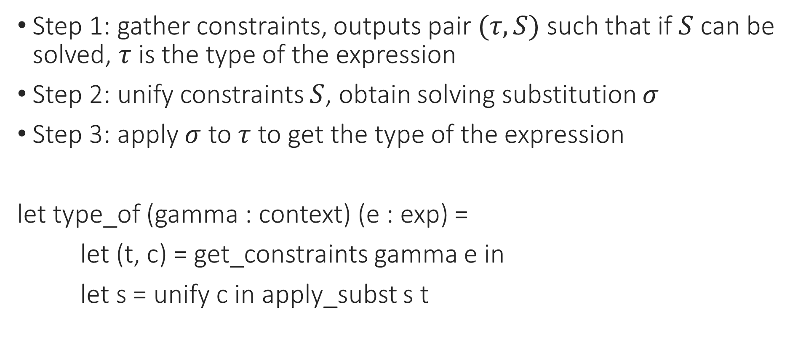
Constraint-Based Type Inference
Step 1: gather constraints, outputs pair $(τ,S)$ such that if $S$ can be solved, $τ$ is the type of the expression
Step 2: unify constraints $S$, obtain solving substitution $σ$
Step 3: apply $σ$ to $τ$ to get the type of the expression
let type_of (gamma : context) (e : exp) =
let (t, c) = get_constraints gamma e in
let s = unify c in apply_subst s t

Slide 22
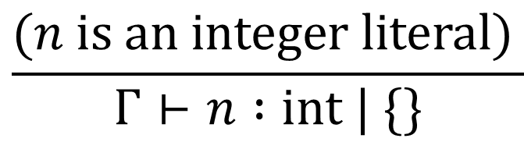
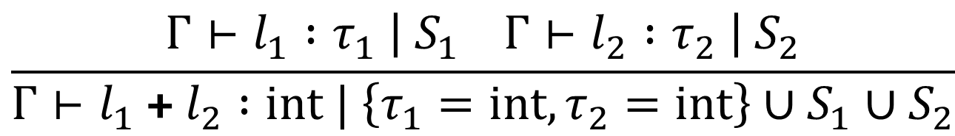
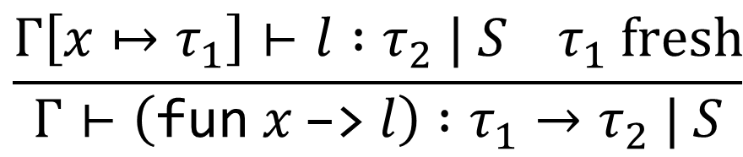
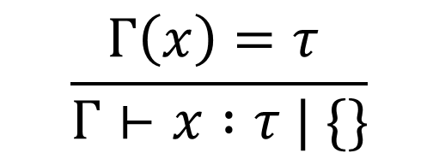
Constraint-Based Type Inference: Rules
$$\frac{(n is an integer literal) }{Γ⊢n :int | \{\}}$$
$$\frac{Γ\left(x\right)=τ }{Γ⊢x :τ | \{\}}$$
$$\frac{Γ⊢l_{1} :τ_{1} \left| S_{1} Γ⊢l_{2} :τ_{2} \right| S_{2}}{Γ⊢l_{1} \text{+} l_{2} :int | \left\{τ_{1}=int,τ_{2}=int\right\}∪S_{1}∪S_{2}}$$
$$\frac{Γ\left[x↦τ_{1}\right]⊢l :τ_{2} | S τ_{1} fresh}{Γ⊢\left(\text{fun} x \text{−>} l\right) :τ_{1}→τ_{2} | S}$$
Notes:
Why don’t we force l1 and l2 to typecheck as int? Because they might be “unknowns” that only get filled in when we see the plus.

Slide 23
The Unification Algorithm
Pick a constraint $L=R$ from the current set $S$
Apply one of the following rules, as appropriate:
  Discard
  Substitute left
  Substitute right
  Decompose
Update the constraint set $S$ and the substitution $σ$ accordingly
Repeat on the remaining constraints
When finished, $σ$ will unify all the original constraints
Notes:
And this algorithm does actually terminate for all inputs.

Slide 24
Constraint-Based Type Inference: Example
$$\{\}⊢\left(\text{fun} \text{f}\text{ −> }\text{fun} \text{x}\text{ −> }\text{f} \text{x} \text{+} \text{f}\text{ 3}\right) :τ_{1}→τ_{2}→int | S_{1}$$
$$S_{1}=\{τ_{3}=int,τ_{4}=int,τ_{1}=τ_{2}→τ_{3},τ_{1}=int→τ_{4}\}$$
Notes:
Next: unify C!

Slide 25

Constraint-Based Type Inference: Example
$$\{\}⊢\left(\text{fun} \text{f}\text{ −> }\text{fun} \text{x}\text{ −> }\text{f} \text{x} \text{+} \text{f}\text{ 3}\right) :τ_{1}→τ_{2}→int | S_{1}$$
$$S_{1}=\{τ_{4}=int,τ_{1}=τ_{2}→τ_{3},τ_{1}=int→τ_{4}\}$$
$$σ=\{τ_{3}↦int\}$$

Slide 26
Constraint-Based Type Inference: Example
$$\{\}⊢\left(\text{fun} \text{f}\text{ −> }\text{fun} \text{x}\text{ −> }\text{f} \text{x} \text{+} \text{f}\text{ 3}\right) :τ_{1}→τ_{2}→int | S_{1}$$
$$S_{1}=\{τ_{4}=int,τ_{1}=τ_{2}→int,τ_{1}=int→τ_{4}\}$$
$$σ=\{τ_{3}↦int\}$$

Slide 27

Constraint-Based Type Inference: Example
$$\{\}⊢\left(\text{fun} \text{f}\text{ −> }\text{fun} \text{x}\text{ −> }\text{f} \text{x} \text{+} \text{f}\text{ 3}\right) :τ_{1}→τ_{2}→int | S_{1}$$
$$S_{1}=\{τ_{1}=τ_{2}→int,τ_{1}=int→int\}$$
$$σ=\{τ_{3}↦int,τ_{4}↦int\}$$

Slide 28

Constraint-Based Type Inference: Example
$$\{\}⊢\left(\text{fun} \text{f}\text{ −> }\text{fun} \text{x}\text{ −> }\text{f} \text{x} \text{+} \text{f}\text{ 3}\right) :τ_{1}→τ_{2}→int | S_{1}$$
$$S_{1}=\{τ_{2}→int=int→int\}$$
$$σ=\{τ_{3}↦int,τ_{4}↦int,τ_{1}↦τ_{2}→int\}$$

Slide 29

Constraint-Based Type Inference: Example
$$\{\}⊢\left(\text{fun} \text{f}\text{ −> }\text{fun} \text{x}\text{ −> }\text{f} \text{x} \text{+} \text{f}\text{ 3}\right) :τ_{1}→τ_{2}→int | S_{1}$$
$$S_{1}=\{τ_{2}=int,int=int\}$$
$$σ=\{τ_{3}↦int,τ_{4}↦int,τ_{1}↦τ_{2}→int\}$$

Slide 30

Constraint-Based Type Inference: Example
$$\{\}⊢\left(\text{fun} \text{f}\text{ −> }\text{fun} \text{x}\text{ −> }\text{f} \text{x} \text{+} \text{f}\text{ 3}\right) :τ_{1}→τ_{2}→int | S_{1}$$
$$S_{1}=\{int=int\}$$
$$σ=\{τ_{3}↦int,τ_{4}↦int,τ_{1}↦int→int,τ_{2}↦int\}$$

Slide 31

Constraint-Based Type Inference: Example
$$\{\}⊢\left(\text{fun} \text{f}\text{ −> }\text{fun} \text{x}\text{ −> }\text{f} \text{x} \text{+} \text{f}\text{ 3}\right) :τ_{1}→τ_{2}→int | S_{1}$$
$$S_{1}=\{\}$$
$$σ=\{τ_{3}↦int,τ_{4}↦int,τ_{1}↦int→int,τ_{2}↦int\}$$
$$\left[σ\right]\left(τ_{1}→τ_{2}→int\right)=\left(int→int\right)→int→int$$
$$\{\}⊢\left(\text{fun} \text{f}\text{ −> }\text{fun} \text{x}\text{ −> }\text{f} \text{x}\text{ + }\text{f}\text{ 3}\right) :\left(int→int\right)→int→int$$
Notes:
Now we can apply sigma…
Let’s see if we can do this in code!

Slide 32
Notes:
Poll Title: Do not modify the notes in this section to avoid tampering with the Poll Everywhere activity.
More info at polleverywhere.com/support
Questions
https://www.polleverywhere.com/discourses/SRzwhp4zztmGWgIgz520A

