Slide 1
CS 554 – Advanced Topics in Concurrent Computing Systems
William Mansky

Slide 2
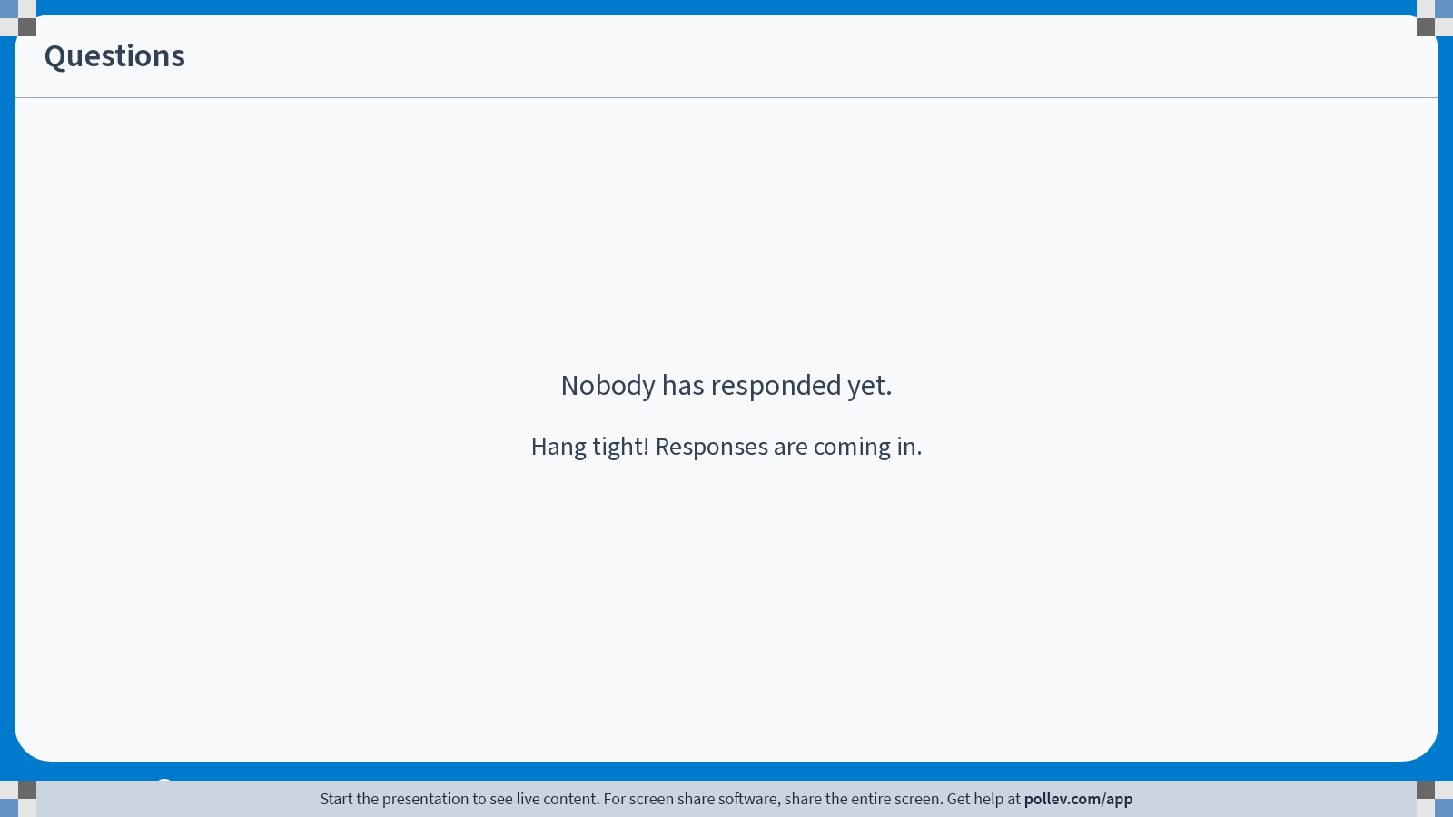
Notes:
Poll Title: Do not modify the notes in this section to avoid tampering with the Poll Everywhere activity.
More info at polleverywhere.com/support
Questions
https://www.polleverywhere.com/discourses/9lqXsklTQ5Mxj2gy9gGyX

Slide 3
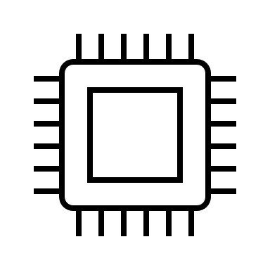

Concurrent programming with caches
int val = *x;
*x = 0 + 1;
int val = *y;
*y = 0 + 1;
x | y
1 | 0
x | y
0 | 0
x | y
0 | 0
Memory
Notes:
What’s actually happening here?
Memory can only do one thing at a time, and each CPU has to wait for its operation to finish before proceeding.

Slide 4
Hardware memory models
Easiest to start at the processor level
We’ll still sometimes write C-like pseudocode, but imagine it’s in your preferred assembly language
Every processor architecture comes with a specification explaining its memory model – on this chip, what can you expect?
Notes:
So we don’t have to worry about compilers, variable sizes, memory management, …
We’ll look at some of the possible answers.

Slide 5
Sequential Consistency
Sequential consistency (SC): programs execute as if every operation happens in a single total order
store(x, 1)
r1 = load(y)
store(y, 1)
r2 = load(x)

Slide 6
Sequential Consistency
Sequential consistency (SC): programs execute as if every operation happens in a single total order
1 store(x, 1)
3 r1 = load(y)
2 store(y, 1)
4 r2 = load(x)

Slide 7
Sequential Consistency
Sequential consistency (SC): programs execute as if every operation happens in a single total order
1 store(x, 1)
4 r1 = load(y)
2 store(y, 1)
3 r2 = load(x)

Slide 8
Sequential Consistency
Sequential consistency (SC): programs execute as if every operation happens in a single total order
This matches the one-memory, no-caches picture (but note the “as if”!)
1 store(x, 1)
2 r1 = load(y)
3 store(y, 1)
4 r2 = load(x)

Slide 9
Sequential Consistency
Exercise: What are the possible outcomes of this program?
1 store(x, 1)
2 r1 = load(y)
3 store(y, 1)
4 r2 = load(x)

Slide 10
Sequential Consistency and beyond
A weak or relaxed memory model is one that allows non-SC behavior
E.g., almost every model other than SC allows
r1 = 0, r2 = 0
1 store(x, 1)
2 r1 = load(y)
3 store(y, 1)
4 r2 = load(x)
Notes:
SC admits an argument style about the order in which things happen.
How can that happen? We saw it in the caching example.

Slide 11
Concurrent programming with caches
int val = *x;
*x = 0 + 1;
int val = *y;
*y = 0 + 1;
x | y
1 | 0
x | y
0 | 0
x | y
0 | 0
Memory
Notes:
What’s actually happening here?
Memory can only do one thing at a time, and each CPU has to wait for its operation to finish before proceeding.

Slide 12
Notes:
Poll Title: Do not modify the notes in this section to avoid tampering with the Poll Everywhere activity.
More info at polleverywhere.com/support
Questions
https://www.polleverywhere.com/discourses/9lqXsklTQ5Mxj2gy9gGyX

Slide 13
Weak MM #1: Total Store Order (TSO)
Sequential consistency (SC): programs execute as if every operation happens in a single total order
Total store order (TSO): stores are totally ordered, but loads can read anywhere in that order (subject to program order)
store(x, 1)
r1 = load(y)
store(y, 1)
r2 = load(x)

Slide 14
Weak MM #1: Total Store Order (TSO)
Total store order (TSO): stores are totally ordered, but loads can read anywhere in that order (subject to program order)
Or equivalently: writes are buffered, propagate to other threads eventually
store(x, 1)
r1 = load(y)
store(y, 1)
r2 = load(x)
Notes:
Can draw arrows, or break writes into two separate events, insertion and clear

Slide 15
Weak MM #1: Total Store Order (TSO)
Exercise: can we get r1 = r2 = 1? Why or why not?
r1 = load(y)
store(x, 1)
r2 = load(x)
store(y, 1)
Notes:
So what *can’t* happen?

Slide 16
Weak MM #1: Total Store Order (TSO)
// Thread 1 // Thread 2 // Thread 3 // Thread 4
x = 1 y = 1 r1 = x r3 = y
r2 = y r4 = x
Total store order (TSO): stores are totally ordered, but loads can read anywhere in that order (subject to program order)
Or equivalently: writes are buffered, propagate to other threads eventually
Notes:
So what *can’t* happen?

Slide 17
Weak MM #1: Total Store Order (TSO)
If we don’t want weak behavior, we can add fences
store(x, 1)
r1 = load(y)
store(y, 1)
r2 = load(x)

Slide 18
Notes:
Poll Title: Do not modify the notes in this section to avoid tampering with the Poll Everywhere activity.
More info at polleverywhere.com/support
Questions
https://www.polleverywhere.com/discourses/9lqXsklTQ5Mxj2gy9gGyX

Slide 19
Weak MM #2: Partial Store Order (PSO)
Total store order (TSO): stores are totally ordered, but loads can read anywhere in that order (subject to program order)
Partial store order (PSO): stores to each location are totally ordered (subject to program order)
store(x, 1)
r1 = load(y)
store(y, 1)
r2 = load(x)

Slide 20
Weak MM #2: Partial Store Order (PSO)
Partial store order (PSO): stores to each location are totally ordered (subject to program order)
Or equivalently: writes are buffered, with a separate buffer for each location
store(x, 1)
r1 = load(y)
store(y, 1)
r2 = load(x)

Slide 21
Weak MM #2: Partial Store Order (PSO)
Partial store order (PSO): stores to each location are totally ordered (subject to program order)
Or equivalently: writes are buffered, with a separate buffer for each location
r1 = load(y)
store(x, 1)
r2 = load(x)
store(y, 1)
Notes:
So what *can’t* happen?

Slide 22
Weak MM #2: Partial Store Order (PSO)
Partial store order (PSO): stores to each location are totally ordered (subject to program order)
Or equivalently: writes are buffered, with a separate buffer for each location
store(x, 1)
store(y, 1)
r1 = load(y)
r2 = load(x)
Notes:
So what *can’t* happen?

Slide 23
Litmus Tests
// Thread 1 // Thread 2 // Thread 3 // Thread 4
x = 1 y = 1 r1 = x r3 = y
r2 = y r4 = x
Write buffering, read buffering, independent reads of independent writes, …
A good practical characterization, but not very expressive – there are always more variations
Notes:
So what *can’t* happen?

Slide 24
Notes:
Poll Title: Do not modify the notes in this section to avoid tampering with the Poll Everywhere activity.
More info at polleverywhere.com/support
Questions
https://www.polleverywhere.com/discourses/9lqXsklTQ5Mxj2gy9gGyX

