Slide 1
CS 554 – Advanced Topics in Concurrent Computing Systems
William Mansky

Slide 2
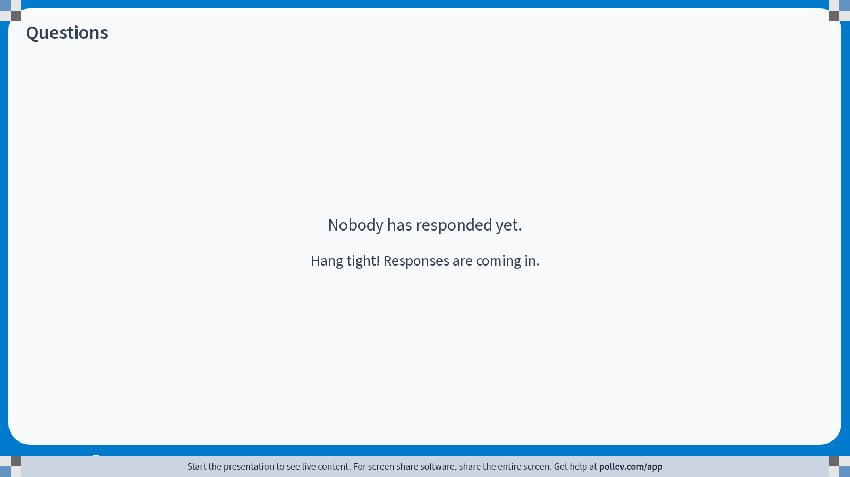
Notes:
Poll Title: Do not modify the notes in this section to avoid tampering with the Poll Everywhere activity. More info at polleverywhere.com/support Questions https://www.polleverywhere.com/discourses/9lqXsklTQ5Mxj2gy9gGyX

Slide 3
Welcome to the Course!
This is CS 554, Advanced Topics in Concurrent Computing Systems
I’m glad you’re here!
Meets MW 11:00 AM – 12:15 PM in CDLRC 2407
My office hours: Tuesday 10 AM, Thursday 2 PM, and by appointment, in CDLRC 4450 and on Zoom via Blackboard
Office hours are great for homework help, or just to say hi!

Slide 4
Course Information
Professor: William Mansky (he/him) (mansky1@uic.edu)
Website: https://www.cs.uic.edu/~mansky/teaching/cs472/sp25/
Anonymous in-class questions: https://pollev.com/wmansky771
In-person lectures, in-class exercises
Discussion board on Piazza, assignments via Gradescope (entry code J6GYJV)
Notes:
My research area is program verification, so in this class you’ll be learning the tools and techniques I use every day.

Slide 5
Asking questions
In class: raise your hand anytime
You can ask questions anonymously with PollEverywhere (https://pollev.com/wmansky771)
On Piazza
Can ask/answer anonymously
Can post privately to instructors
Can answer other students’ questions
In office hours
If you have a question, someone else probably has the same question!
Notes:
This class is going to be significantly different from any other CS class you’ve taken, so please, stop me and ask questions!

Slide 6
Notes:
Poll Title: Do not modify the notes in this section to avoid tampering with the Poll Everywhere activity. More info at polleverywhere.com/support Questions https://www.polleverywhere.com/discourses/9lqXsklTQ5Mxj2gy9gGyX

Slide 7
Concurrent programming
int add1(void* arg){
int* p = (int*) arg;
int val = *p;
*p = val + 1;
}
int main(){
int* x = malloc(sizeof(int)); *x = 0;
int* y = malloc(sizeof(int)); *y = 0;
thrd_t *t;
thrd_create(t, add1, x);
add1(y);
}
Notes:
We have multiple threads of execution in the program.

Slide 8
Concurrent programming
int val = *x;
*x = val + 1;
int val = *y;
*y = val + 1;
x | y
0 | 0
Memory
Notes:
We have multiple threads of execution in the program.

Slide 9
Concurrent programming
int val = *x;
*x = 0 + 1;
int val = *y;
*y = val + 1;
x | y
0 | 0
Memory
Notes:
We have multiple threads of execution in the program.

Slide 10
Concurrent programming
int val = *x;
*x = 0 + 1;
int val = *y;
*y = 0 + 1;
x | y
0 | 0
Memory
Notes:
We have multiple threads of execution in the program.

Slide 11
Concurrent programming
int val = *x;
*x = 0 + 1;
int val = *y;
*y = 0 + 1;
x | y
1 | 0
Memory
Notes:
We have multiple threads of execution in the program.

Slide 12
Concurrent programming
int val = *x;
*x = 0 + 1;
int val = *y;
*y = 0 + 1;
x | y
1 | 1
Memory
Notes:
Or maybe it happens in a different order.

Slide 13
Notes:
Poll Title: Do not modify the notes in this section to avoid tampering with the Poll Everywhere activity. More info at polleverywhere.com/support Questions https://www.polleverywhere.com/discourses/9lqXsklTQ5Mxj2gy9gGyX

Slide 14


Concurrent consistency
int val = *x;
*x = 0 + 1;
int val = *y;
*y = 0 + 1;
x | y
0 | 0
Memory
Notes:
What’s actually happening here? Memory can only do one thing at a time, and each CPU has to wait for its operation to finish before proceeding.

Slide 15
Concurrent consistency
int val = *x;
*x = 0 + 1;
int val = *y;
*y = 0 + 1;
x | y
0 | 0
x | y
0 | 0
x | y
0 | 0
Memory
Notes:
What’s actually happening here? Memory can only do one thing at a time, and each CPU has to wait for its operation to finish before proceeding.

Slide 16
Concurrent consistency
int val = *x;
*x = 0 + 1;
int val = *y;
*y = 0 + 1;
x | y
1 | 0
x | y
0 | 0
x | y
0 | 0
Memory
Notes:
What’s actually happening here? Memory can only do one thing at a time, and each CPU has to wait for its operation to finish before proceeding.

Slide 17
Concurrent consistency
int val = *x;
*x = 0 + 1;
int val = *y;
*y = 0 + 1;
x | y
1 | 0
x | y
0 | 0
x | y
1 | 0
Memory
Notes:
What’s actually happening here? Memory can only do one thing at a time, and each CPU has to wait for its operation to finish before proceeding.

Slide 18
Concurrent consistency
int val = *x;
*x = 0 + 1;
int val = *y;
*y = 0 + 1;
x | y
1 | 0
x | y
1 | 0
x | y
1 | 0
Memory
Notes:
What’s actually happening here? Memory can only do one thing at a time, and each CPU has to wait for its operation to finish before proceeding.

Slide 19
Concurrent consistency
int val = *x;
*x = 0 + 1;
int val = *y;
int val2 = *x;
x | y
1 | 0
x | y
0 | 0
x | y
1 | 0
Memory
Notes:
What’s actually happening here? Memory can only do one thing at a time, and each CPU has to wait for its operation to finish before proceeding.

Slide 20
Cores don’t take turns
Caches, etc. mean that writes aren’t immediately visible to other threads
Different threads have different ideas of what the current value is at a single location
So, what do we know about the state of memory at any point? And what can threads know about each other’s state?
The answers come from memory consistency models
Notes:
This raises all sorts of weird questions. Do threads have to agree on the order writes happened in? How about writes to the same location? Is it possible to read a value while it’s being updated?

Slide 21
Memory models
What can we assume about concurrent memory operations?
Will writes happen in order? Will reads happen in order? Will writes to the same location happen in order?
What can the programmer do to request stronger guarantees when needed?
How do we use just enough synchronization to make a program work?
Are some interactions just too dangerous to use at all (data races)?
This question gets answered twice: at the hardware level, and at the language level
This course: understand the different kinds of answers and what we can do with them
Goal: how do you know you’ve written a correct concurrent program?
Notes:
This raises all sorts of weird questions. Do threads have to agree on the order writes happened in? How about writes to the same location? Is it possible to read a value while it’s being updated?

Slide 22
Notes:
Poll Title: Do not modify the notes in this section to avoid tampering with the Poll Everywhere activity. More info at polleverywhere.com/support Questions https://www.polleverywhere.com/discourses/9lqXsklTQ5Mxj2gy9gGyX

Slide 23
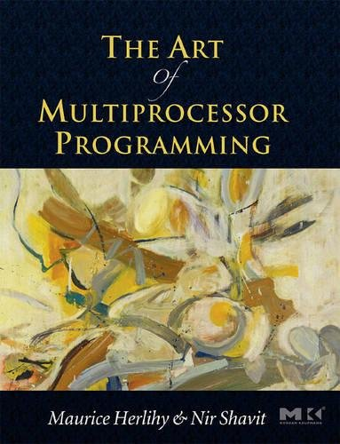
Calibration
Have you:
Written a program in the C language?
Written a concurrent/multithreaded program? (using fork, pthread, GPU programming, …)
Taken CS 454 (Principles of Concurrent Programming) or a similar class?
Taken a class where you wrote mathematical proofs?
Learned about programming language semantics (e.g., small-step and big-step operational semantics)?
Mathematically proved the correctness of a program, either on paper or with tools (model checking, static analysis, theorem proving)?
Submit on Gradescope (entry code J6GYJV), Exercise 8/25
Notes:
This course doesn’t have any prerequisites.

Slide 24
Class Goals and Structure
What are memory models? How are they expressed? What do they let us do?
3 modes: math, code, tools
Most classes will have in-class exercises
Exercises are practice for the homework; homework is practice for the final project

Slide 25
Grading
In-class exercises: 25%
Assignments: 50%
Project: 25%

Slide 26
Exercises
In each class, we’ll work through some example problems/proofs
Submit via Gradescope
Due at the start of the next class
You get credit as long as you make some progress on the problem
Feel free to discuss with your neighbors, ask questions, suggest other approaches, etc.!
Notes:
This is the first time the class has been this big, so we’ll probably make adjustments as we go – please let me know if you think of anything that would help you!

Slide 27
Assignments
Programming/proving assignments
Submit via Gradescope
Due at 11:59 PM on the due date
You can discuss strategy with other students, but don’t look at each other’s solutions/code!
Cite your sources (websites, other students, StackOverflow, ChatGPT, etc.)
You’ll get most of the credit for attempting a problem, even if you don’t finish it – do what you can, and we’ll work through tricky ones in class after the deadline

Slide 28
Notes:
Poll Title: Do not modify the notes in this section to avoid tampering with the Poll Everywhere activity. More info at polleverywhere.com/support Questions https://www.polleverywhere.com/discourses/9lqXsklTQ5Mxj2gy9gGyX

